Slide 1
DISCOURSE-Opening Remarks
Vijay A. Mittal
Northwestern University
Department of Psychology

Slide 2
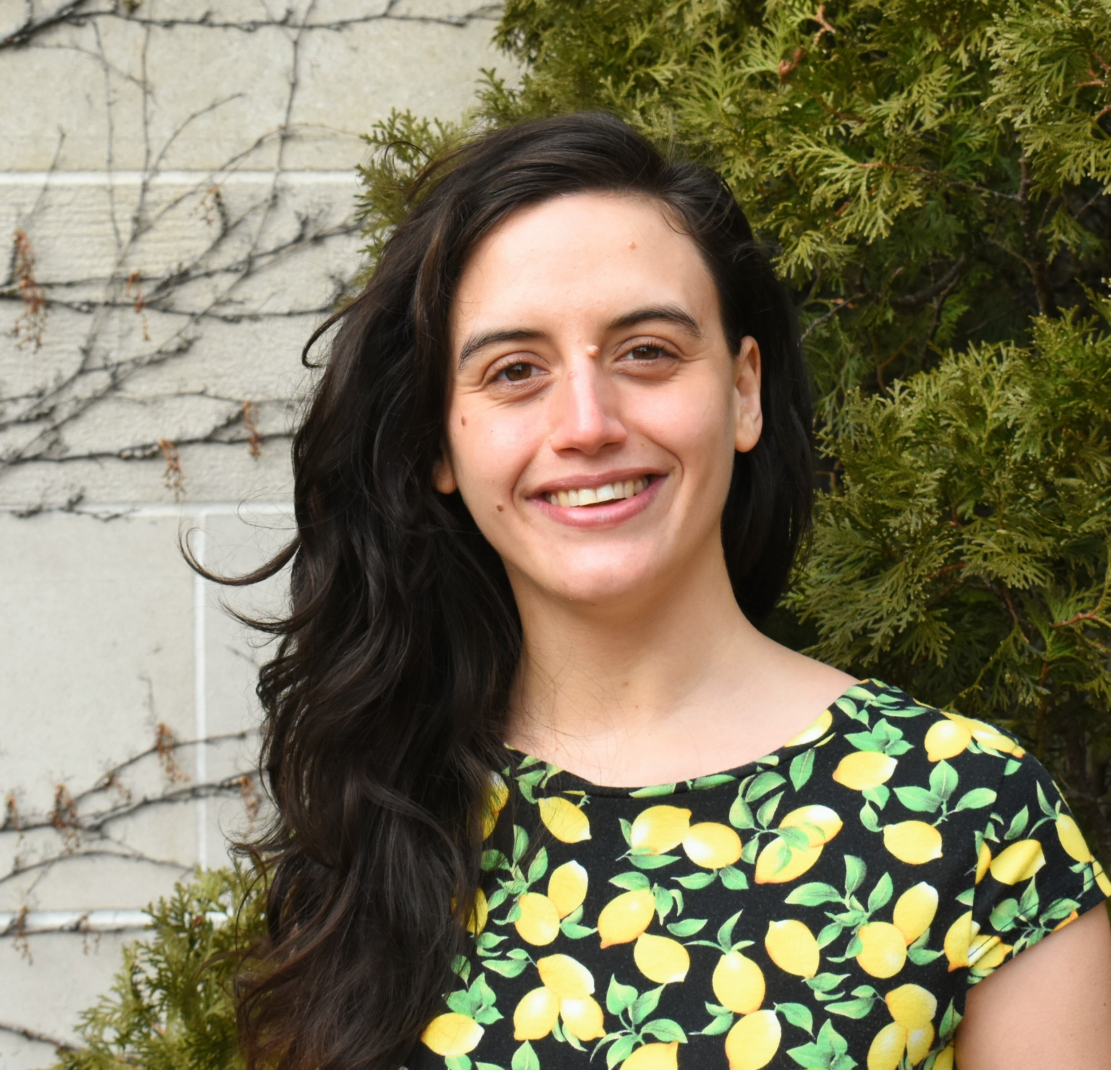
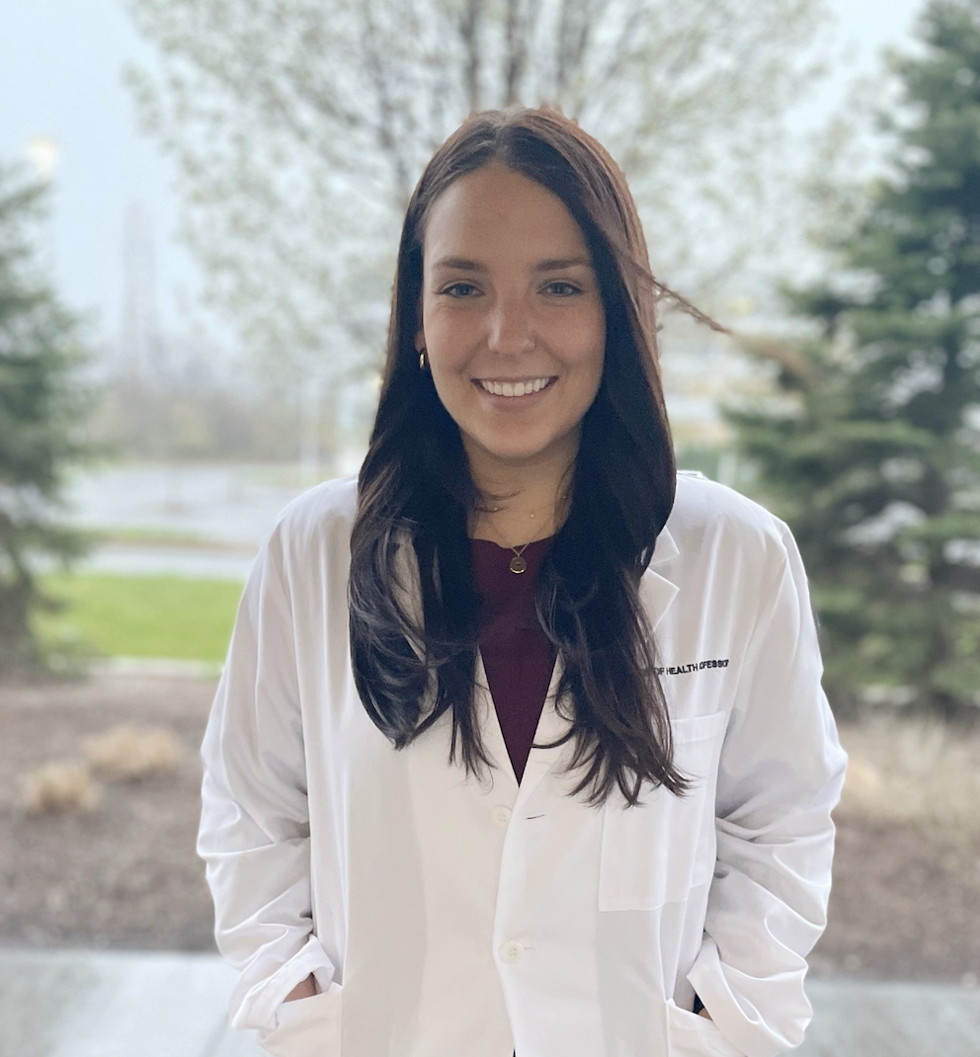
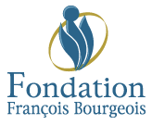
Thanks to Local Coordinators and Partners
Thanks to Betsy Schaefer and the entire planning team.
Our Program committee
Sunny Tang
Natàlia Mota
Rui He
Paulina Dzialoszynski
Lena Palaniyappan
Psychology
Communication Sciences and Disorders

Slide 3
Thought, Language, and Communication Disturbances in Serious Mental Illness and 2025
Alleviating language dysfunction will improve the lives of people and families with severe mental illnesses.
Leveraging speech to reduce the suffering due to mental illnesses
We will ask the crucial questions that remain unanswered and overcome challenges in answering them with our collective effort
Collaboration > competition
Effortful building of shared trust
Learning mutual strengths and opportunities
No shortcuts to successful
collaboration transparent and inclusive actions are critical
Not just data or methods sharing
but also nurturing ideas and actions - i.e., letting others lead, co-lead and contribute
A model for the entire field and beyond!

Slide 4
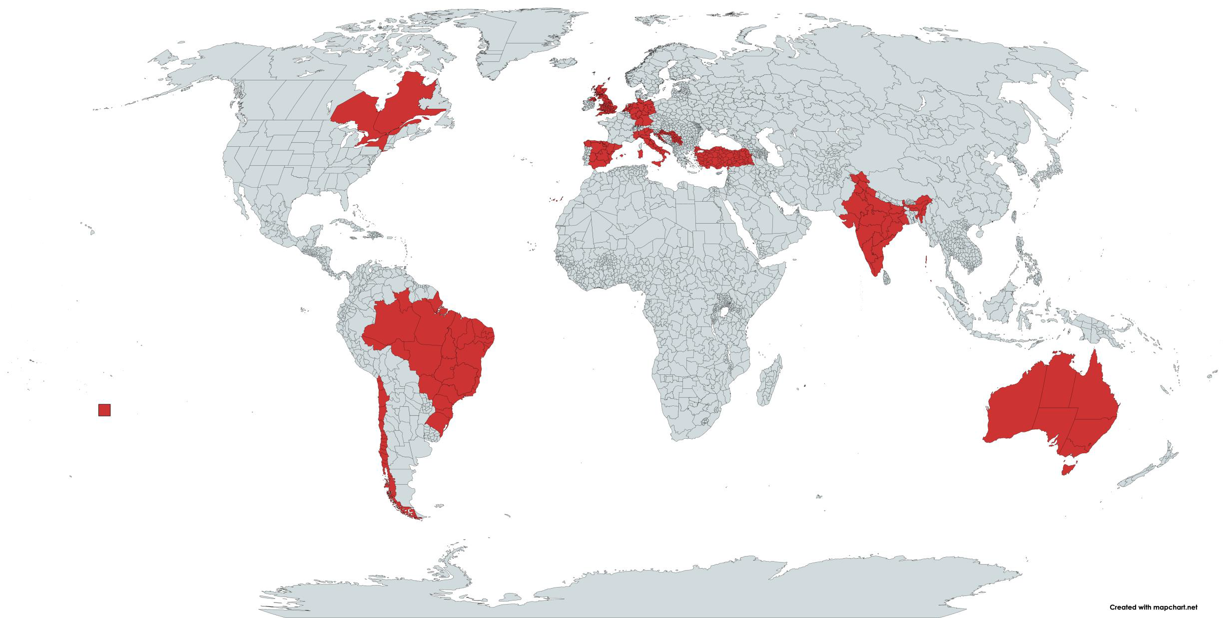
DISCOURSE
Dedication – visiting US
International Cooperation
We meet these challenges with enthusiasm and commitment:
84 in-person attendees and 35 virtual
20 Posters
Directly leveraging the existence of our network and/or contributing data to the network
Funding success for consortium members*
$24,864,001.78 Million USD since 2021
Over 320 DISCOURSE members across 6 continents consisting of researchers with projects spanning linguistics, speech and language therapy, and artificial intelligence applied to diverse fields of study, including linguistics, neuroscience, psychiatry, genetics, pharmacology, and behavioural science

Slide 5
DIALOG Project
Wellcome Trust has awarded $8.7 million (CAD) to a project proposed by DISCOURSE collaborators - "DIALOG: Understanding Disorganisation: A Language-Focused Global Initiative In Psychosis."
This initiative, led by Lena Palaniyappan and a team of international co-investigators, aims to explore how the neurobiological underpinnings of disorganisation affect speech production and comprehension.
DIALOG will combine neuroimaging and naturalistic language to investigate the role of imprecise predictive processing in disorganisation. The project will utilize Large Language Models (LLM) applied to speech recordings and large-scale participant data from MRI, PET, and MEG tools. By examining the brain's architecture at synaptic, neuronal, and oscillatory levels, DIALOG seeks to provide a comprehensive neurocomputational framework to understand disorganisation and its impact on social dysfunction in psychosis.
Congratulations to the team, including Iris E. Sommer (Netherlands), Susan L. Rossell (Australia), Tilo Kircher (Germany), Gina R. Kuperberg (USA), Valentina Bambini (Italy), Neil A. Harrison (UK), and Krish D. Singh (UK).

Slide 6
DISCOURSE Databanking
International collaborative efforts have focused on compiling large datasets to answer key research questions examining the multimodal nature of speech elicitation, studying the mechanisms underlying thought/language/communication disturbances, and their impacts on functioning.
We approach this from many perspectives, including a harmonized data collection effort which is currently ongoing in 14 languages, at 20 sites around the world, including the US, Canada, UK, Italy, Spain, and Australia.
Our group has been collecting short, everyday social conversations from patients. This means we're using verbatim speech data (audio and transcripts) from consenting patients receiving clinical care – so wide and representative sampling has become possible.
We're creating a large speech-bank that is diverse with multiple languages, robust privacy, and open to researchers around the globe. We also have working groups dedicated to the data banking process, advancing standards and harmonization efforts for the field, advancing computational methods, investigating clinical interventions, and understanding the mechanisms behind these disturbances in psychosis.

Slide 7
Today!
Common Themes:
Transdiagnostics across SMI and neurodevelopmental disorders and clinical stages
Meaningful Translational Application (treatment outcomes, lived experience, practical implementation, industry partnerships)
A multipronged approach benefiting from expertise across working groups
Rigor in collection, harmonization, and collection
A focus on mechanism
Blistering methodological innovation
3 local speakers (Molly Losh, Matt Goldrick, Luz Maria Alliende)
3 panelists with lived experience (Vegas Hodgins, Irnes Zeljkovic, Chantal Murthy)
2 speakers talking about 2 specific projects Frederike Stein and Rui He
Discourse work groups (Discussant: Lena Palaniyappan):
Sunny Tang (Clinical Harmonization)
Alban Voppel (Computational Methods)
Julianna Olah (Collaborations and Stakeholders)
Maria Alonso Sanchez and Gina Kuperberg (Mechanisms, Models, and Theory of Language)
Susan Rossell & Marta Bosia (Clinical Translation)
3 speakers talking about recent finding related to speech related topics (GPT-3) Gina Kuperberg, Tiana Wei (Magnetoencephalography), Michael Spilka (Computational speech markers).
Opportunities for informal discussion including a poster session, lunch, breaks, and dinners.

