Slide 1
MEG in Psychosis: individual differences in neuronal oscillations underlying language disorganization and impoverishment
Hsi (Tiana) Wei, MA, PhD

Slide 2
Motivation
Patients with schizophrenia struggle with daily communication (i.e., language disorganization and impoverishment)
Patients experience aberrant multisensory integration
Given the multisensory nature of language processing, there may be a shared neural mechanism behind these two domains of phenomena
Deviant neural activity has been observed during multisensory processing, especially in inferior frontal gyrus (Broca’s; language processing)
Magnetoencephalography (MEG) measures the magnetic field of electrical current of neurons in the brain at millisecond timescale with higher spatial resolution than EEG.
Gröhn C, Norgren E, Eriksson L. A systematic review of the neural correlates of multisensory integration in schizophrenia. Schizophr Res Cogn. 2021 Oct 5;27:100219. doi: 10.1016/j.scog.2021.100219.

Slide 3
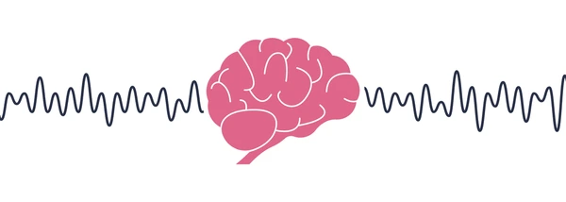
Motivation
Beta oscillations (~15-30 Hz)
Ideal for maintaining and preserving the activity of neuronal assemblies over time and mediate long-range communications
Important for motor and speech functions
Deviation in neuropsychological pathologies, reflecting neurochemical aberrations
Dopamine depletion in Parkinson’s -> enhanced beta -> motor rigidity;
Dopamine excess in Schizophrenia -> reduced beta -> positive symptoms (e.g., hallucination)
Hypothesis:
Beta oscillations underly multisensory processing and associates with language disorganization and impoverishment in schizophrenia
Briley et al., 2021, Palaniyappan, 2022

Slide 4
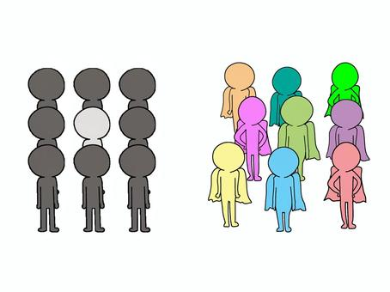
Research questions
Q1: HC vs. PT: Are multisensory integration, speech, and beta oscillations altered in patients?
Q2: Across individuals, are multisensory processing and natural speech associated with beta power?
Q1
Q2

Slide 5
Method
Participants and experimental flow

Slide 6
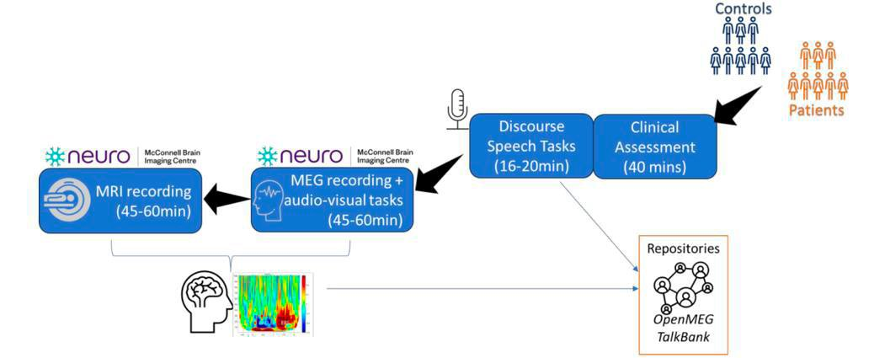
Data collection
SECTION 1: FREE CONVERSATIONAL SPEECH (Min 3 min)
SECTION 2. PERSONAL NARRATIVE (Min. 2 min)
SECTION 3: HEALTH NARRATIVE (Min. 3 min)
SECTION 4. PICTURE DESCRIPTIONS (Min. 3 min)
SECTION 5: STORY BOARD (Min 2 mins)
SECTION 6. DREAM REPORTS (Min 1 min)
SECTION 7: READING AND RECALL TASK (Min 3 mins)
 | HC (N=16 / 25) | PT (N=13 / 25)
Age | 31.81 ± 9.59 | 34.46 ± 9.38
Gender | 6 F; 10 M | 3 F; 10 M
Education | 18.44 ± 4.19 | 12.69 ± 3.20
Multisensory integration

Slide 7
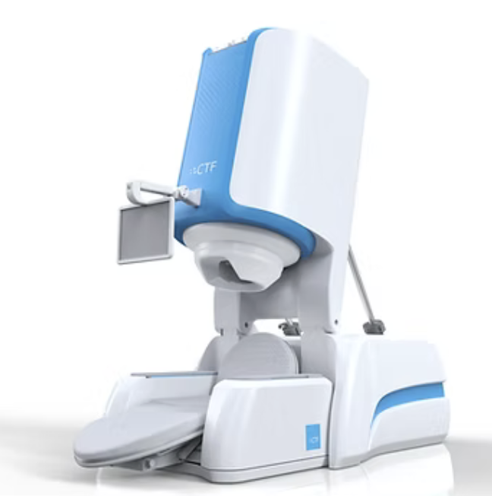
Audio-visual simultaneity judgement
+
Stimulus onset asynchrony (SOA)
-350 ~ +350 ms
+
Judge whether the visual square and the audio tone are presented at the same time or not by pressing a button with the left or right hand (hand assignment counterbalanced across blocks)
50 ms
50 ms
S+A
A+S

Slide 8
Preliminary Results
Multisensory behavioral judgement
Event-related beta power
Natural speech

Slide 9
Multisensory behavioral judgement
+
S+A
Curve fitted to HC (TR = 32 ms)
Curve fitted to SCZ (TR = 12 ms)
Visual first in preceding trial
Audio first in preceding trial
Point of Subjective Simultaneity (PSS)
Percentage simultaneous judgement (%)
Percentage simultaneous judgement (%)
Temporal Recalibration (TR)
→ Tendency to temporally recalibrate sensations to perceive stimuli as simultaneous
SOA (ms)
SOA (ms)
Auditory first
Visual first
Auditory first
Visual first
Patients’ PSS is closer to objective truth (0 on x-axis)
Patients have a weaker TR (less tendency to judge as simultaneous)

Slide 10
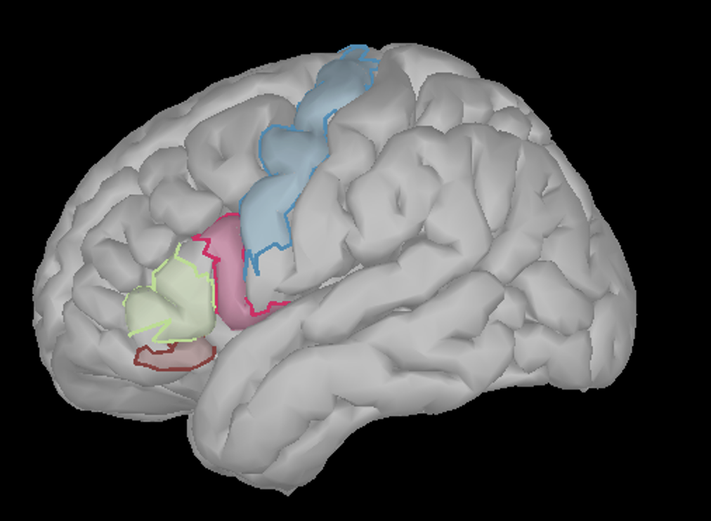
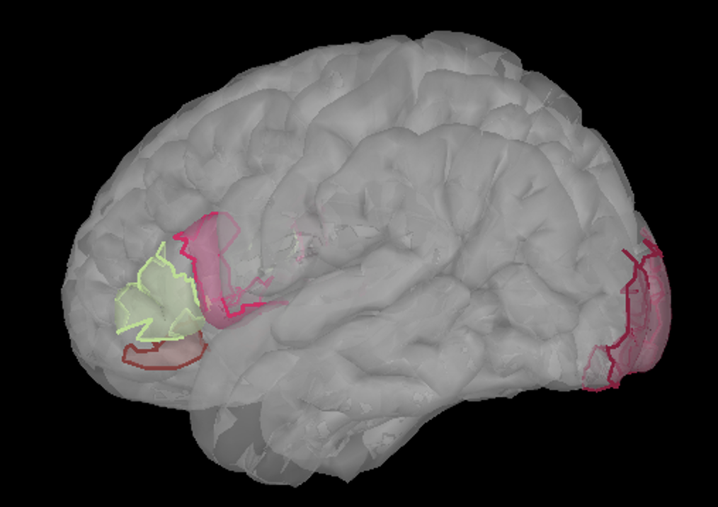
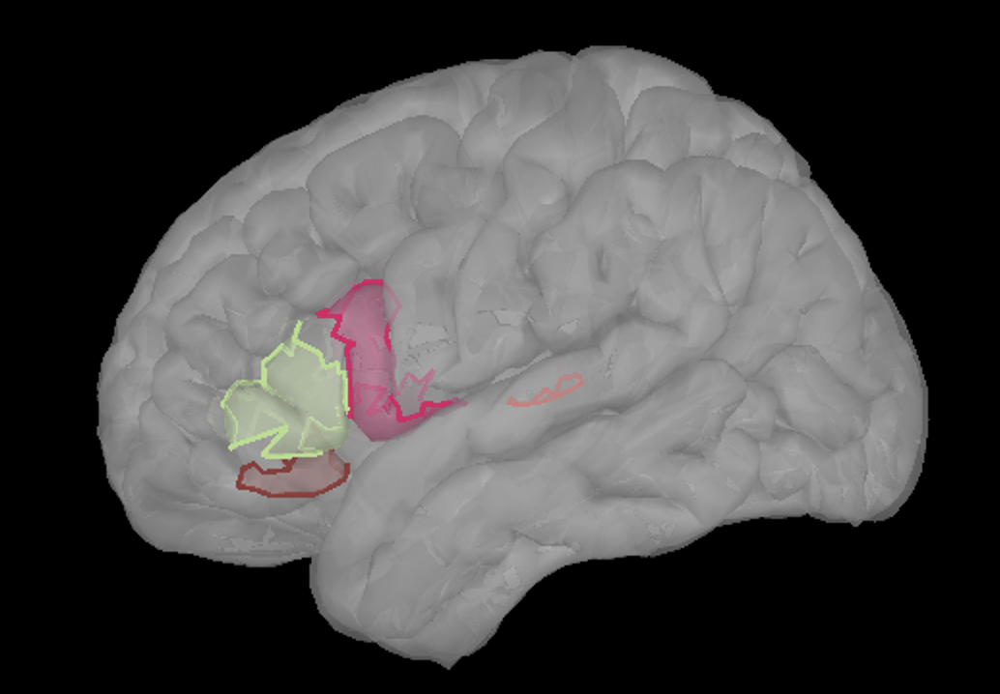
Event-related beta power
Happy to chat about analysis pipeline!
+
S+A
Primary motor cortices (M1s) & Inferior Frontal Gyri (IFGs)
Primary visual cortices (V1s) & Inferior Frontal Gyri (IFGs)
Primary auditory cortices (A1s) & Inferior Frontal Gyri (IFGs)
Destrieux cortical atlas (Destrieux et al. 2011)

Slide 11
Movement-related beta power
+
S+A
Primary motor cortices (M1s) & Inferior Frontal Gyri (IFGs)
Primary visual cortices (V1s) & Inferior Frontal Gyri (IFGs)
Primary auditory cortices (A1s) & Inferior Frontal Gyri (IFGs)

Slide 12
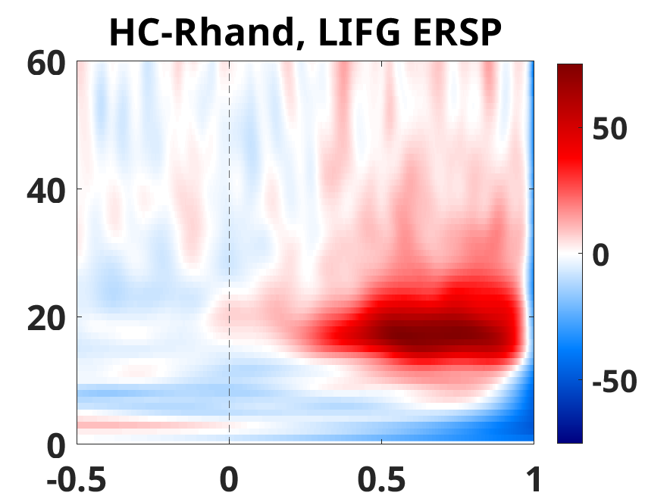
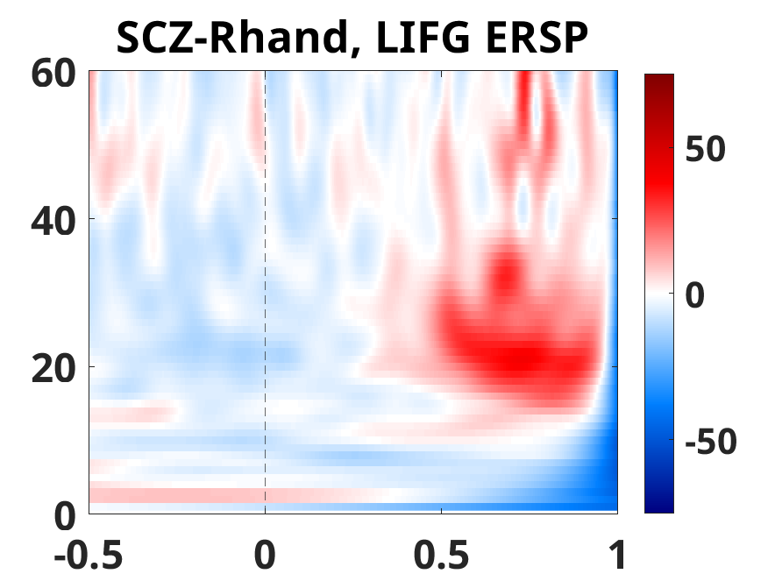
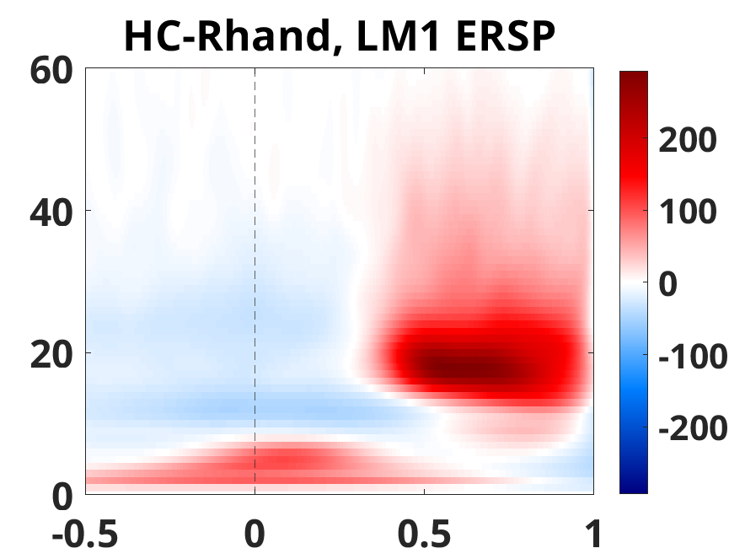
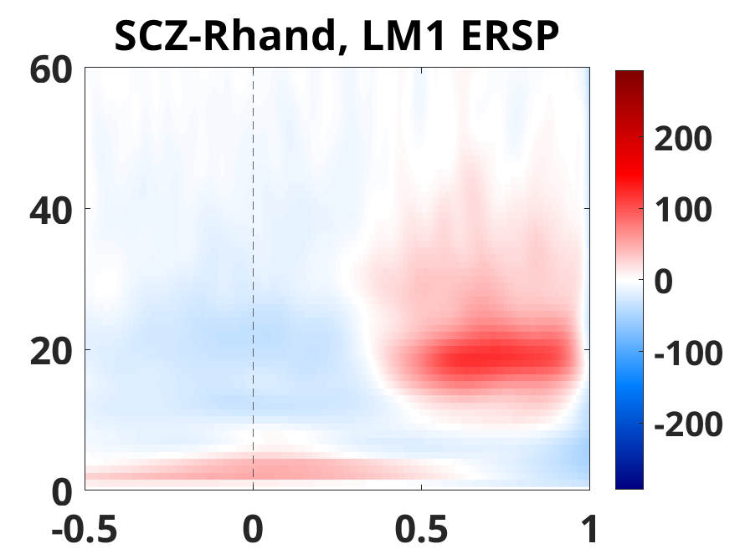
Movement-related beta power
S+A
p<0.001***
p<0.01**
Frequency (Hz)
Frequency (Hz)
Time (s)
Time (s)
Patients showed weaker beta modulations that are typical for a movement (pre-movement decrease / post-movement increase)

Slide 13
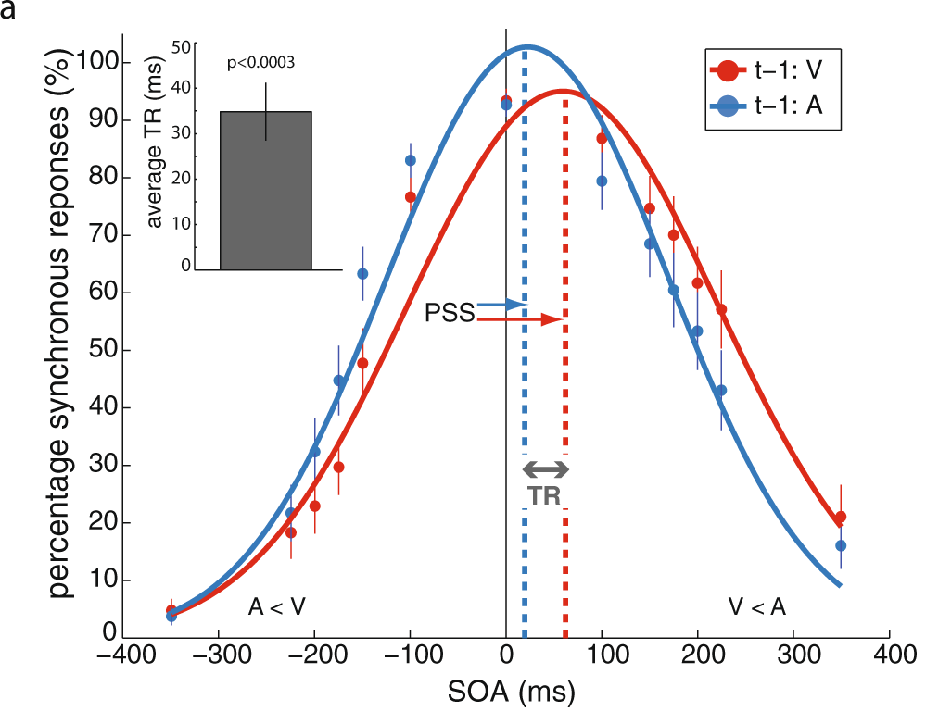
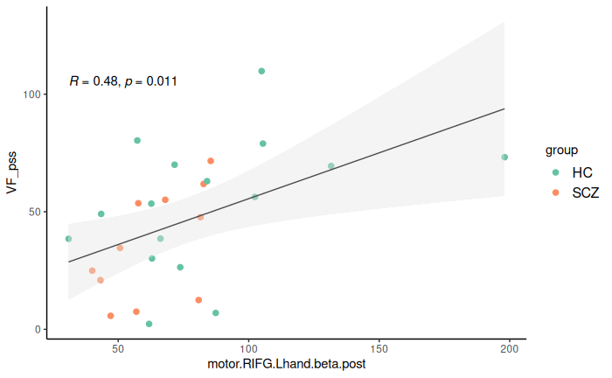
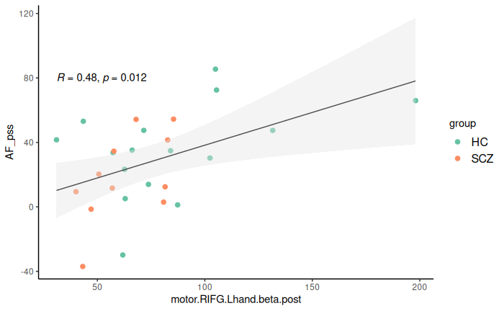
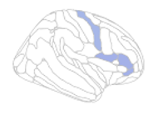
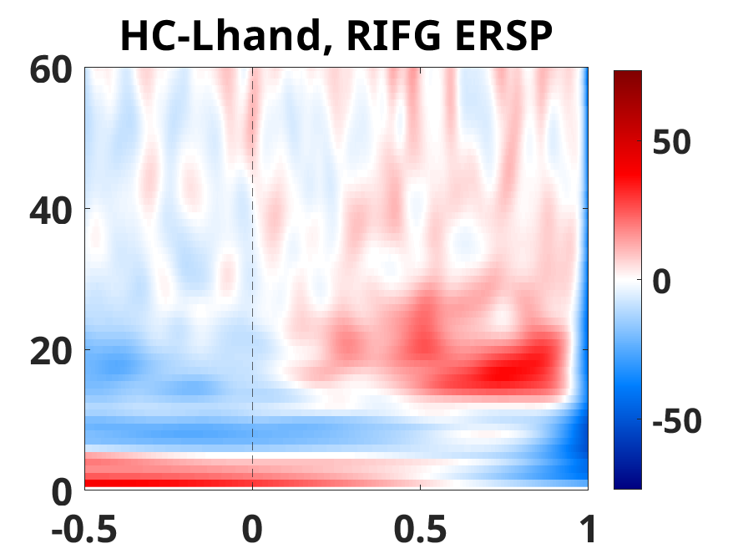
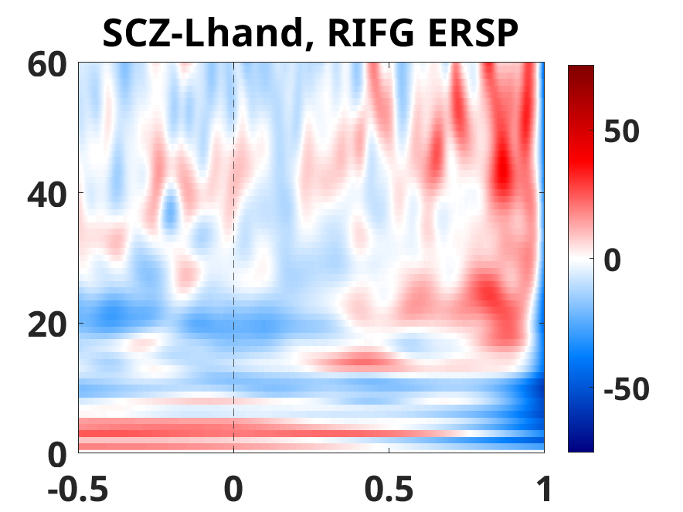
Beta power with multisensory judgment
Point of subjective simultaneity (PSS)
Point of subjective simultaneity (PSS)
Lennert, T., Samiee, S. & Baillet, S. Coupled oscillations enable rapid temporal recalibration to audiovisual asynchrony. Commun Biol 4, 559 (2021). https://doi.org/10.1038/s42003-021-02087-0
Post-movement beta power in Right IFG
Post-movement beta power in Right IFG
Stronger post-movement beta increase in the right IFG relates to higher PSS (tendency to judge stimuli as simultaneous when not)

Slide 14
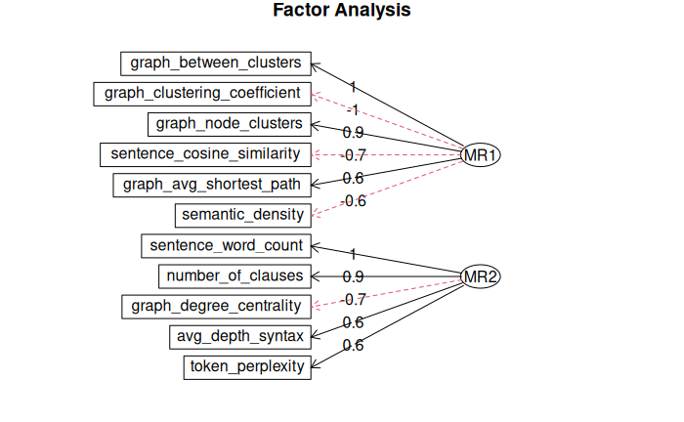
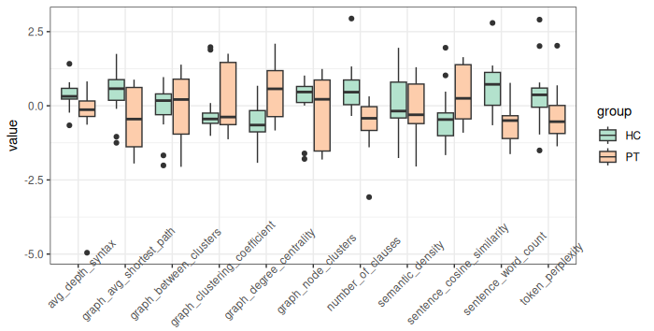
Natural speech
Transcribe audio recording with speaker diarization using Whisperx and pyannote
*
*
***
***
*
***
*
Content diversity
42%
p < 0.001 ***
33%
Verbosity & syntax complexity
Patients have less diverse topics, lower verbosity, and simpler sentence structure
e.g., Hitczenko et al. (2021)

Slide 15
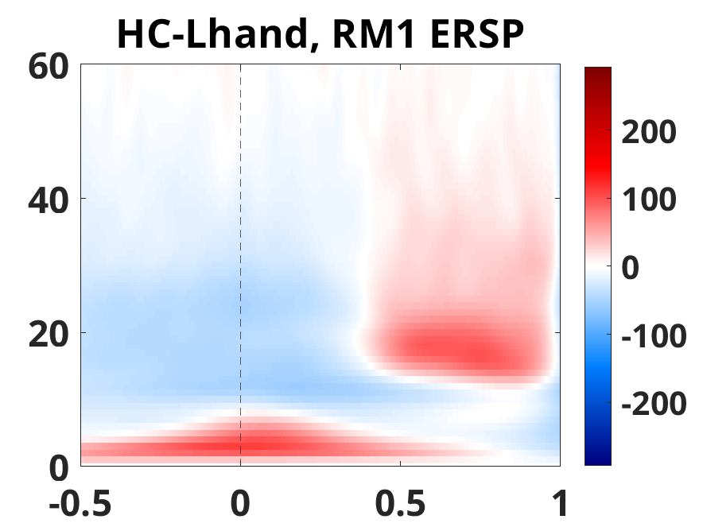
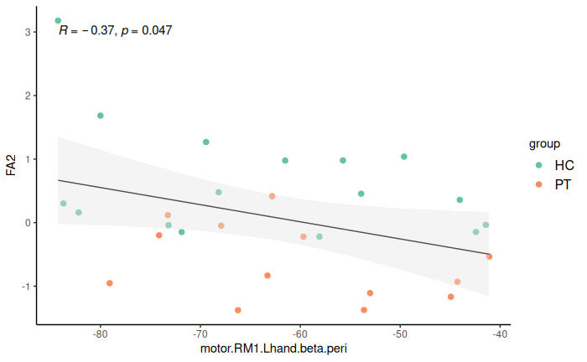
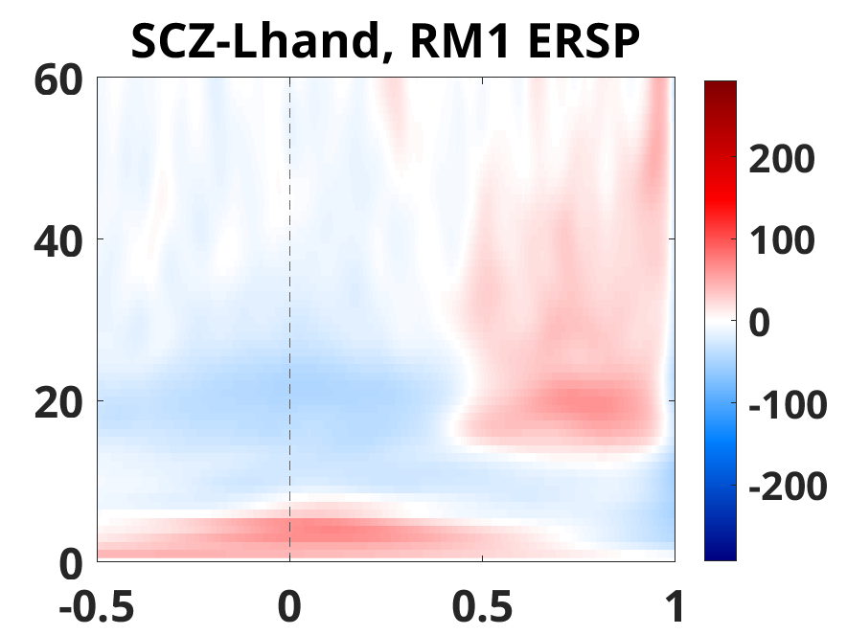
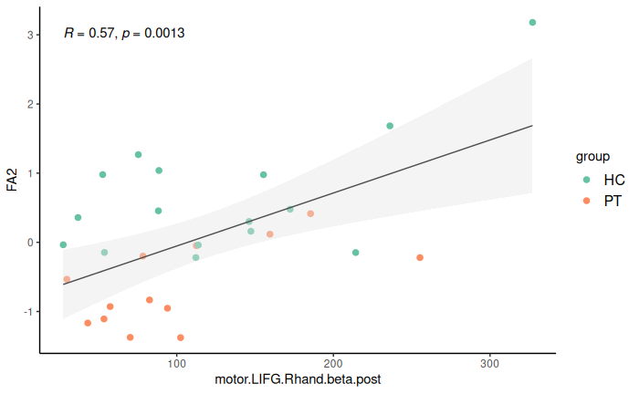
Movement-related beta power with speech factor
Speech factor for verbosity
Verbosity
Peri-movement beta power in right M1
Movement-related beta power (stronger beta decrease followed by stronger beta increase) in M1 and IFG associated with higher verbosity in natural speech
Speech factor for verbosity
Post-movement beta power in left IFG

Slide 16
Visual-related beta power
+
S+A
Primary motor cortices (M1s) & Inferior Frontal Gyri (IFGs)
Primary visual cortices (V1s) & Inferior Frontal Gyri (IFGs)
Primary auditory cortices (A1s) & Inferior Frontal Gyri (IFGs)

Slide 17
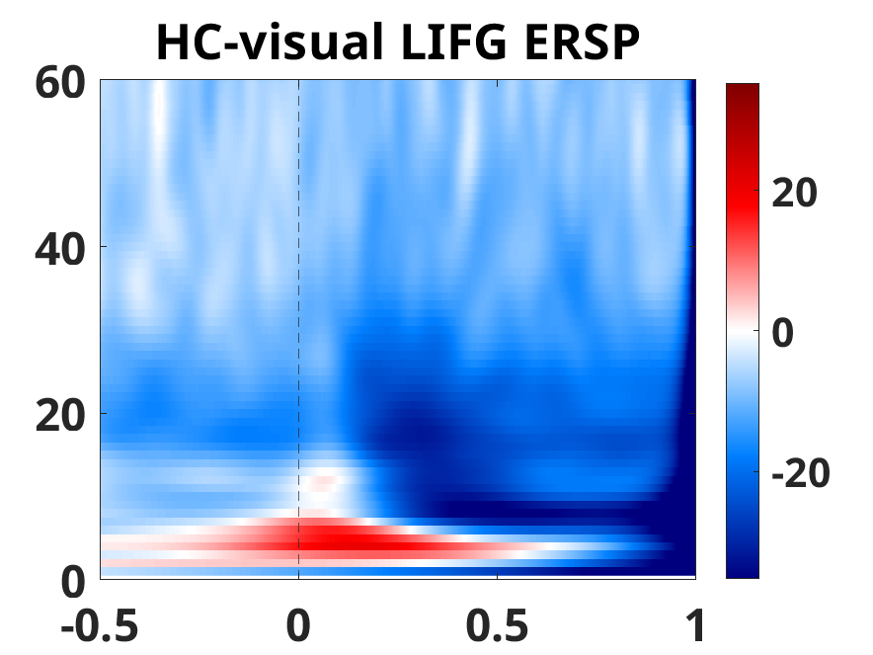
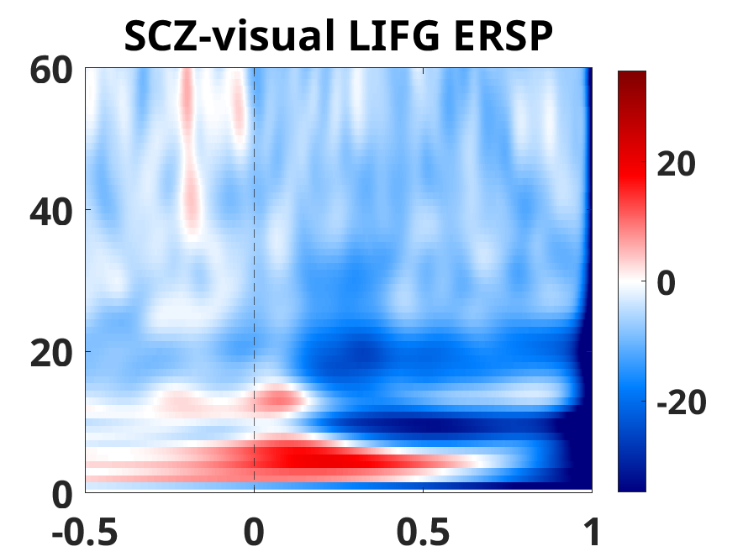
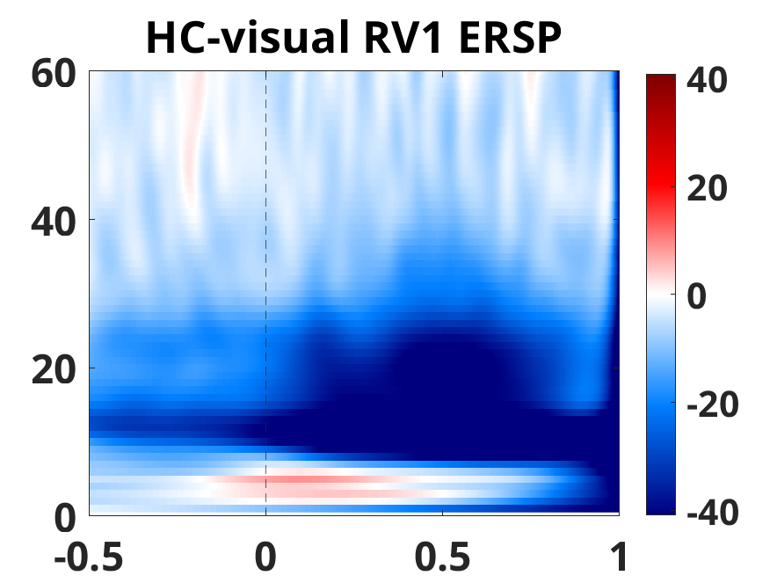
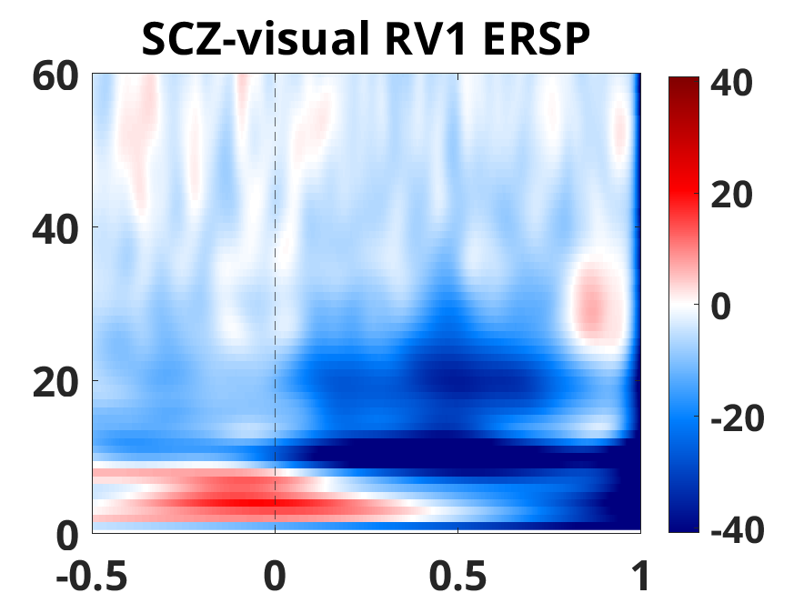
Visual-related beta power
p-value
p-value
Patients had weaker beta power decrease in IFG and V1 around visual events

Slide 18
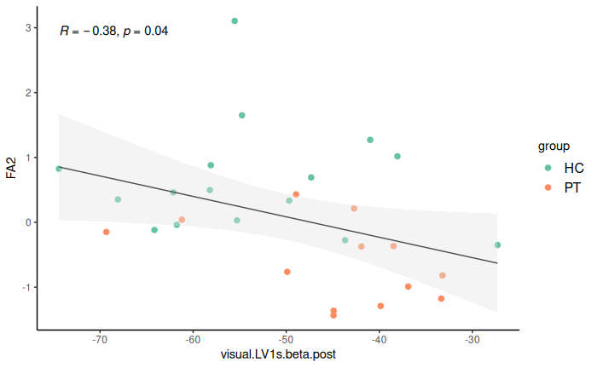
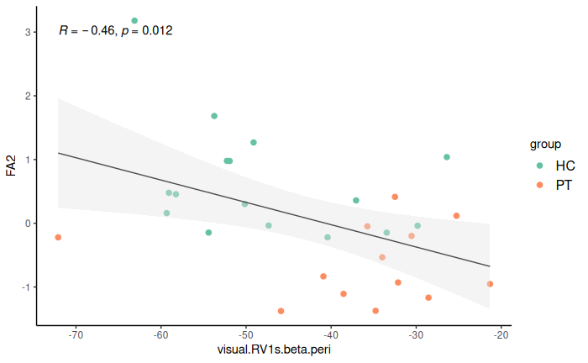
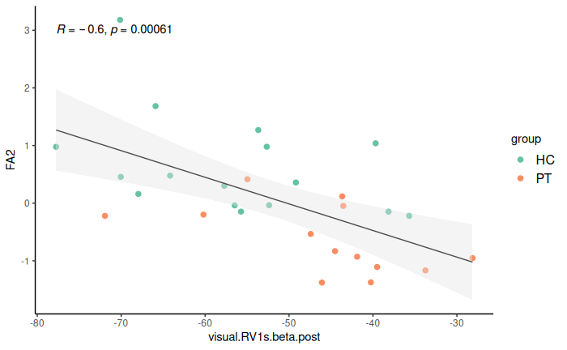
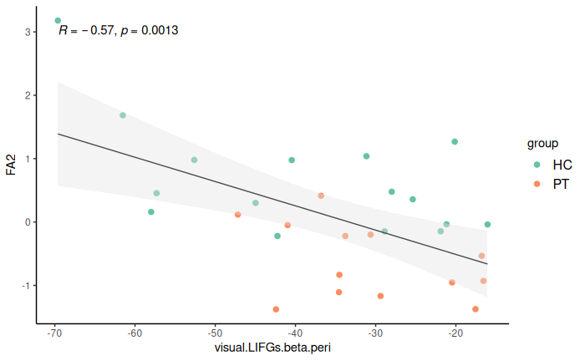
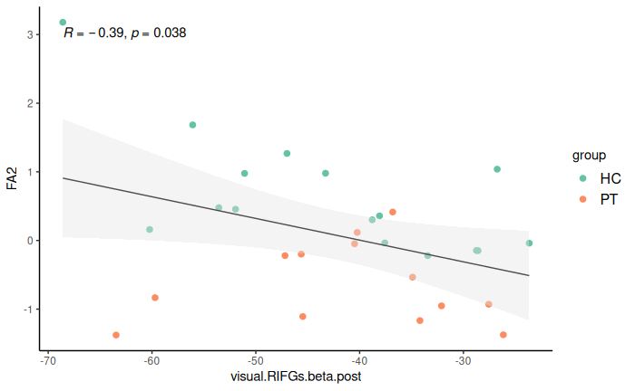
Visual-related beta power with speech factor
Verbosity
Verbosity
Post-visual beta in left V1
Peri-visual beta in right V1
Post-visual beta in right V1
Stronger beta power decrease around visual events relates to more verbosity in speech
Verbosity
Peri-visual beta in left IFG
Post-visual beta in right IFG

Slide 19
Audio-related beta power
+
S+A
Primary motor cortices (M1s) & Inferior Frontal Gyri (IFGs)
Primary visual cortices (V1s) & Inferior Frontal Gyri (IFGs)
Primary auditory cortices (A1s) & Inferior Frontal Gyri (IFGs)

Slide 20
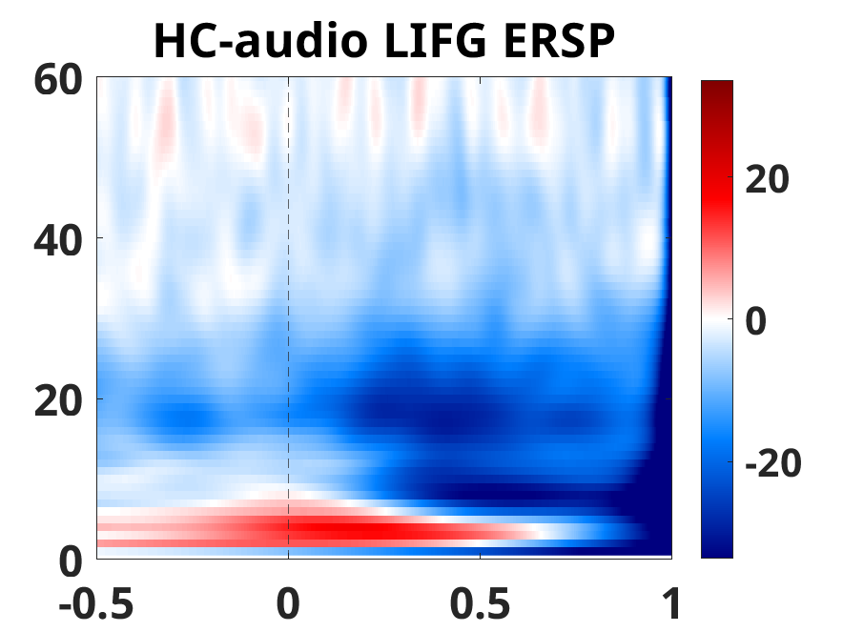
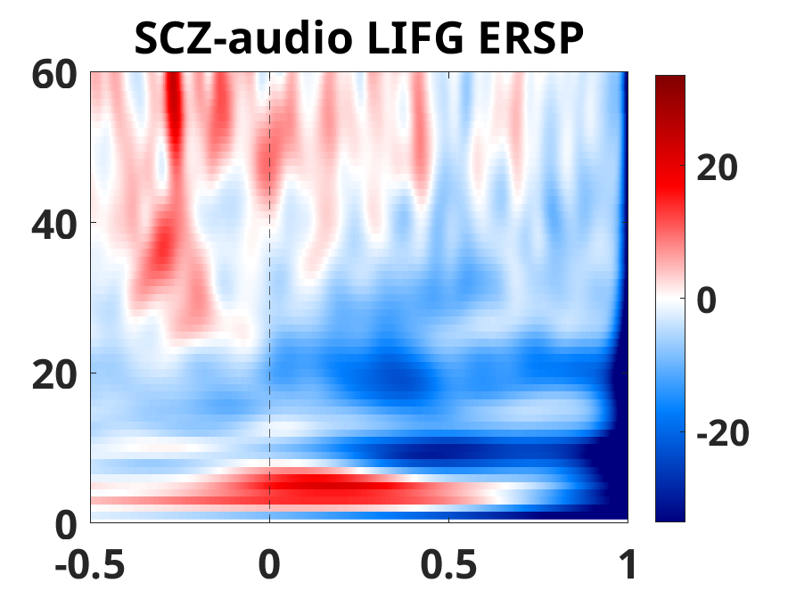
Audio-related beta power
+
Patients had weaker beta power decrease in IFG around audio events
p<0.01**
p<0.05*

Slide 21
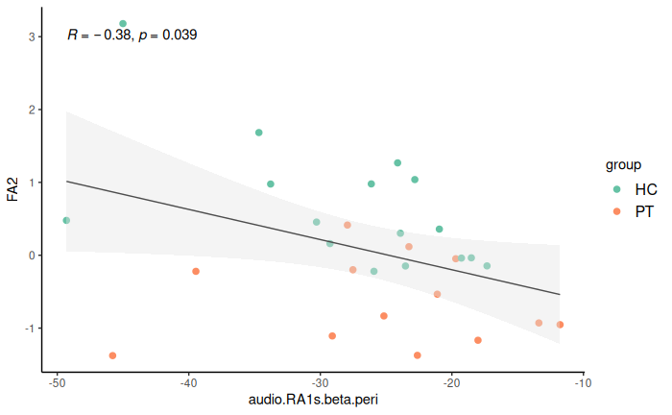
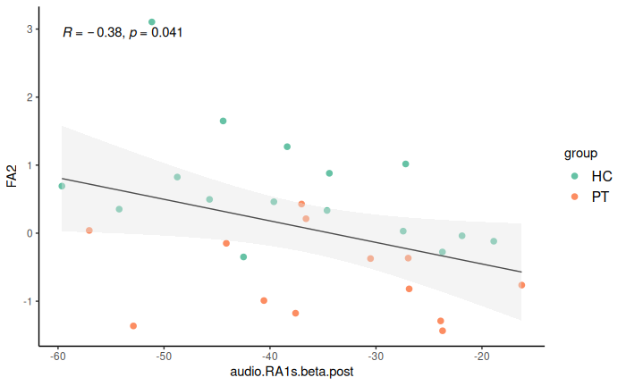
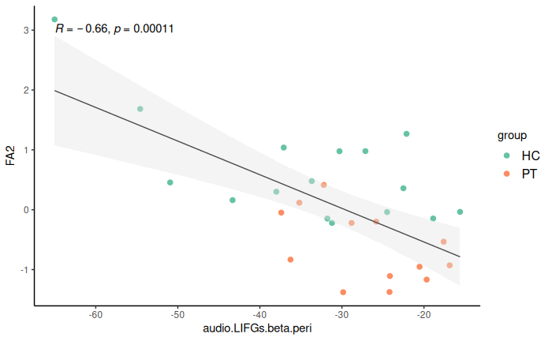
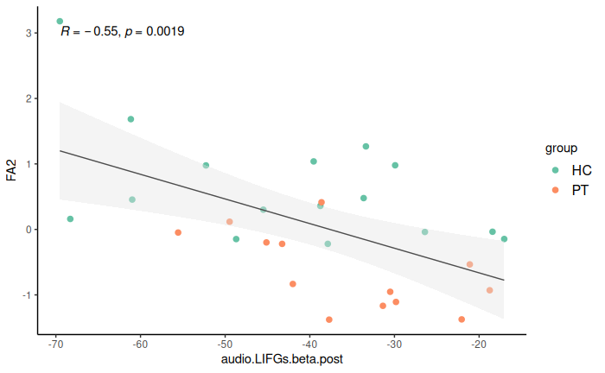
Audio-related beta power with speech factor
Verbosity
Verbosity
Verbosity
Weaker beta power decrease around audio processing in right A1 and left IFG relates to lower verbosity in speech
Peri-audio beta power in right A1
Post-audio beta power in right A1
Verbosity
Verbosity
Peri-audio beta power in left IFG
Post-audio beta power in left IFG

Slide 22
Preliminary results summary
A1:
Patients with SCZ compared to HCs had:
(1) perceive multisensory information closer to objective truth,
(2) showed weaker event-related beta decreases and increases.
(3) lower verbosity and syntactic complexity,
A2:
(1) Post-movement beta power increase in right IFG was related to the tendency to perceive audio-visual simultaneity
(2) Movement and sensory-related beta power modulations in M1s, V1s, A1s, IFGs were associated with verbosity in natural speech
Q1
Q2
Beta oscillations index multisensory integration and (esp. negative) speech symptoms in schizophrenia.

Slide 23
Next steps
Connectivity between IFG-M1/V1/A1, connectivity between hemispheres
Other frequencies oscillations (e.g., alpha, gamma, cross-frequency coupling)
Resting state, periodic and aperiodic components
Speech feature extraction
Multivariate analysis across clinical assessment, speech, and oscillations

Slide 24
Future implications If a role for beta-deficits is established in Schizophrenia, we can 1. Guide neuromodulatory interventions 2. Conduct symptom-focused clinical trials to select treatments based on their effect on this target oscillatory marker.

Slide 25
Thank you
Dominic Boutet
Rukun Dou
Jessica Ahrens
Nadia Zeramdini
Alban Voppel, PhD
Fernando Gonzales, MD
Hsi (Tiana) Wei, MA, PhD
hsi.wei@mail.mcgill.ca
Sylvain Baillet, PhD
Lena Palaniyappan, MD, PhD
No conflict of interest to disclose

