Slide 1

Clinical Translation
Professor Susan Rossell
Director of Clinical Trials
Swinburne University of Technology

Slide 2
AIMS:
To identify opportunities/barriers towards democratising treatment development for disorganised patients.
To extend PragmaCom based on findings from Aim 1 with co-design

Slide 3

Work Package 5: Scoping Exercise
Focus Groups
n=32 in 4 groups:
Patients
Family caregivers,
Researchers
Clinicians from psychology, nursing, psychiatry, speech
therapy, neuropsychology and social work
Discuss barriers, challenges and aspirations

Slide 4

Work Page 5: Scoping Exercise
International Survey
Addressing disorganisation and related social/occupational dysfunction. Professionals:
Exploring:
treatment settings,
interventions,
access restrictions
Patients:
aspirations,
wishes
obstacles

Slide 5
Sharing of assessment tools

Slide 6
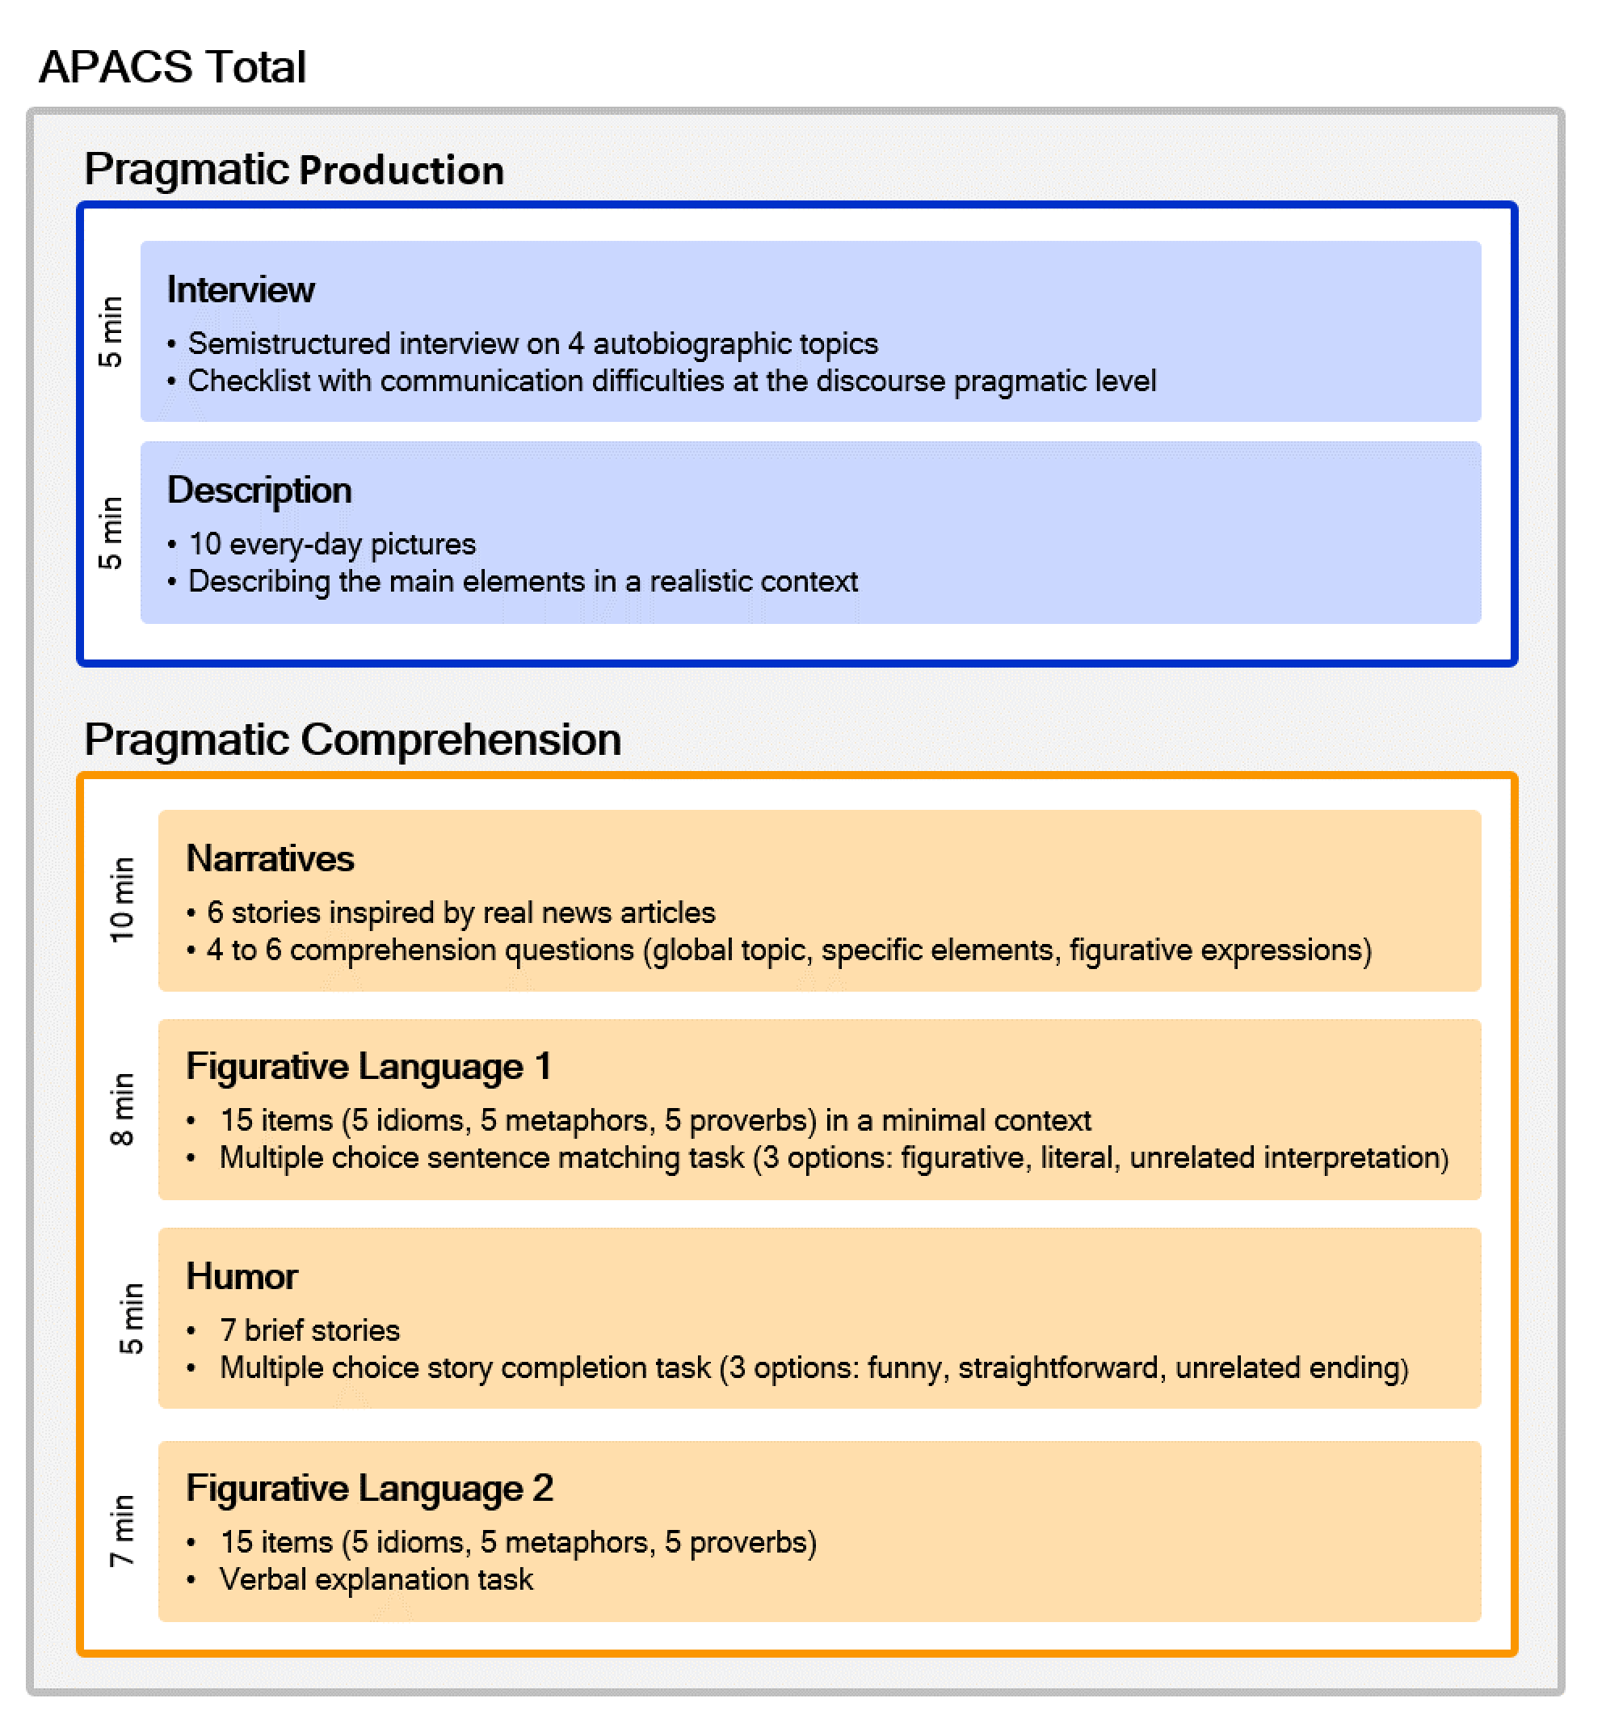
Assessment of Pragmatic Abilities and Cognitive Substrates (APACS)
It combines the evaluation of
production of appropriate conversation (based on a broad definition of pragmatics)
comprehension of implicit meanings (based on a Gricean-inspired definition of pragmatics)
(Arcara & Bambini, 2016)
Notes:
So to sum up, the last 10 years have seen a radical change in the scenary and a renovated interest in pragmatic language disorder. Of course when you start studying this field you want to coinntribute, the first thing you need are tests. For the italian language, when I started 10 years ago, the available tools were limited, had some flaws (meant for RHBD patients), so we started constructing a new test.
We built the apacs, stands for XXX. It includes t

Slide 7
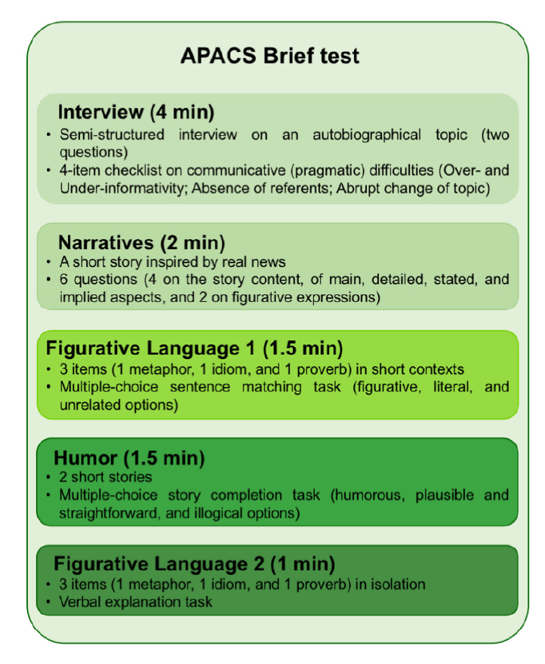
APACS Brief
Course-grained evaluation of
Expressive pragmatics
Receptive pragmatics
10-minute duration
Validated also for remote administration (APACS Brief Remote, Bischetti et al. 2024)
(Bischetti, …, Bosia, Arcara, Bambini 2025)

Slide 8

Cross-national sharing and evaluation
APACS-IT
(Arcara & Bambini 2016)
APACS-Dutch-Flemish
(Bambini et al. 2021)
APACS-Hebrew
(Fussman & Mashal 2022)
APACS - French
(Petit et al. submitted)
APACS German
(Buttner & Baumgartner, in progress)
APACS-Spanish
(Alonso, in progress)
APACS Brief IT
(Bischetti et al. 2025)
APACS Brief German
(Tomasello et al. in preparation)
APACS Brief English
(Lena Palaniyappan in progress)
APACS Brief French
(in progress)
valentina.bambini@iusspavia.it

Slide 9
Thank you
Any questions?
Professor Susan Rossell
srossell@swin.edu.au

