Slide 1
The PANSS Prediction Project Cross-lingual Prediction of PANSS Scores from Spontaneous Speech (audio only)
Rui He, Postdoc at GraC Lab
Universitat Pompeu Fabra (Barcelona, Spain)
3rd April, 2025

Slide 2
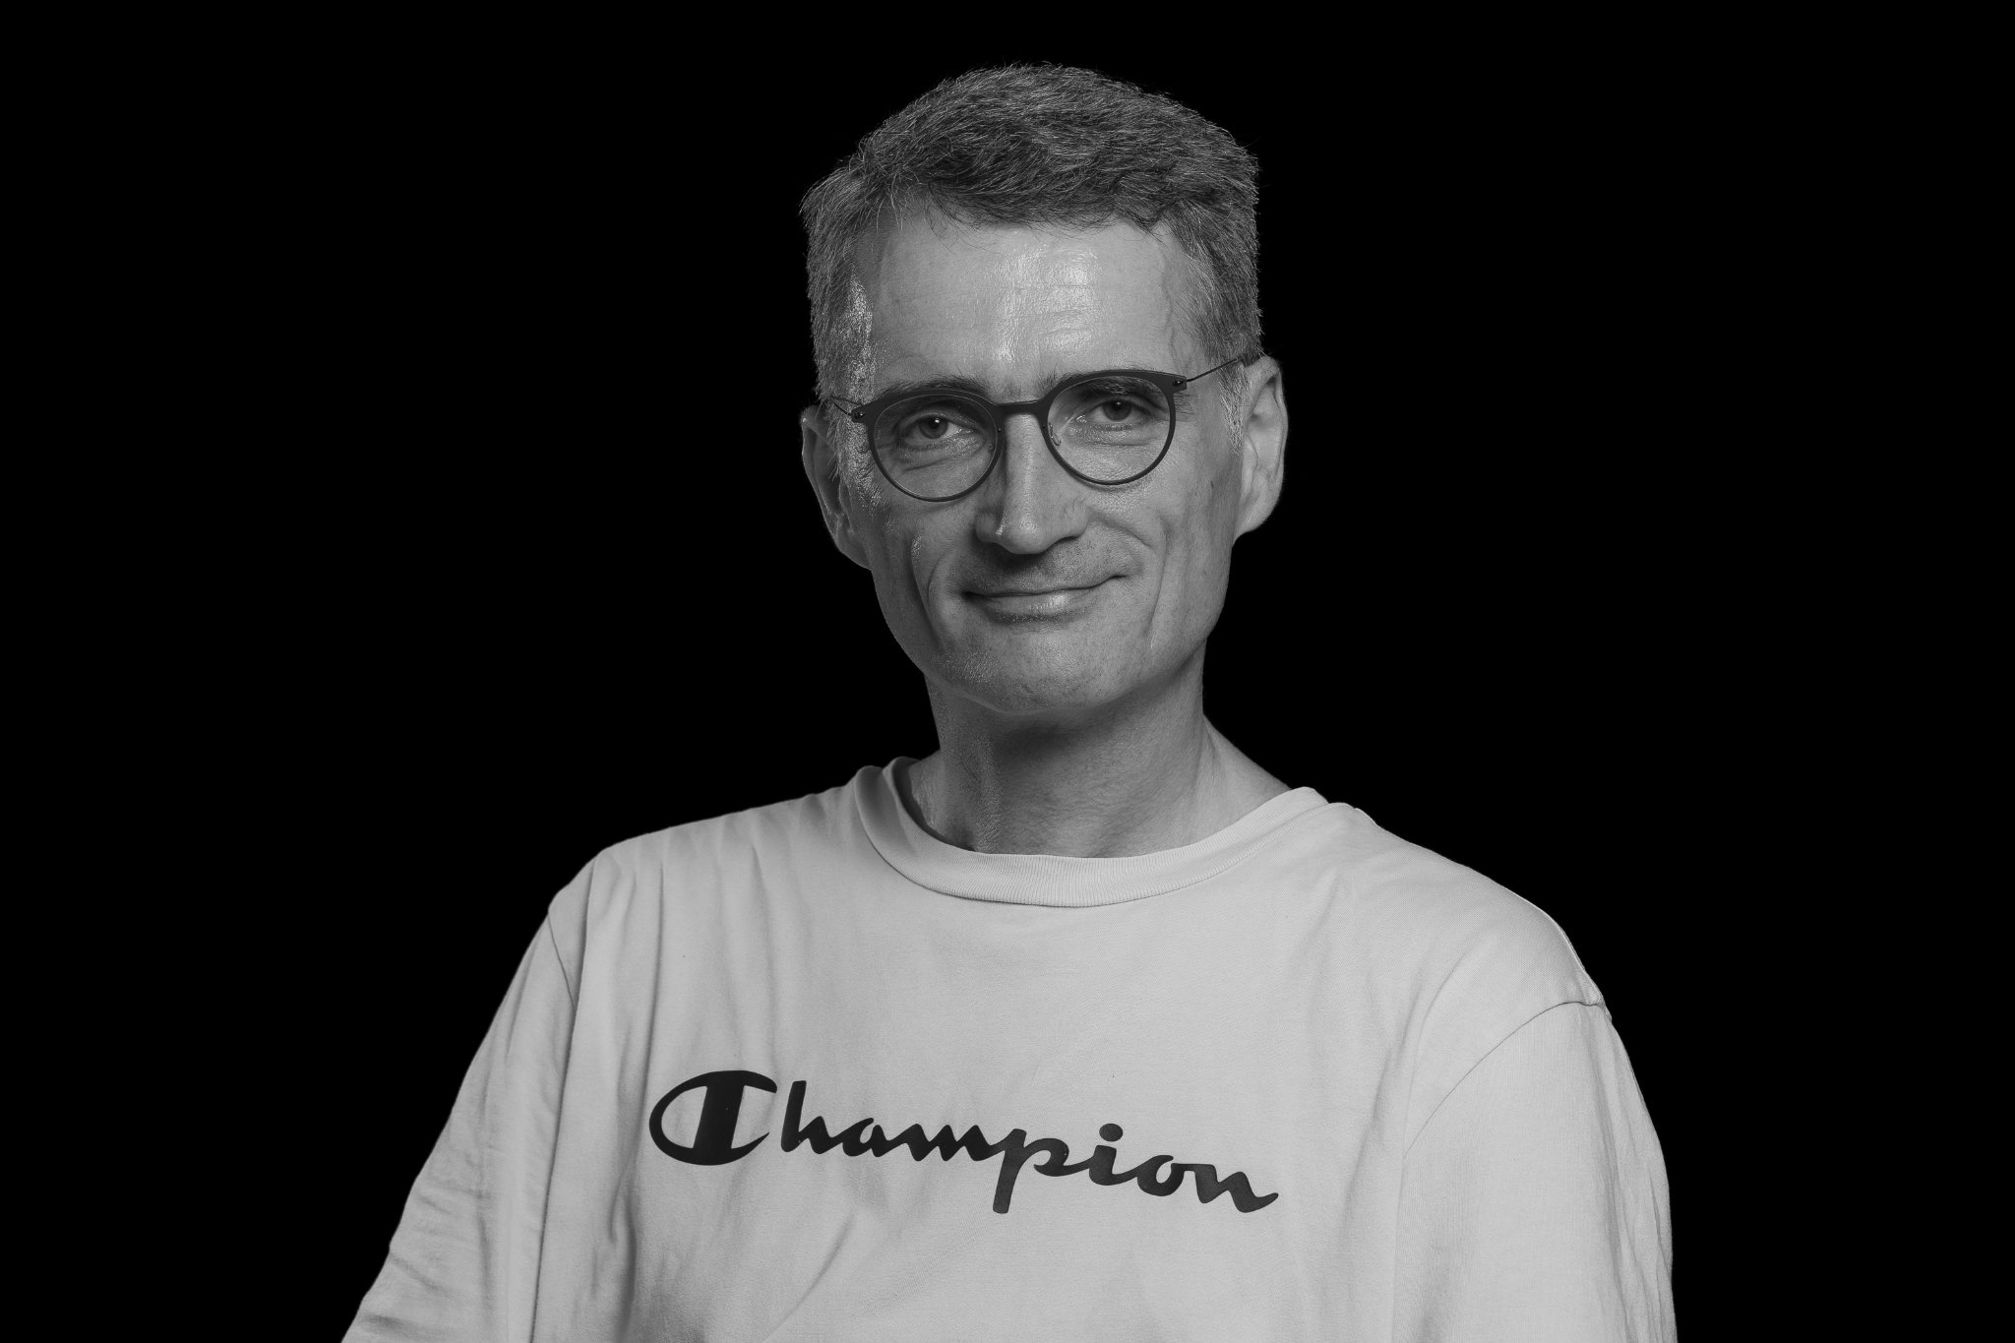
WE
Work Package 2 of the TRUSTING grant
WOLFRAM HINZEN
CLAUDIO PALOMINOS
Postdoctoral Researcher
MARYIA KIRDUN
Researcher
RUI HE
Postdoctoral Researcher

Slide 3
Symptom-based relapse prediction
The TRUSTING grant: A TRUSTworthy speech-based AI monitoring system for the prediction of relapse in individuals with schizophrenia
The RSWG remission criteria: PANSS score-based definition
(Siafis et al, 2024; The Lancet Psychiatry)

Slide 4
We aim to explore:
How rich is the information we can extract from speech recordings for assessing positive and disorganization symptoms without requiring transcriptions?
Key issues:
Dataset size (scarcity)
Symptom score predictions
Cross-lingual generalizability

Slide 5
An extensive collaboration thanks to

Slide 6
Our beloved data Contributors
Dutch: Iris Sommer’s team from UMCG, Netherlands
Swiss German: Philipp Homan’s team from UZH, Switzerland
English: Sunny X Tang’s team from Northwell Health, USA
Spanish: Rosa Ayesa Arriola’s team from IDIVAL, Spain
Turkish: Emre Bora’s team from Dokuz Eylül University, Turkey
Czech: Filip Spaniel’s team from NIMH, Czech Republic
French: Maxime Amblard and Michel Musiol’s team from
Université de Lorraine, France

Slide 7
The dataset so far…
Subjects
Audios per task
1-minute segments
7
Languages
4961
80% Train
20% Test
Data points
Free Speech
Picture Description
Dream Report
Story Reading
Story Recall
…
Similar to
real data collection
in the later trials
324
Participants

Slide 8
And … MORE to come!
English data from Sarah Morgan
German, Mandarin, and Japanese data
from Alberto Parola
Chilean Spanish data from Alicia Figueroa-Barra
Spanish-Catalan data from Barcelona (funded by the DELTA grant)

Slide 9
Dependent data … ? Yes! But why?
Regression on repeated measures -
324 subjects produced 4961 segments!
One single subject can have as many as 40 data points.
Scaling law
Increase robustness and generalizability
Reduce computing load, enhancing efficiency
Making complex models feasible (e.g., DNNs)

Slide 10
Dependent data … ? Yes! But can we?
We can, because:
Dual evaluations
Data augmentation
Pioneers!
One item score from each segment and the median score for each subject
This is similar to augmenting data by adding noises or masking spectrogram
We are not the first
to do this (σ_σ):
Taukdial, DataDriven…
(Dementia challenges)

Slide 11
OK! Now features >>>
Acoustics-prosody
Pretrained embeddings
119 features from eGeMAPs and Prosogram
768-dimensional vectors from m-HuBERT pretrained on ASR and LID tasks
Concatenate
All scripts will be made publicly available.

Slide 12
Machine learning
Feature dimensionality reduction with PCA
Number of components decided by parallel analysis
Eight machine learning models with parameters tuned by GridSearch
Evaluate by Root Mean Squared Error (RMSE)
Support vector
Ridge
Decision Tree
Random forest
Extra trees
Gradient boosting
Ada boosting
XGBoost

Slide 13
Machine learning
Feature dimensionality reduction with PCA
Number of components decided by parallel analysis
Eight machine learning models with parameters tuned by GridSearch
Evaluate by Root Mean Squared Error (RMSE)
Support vector
Ridge
Decision Tree
Random forest
Extra trees
Gradient boosting
Ada boosting
XGBoost

Slide 14
Performance at the segment level
Item | Feat | RMSE | cs | en | es | fr | gsw | nl | tr
P1 | Concat | 1.741 | 1.696 | 2.220 | 1.506 | 2.089 | 2.669 | 2.058 | 0.714
P2 | m-HuBERT | 1.301 | 1.086 | 1.485 | 0.490 | 0.871 | 0.973 | 1.808 | 1.072
P3 | Concat | 1.712 | 0.988 | 2.842 | 1.466 | 2.209 | 3.056 | 1.373 | 0.948
G5 | AcouPros | 0.771 | 0.359 | 1.089 | 0.315 | 0.899 | 0.305 | 0.798
G9 | Concat | 1.588 | 1.370 | 1.948 | 0.343 | 2.067 | 1.841 | 1.398
P1: delusions
P2: conceptual disorganization
P3: hallucinatory behavior
G5: mannerisms and posturing
G9: unusual thought content

Slide 15
Performance at the subject level
Item | Feat | RMSE | cs | en | es | fr | gsw | nl | tr
P1 | Concat | 1.679 | 1.814 | 2.157 | 1.553 | 2.244 | 2.789 | 2.058 | 0.740
P2 | m-HuBERT | 1.104 | 1.165 | 1.574 | 0.538 | 0.896 | 1.188 | 1.808 | 1.142
P3 | Concat | 1.759 | 1.024 | 2.823 | 1.522 | 2.054 | 2.725 | 1.373 | 0.976
G5 | AcouPros | 0.802 | 0.353 | 1.180 | 0.345 | 0.879 | 0.323 | 0.798
G9 | Concat | 1.547 | 1.397 | 1.951 | 0.404 | 1.773 | 1.990 | 1.421
P1: delusions
P2: conceptual disorganization
P3: hallucinatory behavior
G5: mannerisms and posturing
G9: unusual thought content

Slide 16
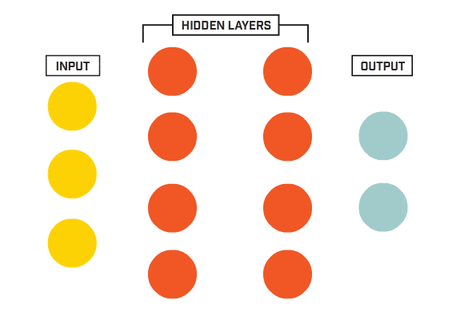
Multi-layer perceptron
Data split: 80% train (same as before), 10% validation, 10% test
After each hidden layer:
SiLU activation,
batch normalization,
drop out.
Early stop trigger with patience of 4 epochs
OneCycleLR scheduler with L2 Normalization
Semi-manually tuned the hyperparameters
Predictions
PANSS
Features
Hidden dimension 1
Hidden dimension 2
RMSE

Slide 17
Performance at the segment level
Item | Feat | RMSE PCA-ET | RMSE MLP | cs | en | es | fr | gsw | nl | tr
P1 | m-HuBERT | 1.741 | 1.614 | 1.537 | 2.018 | 1.871 | 1.796 | 3.182 | 2.099 | 0.802
P2 | m-HuBERT | 1.301 | 1.107 | 1.245 | 1.580 | 0.678 | 0.981 | 1.353 | 1.698 | 1.133
P3 | m-HuBERT | 1.712 | 1.615 | 1.038 | 2.314 | 2.235 | 1.696 | 0.979 | 1.176 | 0.864
G5 | Concat | 0.771 | 0.734 | 0.144 | 1.532 | 0.314 | 0.482 | 0.308 | 0.784
G9 | Concat | 1.588 | 1.377 | 0.445 | 2.332 | 0.434 | 0.232 | 3.622 | 1.467
P1: delusions
P2: conceptual disorganization
P3: hallucinatory behavior
G5: mannerisms and posturing
G9: unusual thought content

Slide 18
Performance at the subject level
Item | Feat | RMSE PCA-ET | RMSE MLP | cs | en | es | fr | gsw | nl | tr
P1 | m-HuBERT | 1.679 | 1.736 | 1.562 | 2.098 | 1.886 | 1.631 | 3.159 | 2.099 | 0.782
P2 | m-HuBERT | 1.104 | 1.269 | 1.258 | 1.566 | 0.629 | 0.848 | 1.241 | 1.698 | 0.992
P3 | m-HuBERT | 1.759 | 1.536 | 0.968 | 2.374 | 2.226 | 1.966 | 0.939 | 1.176 | 0.880
G5 | Concat | 0.802 | 0.785 | 0.019 | 1.362 | 0.205 | 0.393 | 0.264 | 0.784
G9 | Concat | 1.547 | 1.523 | 0.400 | 2.127 | 0.408 | 0.103 | 3.541 | 1.467
P1: delusions
P2: conceptual disorganization
P3: hallucinatory behavior
G5: mannerisms and posturing
G9: unusual thought content

Slide 19
To wrap up:
Schizophrenia symptoms can be predicted automatically from speech recordings only, even without transcriptions, with averaged error just around 1.5
MLP performed slightly better than ExtraTrees model with grid search of parameters, but not too much

Slide 20
We still have these to do >>>
More data on the way
How to aggregate scores from each task to scores per subject?
Subject-level loss function
Model’s performance declines with symptom severity
How to improve model’s performance on severe patients?
Can more complicated model improve the performance – 1dCNN, RNN, transformers …?
We tried a BiLSTM+attention network, which completely overfit…

Slide 21
Disclosures
The PANSS prediction project and travel for this event are funded by the European Union (GA 101080251 – TRUSTING and GA Nº 101118756 - DELTA-LANG). Views and opinions expressed are however those of the author(s) only and do not necessarily reflect those of the European Union or the Agency. Neither the European Union nor the granting authority can be held responsible for them.

Slide 22
THANK
YOU

