Slide 1
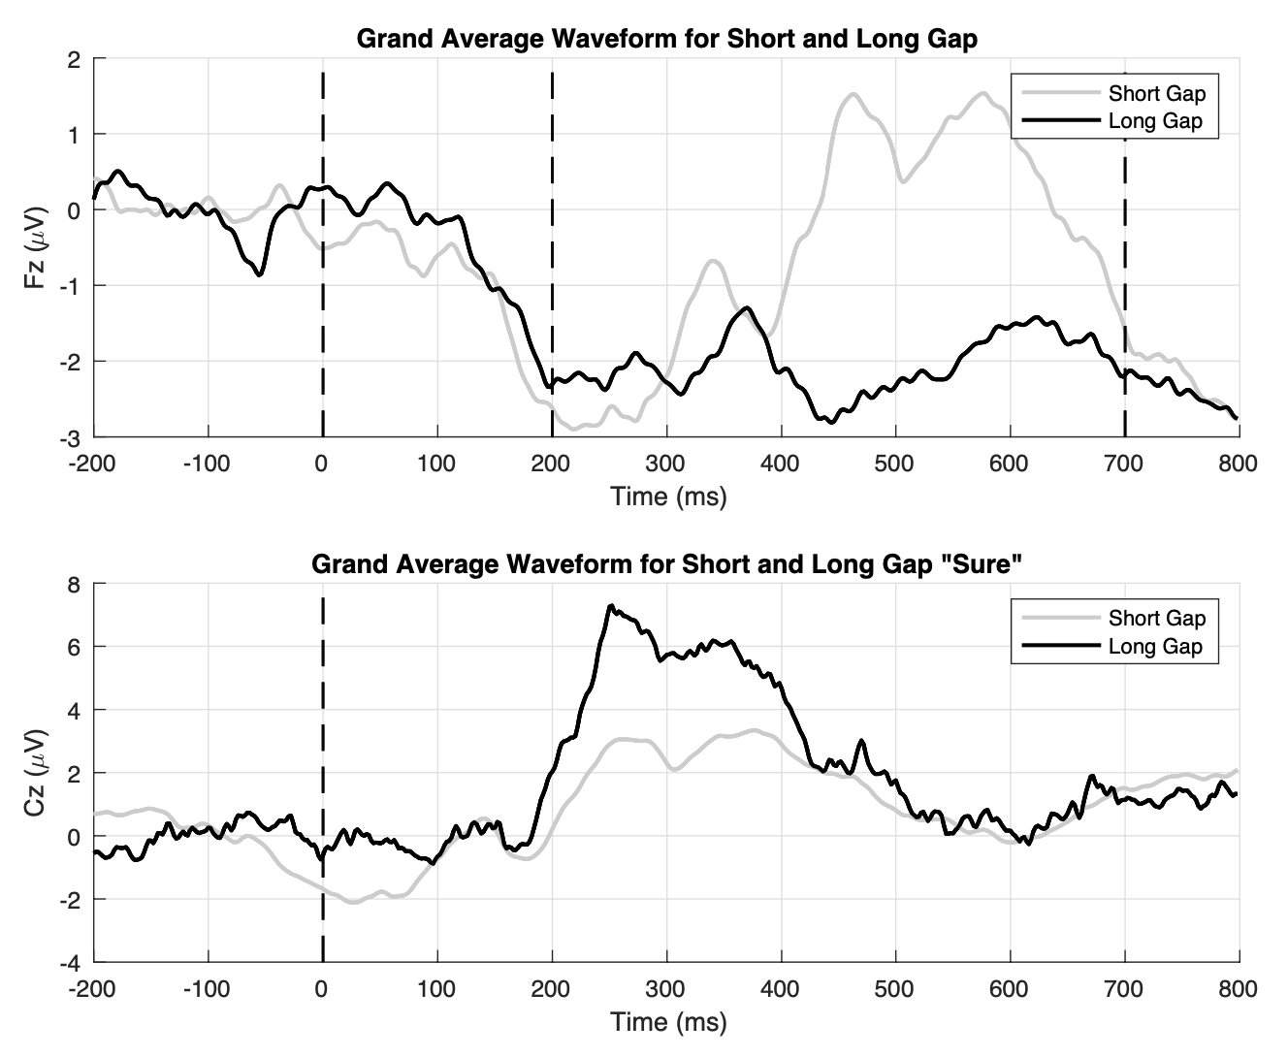
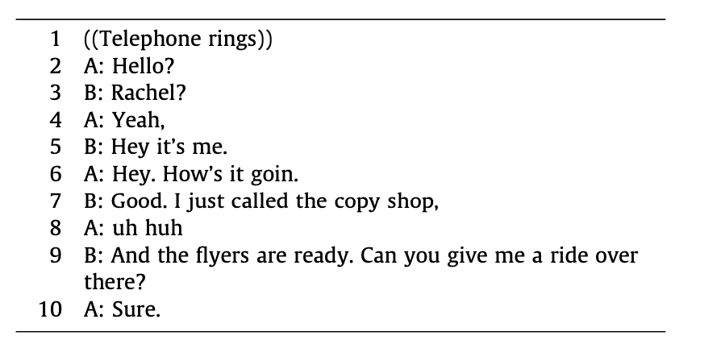
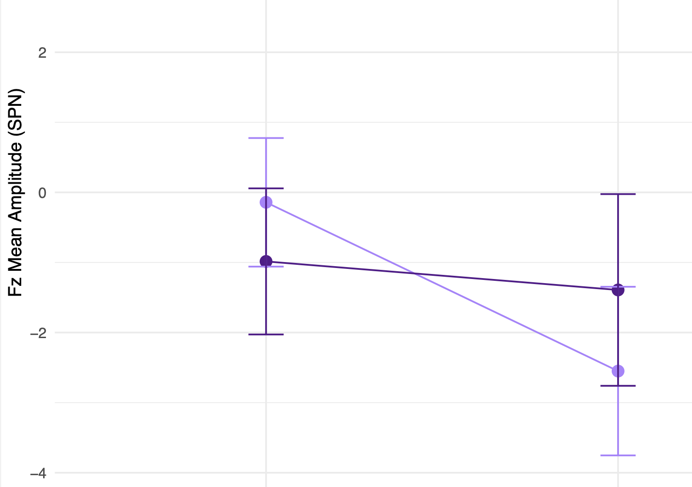
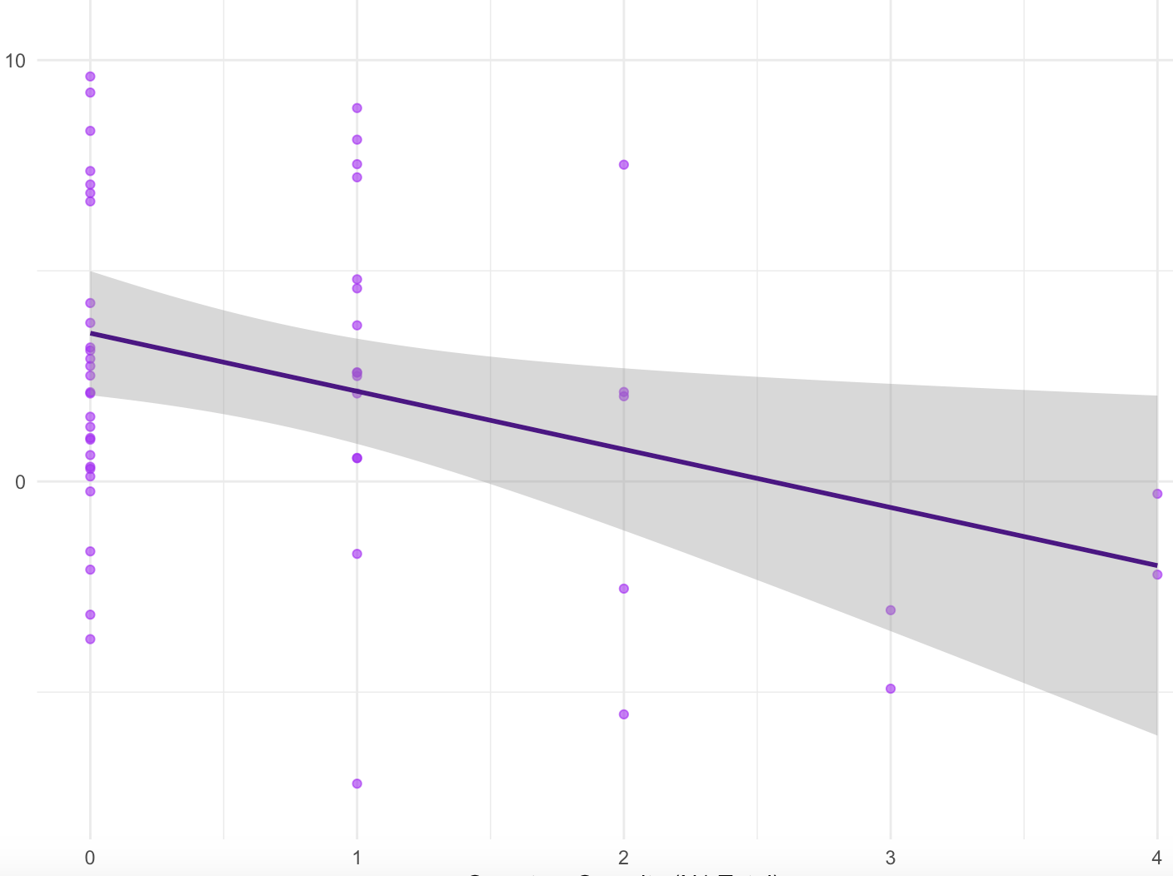
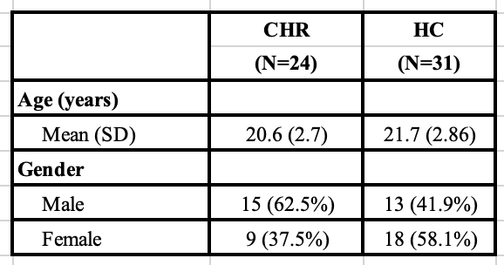
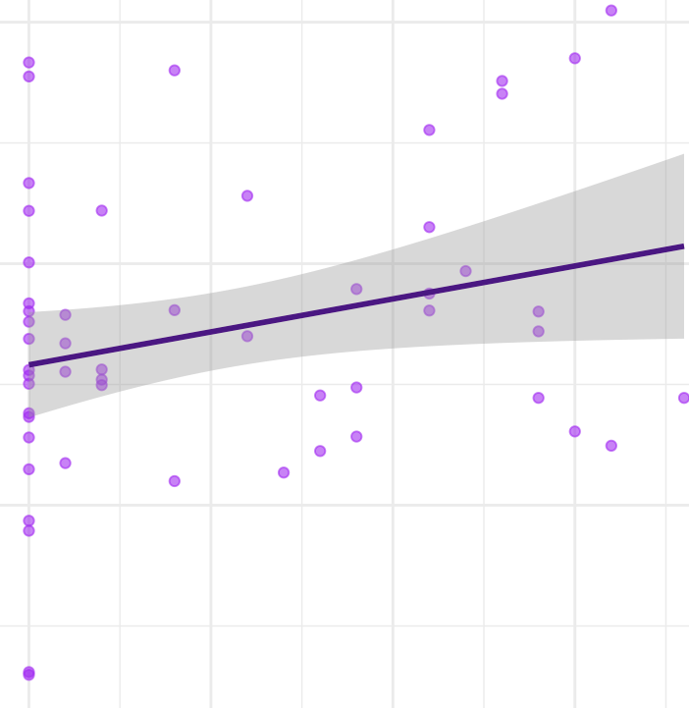
Neurological underpinnings of social anhedonia in clinical high-risk populations: Evidence from a turn-taking task
Adolescent Development and Preventive Treatment
Claire Bertrand¹, Victor Pokorny¹, Dan Foti² , Juston Osborne³, Felicia Roberts⁴, Emily Kappennman⁵, and Vijay Mittal¹
@claireebertrand.bsky.social
@vijayamittal.bsky.social
1. Department of Psychology, Northwestern University, Evanston, IL, USA 2. Department of Psychological Sciences, Purdue University, West Lafayette, IN, USA 3. Department of Psychological & Brain Sciences, Washington University in St. Louis, MO, USA. 4. Brian Lamb School of Communication, Purdue University, West Lafayette, IN, US 5. Department of Psychology, San Diego State University, San Diego, CA, USA.
Background
Grand average waveforms of differences in how people process short versus long gaps in conversations
Methods (continued)
Language processing and patterns are crucial to examine in CHR individuals
Atypical turn-taking is a prominent feature of speech patterns in schizophrenia (Sichlinger et al., 2020)
Baseline subtle language disturbances in CHR individuals are associated with higher transition rates to psychosis (Corcoran & Cecchi, 2020)
CHR individuals exhibit abnormalities in conversation turn-taking (Hitczenko et al., 2020)
A previous study with this same task found that silence during inter-speaker gaps activated the posterior speech perception pathway and speaker responses activated the anterior pathway (Foti & Roberts, 2016)
However, neural abnormalities involved in turn-taking have not yet been researched in CHR populations
Are there abnormalities involved in turn-taking in CHR populations? Are these abnormalities associated with negative symptoms related to social processing?
Each conversation included one friend asking a request, and one friend agreeing with a “Sure”. The sure occcured either after a short gap of 200ms or a long gap of 700ms.
Each trial was 10 seconds long. There were 10 types and 4 distractors.
Sustained SPN
Gap
Begins
“Sure”
Short Gap
“Sure”
Long Gap
Results
Methods
P200/P300
These findings confirm brain responses involved in turn-taking (sustained stimulus preceding negativity is involved in stimulus anticipation and ERP and P200/P300 ERP is involved in early processing)
A greater difference between short and long gap “sure” onset is associated with lower levels of social anhedonia
Greater positive symptoms were associated with altered modulation of neural responses for short and long gap onsets
Subjects: N = 67 participants completed the task
(31 CHR and 36 HC)
EEG: 3 participants were excluded due to inclusion criteria. 6 participants were excluded due to noisy data.
The final sample includes 55 participants
(24 CHR, 31 HC)
Clinical interview: All participants completed the Structured Interview for Psychosis-Risk Syndromes (SIPS)
Task: Participants listened to audio recordings of 2 friends having a conversation
“Sure”
Interaction plot of SPN ERP on short versus long gap anticipation
Short versus long “sure” onset on social anhedonia
p = 0.00169** for bin differences
p = 0.022 for bin:group interaction
10
0
-10
r = -0.3105, t(52) = -2.357, p = 0.0223*
Conclusion
Bin differences: F(1, 53) = 10.94, p < 0.01**
Bin:group interaction: F(1, 53) = 5.53, p = 0.022*
Group
Long Gap Sure – Short Gap Sure
CHR participants view short and long gaps similarly, which could explain social impairments involved in this population
0 1 2 3 4
Symptom severity (SIPS N1)
Short versus long gap onset on positive symptoms
References
5
0
-5
r = 0.266, t(52) = 1.9912, p = 0.0517
MADRS
Long Gap Onset – Short Gap Onset
1. Sichlinger, L., Cibelli, E., Goldrick, M., & Mittal, V. A. (2019). Clinical correlates of aberrant conversational turn-taking in youth at clinical high-risk for psychosis. Schizophrenia research, 204, 419–420. https://doi.org/10.1016/j.schres.2018.08.009
2. Corcoran, C. M., & Cecchi, G. A. (2020). Using Language Processing and Speech Analysis for the Identification of Psychosis and Other Disorders. Biological psychiatry. Cognitive neuroscience and neuroimaging, 5(8), 770–779. https://doi.org/10.1016/j.bpsc.2020.06.004
3. Hitczenko, K., Mittal, V. A., & Goldrick, M. (2021). Understanding Language Abnormalities and Associated Clinical Markers in Psychosis: The Promise of Computational Methods. Schizophrenia bulletin, 47(2), 344–362. https://doi.org/10.1093/schbul/sbaa141
4. Foti, D., & Roberts, F. (2016). The neural dynamics of speech perception: Dissociable networks for processing linguistic content and monitoring speaker turn-taking. Brain and language, 157-158, 63–71. https://doi.org/10.1016/j.bandl.2016.05.001
Short Gap
Long Gap
0 5 10 15
Symptom severity (SIPS P Total)

