Slide 1


Leveraging Deep Learning to Investigate Speech Biomarkers
Matt Goldrick
Linguistics, Psychology, and Cognitive Science
Northwestern University
Research supported by

Slide 2

Example 1:
  ‘desk’
  Male
  Native English speaker
Example 2:
  ‘desk’
  Female
  Non-native English speaker
Speech reveals not only what was said, but who said it

Slide 3

Example 3:
  Conversational, casual speech
Example 4:
  Clear speech
Speech is not just the words that were said; it provides information about the processes underlying speech planning

Slide 4
Pronunciation Variation as a Biomarker
Cue-based approach
  Use deep learning for rapid, objective extraction of known properties of speech
Holistic approach
  Use deep learning to discover properties of speech

Slide 5
Pronunciation Variation as a Biomarker
Cue-based approach
  Use deep learning for rapid, objective extraction of known properties of speech
Holistic approach
  Use deep learning to discover properties of speech

Slide 6
Measuring Speech
Consonants like t,d or p,b are produced by blocking flow of air.
  Tongue tip: t,d
  Lips: p,b
In English, t vs. d and p vs. b: signaled by temporal contrast
  Time from when air begins flowing again to the beginning of the voicing (periodic movement of vocal folds).
  t, p: relatively long period of time (40-120 msec)
  d,b: relatively short period of time (0-40 msec)

Slide 7
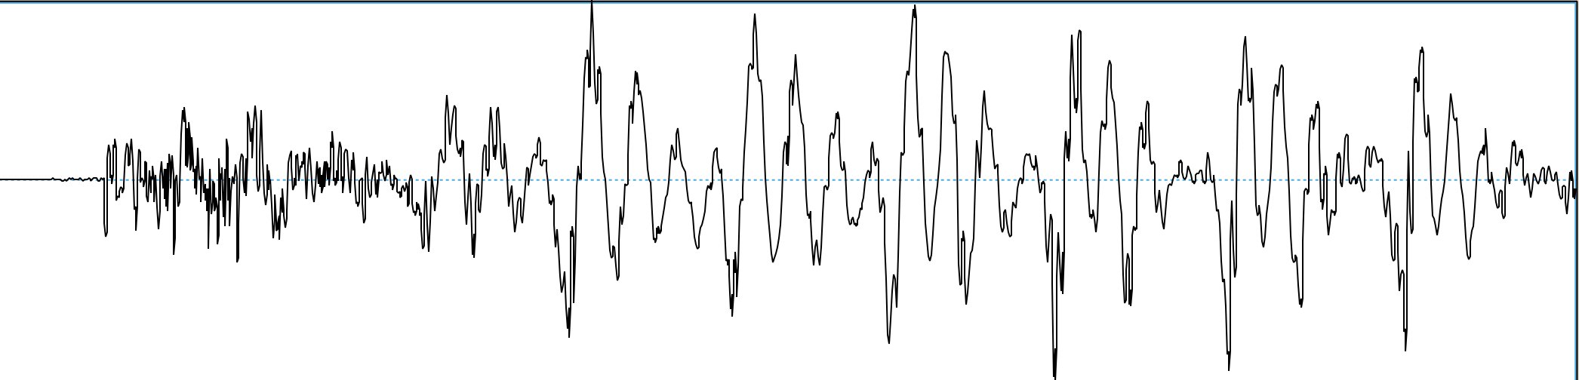
Measuring Speech
‘dip’
Amplitude
(-0.3 – 0.3 Pa)
‘tip’
Amplitude
(-0.3 – 0.3 Pa)
Time (0–120 msec)

Slide 8
Measuring Speech
Release of airflow
Start of voicing
‘dip’
Voice onset time
English:
short lag
Start of voicing
‘tip’
Voice onset time

Slide 9
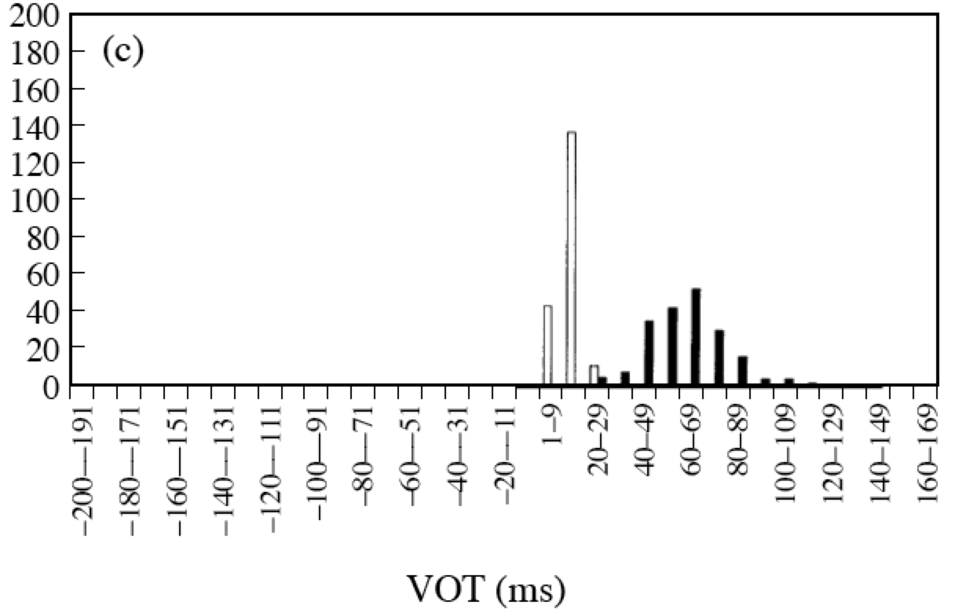
Variation in Speech:
Potential Source of Information?
Kessinger & Blumstein (1997)

Slide 10
Phonetic analysis of large datasets
Gold standard: Human annotation
  Time consuming (> 3K person hours for large study)
  Fundamentally subjective
Matching manual annotation accuracy with machine learning
  Trained on pre-existing corpora of human annotations
  Performs at level of human annotators

Slide 11
Variation as a Window into Psychosis Risk
(Vijay Mittal, Joseph Keshet, Kasia Hitczenko, Yael Segal)
Individuals at risk for schizophrenia show mild motor impairments
Does speech variability show similar patterns?
Cuesta et al.,2018; van Harter et al., 2017; Walther & Strik, 2012; Mittal et al., 2017, a.o.

Slide 12
Variation as a Window into Psychosis Risk
(Vijay Mittal, Joseph Keshet, Kasia Hitczenko)
Hitczenko et al., 2023, Schizophrenia

Slide 13
Variation as a Window into Psychosis Risk
(Vijay Mittal, Joseph Keshet, Kasia Hitczenko)
56 Clinically high risk (CHR) 66 Healthy Controls (HC)
Task: Diadochokinetic speech (DDK)
  Trial A: Say “pataka” 10 times, as quickly and accurately as possible
  Trial B: Say “katapa”
  10 trials of each
Hitczenko et al., 2023, Schizophrenia

Slide 14
Variation as a Window into Psychosis Risk
(Vijay Mittal, Joseph Keshet, Kasia Hitczenko)
SD/mean
VOT ~ Group p < .02
Hitczenko et al., 2023, Schizophrenia

Slide 15
Variation as a Window into Psychosis Risk
(Vijay Mittal, Joseph Keshet, Kasia Hitczenko)
VOT ~ Group p < .01
Hitczenko et al., 2023, Schizophrenia

Slide 16
Other Applications of Cue-Based Approach
Pauses in conversational turn-taking (Sichlinger, Cibelli, Mittal)
Cue variability and psychomotor symptoms in depression (Shankman, Mittal, Keshet, Exton)

Slide 17
Pronunciation Variation as a Biomarker
Cue-based approach
  Use deep learning for rapid, objective extraction of known properties of speech
Holistic approach
  Use deep learning to discover properties of speech

Slide 18
A new approach: Perceptual similarity space
Dimensions:
  discovered by self-supervised learning; not constrained by discrete linguistic units
Acoustic differences:
  assessed holistically, without reference to segmentation
Notes:
We can now envision a new approach to phonetic analysis based on holistic comparison of utterances (in principle, of any length) in terms of trajectory distances (or conversely similarity)
Critical properties…
Now, in order to see if this approach is viable for speech analysis, we need to check if the inter-talker distances that it returns make sense.

Slide 19
Second-language (L2) speech intelligibility
L2 English talker
Why is word recognition accuracy lower for some speakers, higher for others?
L1 English listeners
The shoes were very dirty
the shoes were very dirty (100%)
The bananas are too ripe
the bananas are too ripe (100%)
The mailman brought a letter
the mailman bought a letter (80%)
Notes:
And compare them with the target sentences and calculate word recognition accuracy: how many words the listeners got correct out of the total number of words.
So this word recognition accuracy is considered as an “objective” measure of speech intelligibility. This contrasts with “subjective” measures such as ratings of foreign-accentedness or comprehensibility.

Slide 20
Perceptual similarity space
discovered by self-supervised learning
not constrained by linguistic units
Dimension 1
Dimension 2
HuBERT model: Hsu et al., 2021

Slide 21

Perceptual similarity space
Dimension 1
L1 English talker
Dimension 2
“The shoes were very dirty”
Chernyak et al., 2024, J. Acoustic. Soc. Amer.; Kim et al., in press, Psychonom. Bull. Rev.

Slide 22
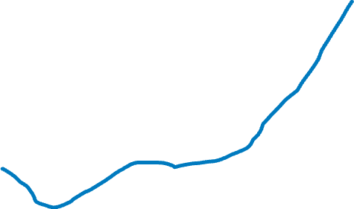
Perceptual similarity space
Dimension 1
L1 English talker
L2 English talker (high intelligibility)
Dimension 2
“The shoes were very dirty”
Chernyak et al., 2024, J. Acoustic. Soc. Amer.; Kim et al., in press, Psychonom. Bull. Rev.

Slide 23
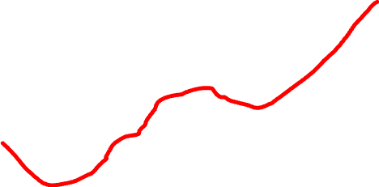
Perceptual similarity space
Dimension 1
L1 English talker
L2 English talker (low intelligibility)
Dimension 2
“The shoes were very dirty”
Chernyak et al., 2024, J. Acoustic. Soc. Amer.; Kim et al., in press, Psychonom. Bull. Rev.

Slide 24
Perceptual similarity space: Talker similarity
Dimension 1
L1 English talker
L2 English talker (high intelligibility)
L2 English talker (low intelligibility)
Dimension 2
“The shoes were very dirty”
Chernyak et al., 2024, J. Acoustic. Soc. Amer.; Kim et al., in press, Psychonom. Bull. Rev.

Slide 25
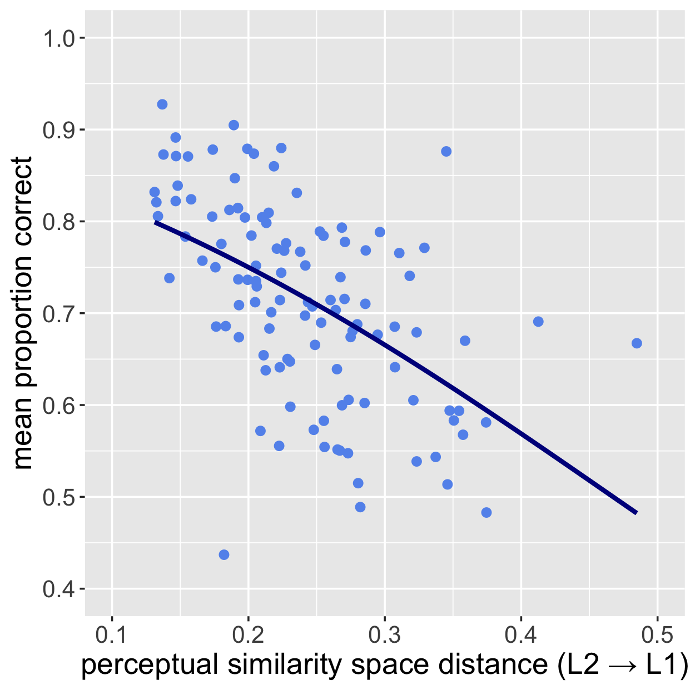
L2 talkers' distances from the L1 talker group predicted their intelligibility
Word recognition accuracy for each L2 talker
p < 0.0001
L2 talkers highly similar to L1
L2 talkers not similar to L1
Kim et al., in press, Psychonomic Bulletin and Review

Slide 26
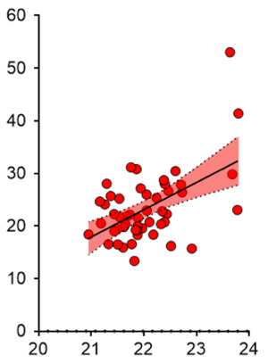
Distance of individuals with autism from non-autistic controls relate to behavioral measures of disruption
Rapid Automatized Naming Time (s)
p < 0.001
Individuals with autism more similar to controls
Individuals with autism less similar to controls
Ethridge et al., in prep.

Slide 27
A new approach: Perceptual similarity space
Dimensions:
  discovered by self-supervised learning; not constrained by discrete linguistic units
Acoustic differences:
  assessed holistically, without reference to segmentation
  May index processing deficits in individuals with autism
Notes:
We can now envision a new approach to phonetic analysis based on holistic comparison of utterances (in principle, of any length) in terms of trajectory distances (or conversely similarity)
Critical properties…
Now, in order to see if this approach is viable for speech analysis, we need to check if the inter-talker distances that it returns make sense.

Slide 28
Pronunciation Variation as a Biomarker
Cue-based approach
  Use deep learning for rapid, objective extraction of known properties of speech
Holistic approach
  Use deep learning to discover properties of speech

Slide 29
Thanks!
Kasia Hitczenko, Georgetown
Bronya Chernyak, Technion
Yael Segal, Technion
Joseph Keshet, Technion
Ann Bradlow, Northwestern
Sarah Ethridge, Northwestern
Seung-Eun Kim, Northwestern
Joe Lau, Northwestern
Molly Losh, Northwestern
Vijay Mittal, Northwestern
Stew Shankman, Northwestern
DRL 2219843
NIMH 119677
NIMH 134369

