Slide 1
Psychosis Stigma in News Media
DISCOURSE, 2025 Meeting
Luz Maria Alliende Serra, MA
PhD Student Northwestern University

Slide 2
Psychosis Stigma in News Media
DISCOURSE, 2025 Meeting
Luz Maria Alliende Serra, MA
PhD Student Northwestern University

Slide 3
Stigma and
Psychosis
Psychosis spectrum disorders are more stigmatized than other mental health diagnoses (Karidi et al., 2015; Wood et al., 2014)
Higher perceptions of stigma related to (Sarraf et al., 2022; Gronholm et al., 2017)
Decreased wellbeing
Worse functional outcomes
Increased depressive symptoms
Barriers to access care

Slide 4
BLA BLA BLA BLA BLA BLA BLA BLA BLA BLA BLA BLA BLA BLA BLA BLA BLA BLA BLA BLA BLA BLA BLA BLA BLA BLA BLA BLA BLA BLA BLA BLA BLA BLA BLA BLA BLA BLA BLA BLA BLA BLA BLA BLA BLA BLA BLA BLA BLA BLA BLA BLA BLA BLA BLA BLA BLA BLA BLA BLA BLA BLA BLA BLA BLA BLA BLA BLA BLA BLA BLA BLA BLA BLA BLA BLA BLA BLA BLA BLA BLA BLA BLA BLA BLA BLA BLA BLA BLA BLA BLA BLA BLA BLA BLA BLA BLA BLA BLA BLA BLA BLA BLA BLA BLA BLA BLA BLA BLA BLA BLA BLA BLA BLA BLA BLA BLA BLA BLA BLA BLA BLA BLA BLA BLA BLA BLA BLA BLA BLA BLA BLA BLA BLA BLA BLA BLA BLA BLA BLA BLA BLA BLA BLA BLA BLA BLA BLA BLA BLA BLA BLA BLA BLA BLA BLA BLA BLA BLA BLA BLA BLA BLA BLA BLA BLA BLA BLA BLA BLA BLA BLA BLA BLA BLA BLA BLA BLA BLA BLA BLA BLA BLA BLA BLA BLA BLA BLA BLA BLA BLA BLA BLA
BLA BLA BLA BLA BLA BLA BLA BLA BLA BLA BLA BLA BLA BLA BLA BLA
(Yang et al., 2015, Sarraf et al. 2022)

Slide 5
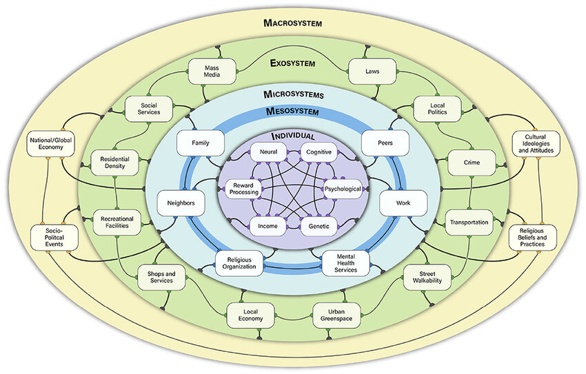
Strauss, 2021

Slide 6
Strauss, 2021

Slide 7
Strauss, 2021

Slide 8
Questions and Hypotheses
What is associated with psychosis in news media?
Do we use psychosis-related words in a clinically-meaningful way?
Less than for other illnesses
Is it related to negative tone? More than for other illnesses

Slide 9
Methods
EVERY available news transcript over 100 words from 1/1/2016 to 3/28/2023 (Lexis Nexus)
116,866 total transcripts (CNN = 84,020, Fox News = 17,951, MSNBC = 14,895)
Notes:
Litmus test to how culture and the environment is reacting. Present hit-rate as a finding: we don’t talk much about schizophrenia/psychosis, when we do its rarely the disorder. Talk more about selection of clinical controls. Describe networks (politically different).

Slide 10
Methods
EVERY available news transcript over 100 words from 1/1/2016 to 3/28/2023 (Lexis Nexus)
116,866 total transcripts (CNN = 84,020, Fox News = 17,951, MSNBC = 14,895)
Notes:
Litmus test to how culture and the environment is reacting. Present hit-rate as a finding: we don’t talk much about schizophrenia/psychosis, when we do its rarely the disorder. Talk more about selection of clinical controls. Describe networks (politically different).

Slide 11
Methods
Illness Groups
Psychosis and Schizophrenia: schiz*,psychos[ei]s, psychotic* (N = 1938)
Illnesses of comparable epidemiological burden (WHO, 2019): asthma*, migrain*, lymphoma*, leukem*, leukaem* (N = 2129)
Extracted 50 words before and after the illness keyword, which was then masked
Notes:
Note hit-rate

Slide 12
Methods: Clinical Usage
Manual coding by 2 independent human raters (N = 4067, masked)
Was the illness keyword used to describe symptoms or diagnoses? : Clinical
“people with severe mental illnesses such as schizophrenia”, “asthma is more severe in the Summer”
Was it metaphorical use or closer to a non-clinical concept? As an insult? Name calling for someone that was clearly not experiencing relevant symptoms? Non-human or symptom related? : Non-clinical
“Pelosi’s psychotic rage”, “this bill started out as a headache, now it’s a migraine”, “Biden is psychotic if he thinks”, “Our congress is weak, asthmatic, feeble”, “our congress is a bit schizophrenic”
Followed detailed rubric. High Interrater reliability : κ = 0.846, se = 0.009. Disagreement (6.15%) was resolved by a third blind rater.
Notes:
Human raters: N of transcripts and rubric description. Non-clinical → stigmatizing. Masked. Face-value: systematic rubric.

Slide 13
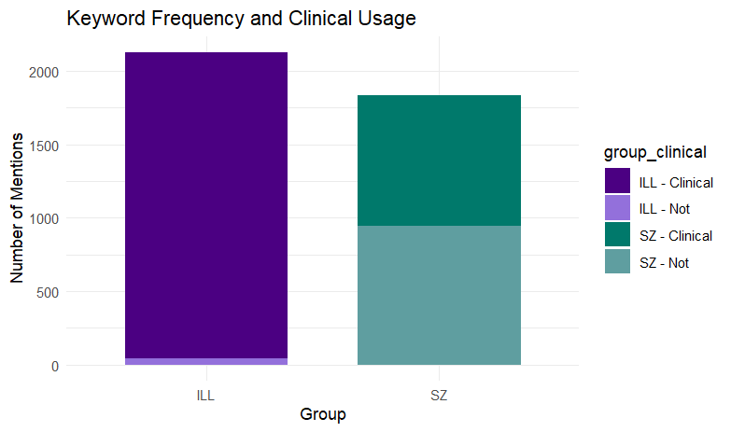
Results: Clinical Usage
Psychosis-illness group: 48.79% clinical use
Comparison-illnesses group: 97.46% non-clinical use
z = 35.00, p < .001
Undeterminable use: psychosis-illness group = 0.026%, comparison-illnesses group = 0.094% (p > .05)

Slide 14
Methods: Sentiment
Twitter-roBERTa-base for Sentiment Analysis: % of Negative, Positive or Neutral Sentiment
Negative | “(…) This man was [psychotic] , he didn`t know right from wrong. GRACE: You know, what? Here`s the thing, Robin. He didn`t kill himself, all right? But he managed to mow down, kill, shoot both of his little girls, and we know the motive. (…) ”
Positive | “ (…) He missed the entire 2018-19 season after undergoing treatment for Hodgkin's [lymphoma] diagnosed in December of 2018. Parrot completing his chemotherapy in late June of 2019 and returning to action. Really remarkable achievement for him. (…) ”
Neutral | “(…) DR. MANEL ESTELLER, CO-AUTHOR OF STUDY ON DOPPELGANGERS AND DIRECTOR, JOSEP CARRERAS [Leukaemia] RESEARCH INSTITUTE: So, we look at these people that they share the same faces. (…) ”

Slide 15
Methods: Sentiment
Positive / Negative Sentiment = β₀ + β₁ (Illness Group) + β₂ (Network) + β₃ (Illness Group x Network)

Slide 16
Results: Sentiment
Main effect of illness group across positive and negative sentiment
Psychosis keyword extracts:
More negative: β = 0.078, t = 6.85, p < .001
Less positive: β = -0.10, t = -11.55, p < .001

Slide 17
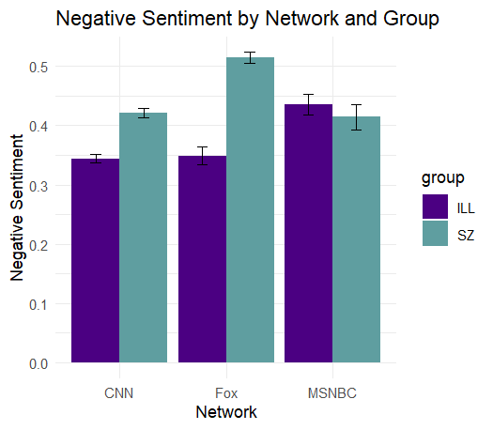
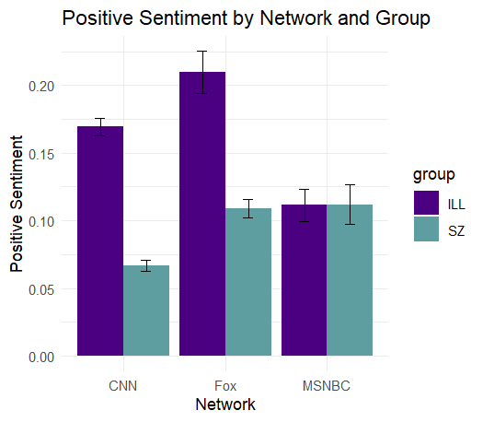
Results: Sentiment
Notes:
Proportion in axis

Slide 18
Discussion
When we use psychosis related words in news media it is a coinflip whether we are talking about psychosis-spectrum disorders.
Above and beyond comparable illnesses
Negative sentiment in language in news media replicates findings in the individual, meso and micro systems.

Slide 19
Words have power
Notes:
Give the words backs to people with lived experience

Slide 20
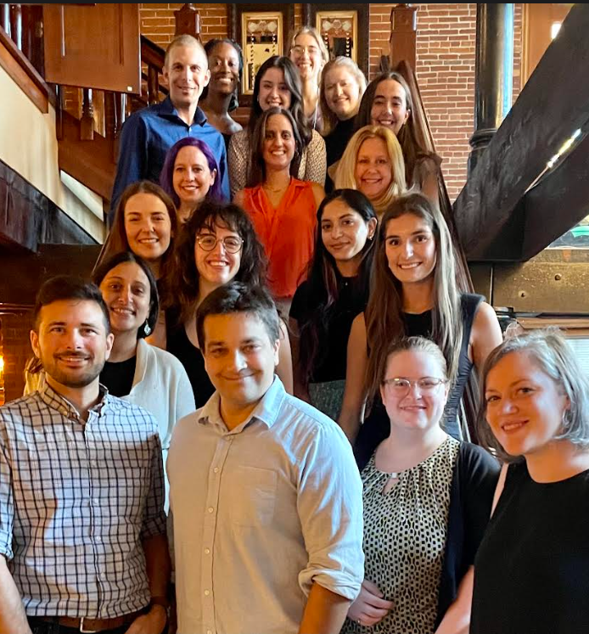
Acknowledgements
Dr. Vijay Mittal
The ADAPT Lab
Jason Schiffman & Rob Voigt
Raters: Jessica Fattal, Natalie Larson, Emily Park, Beckett Sands, Louis Flagel and Alani Cox-Cáceres
Data Management: Emily Park and Claire Marrie

