Slide 1


Large Language Model reveals selective insensitivity to global vs. local linguistic context in speech produced by treatment-naïve patients with positive thought disorder
AND
What Large Language Models can and can’t tell us about predictive processing in the brain
Gina R. Kuperberg, MD PhD
Dennett Stibel Professor in Cognitive Science
Tufts University
Athinoula A. Martinos Center for Biomedical Imaging
Massachusetts General Hospital

Slide 2


Assessment of Positive Thought Disorder:
Clinical ratings
Tangentiality & Derailment
“I always liked geography. My last teacher in that subject was Professor August A. He was a man with black eyes. I also like black eyes. There are also blue and grey eyes and other sorts, too...”
Bleuler, 1911/1950
Loosening of associations
“If you think you are being wise to send me a bill for money I have already paid, I am in nowise going to do so unless I get the whys and wherefores from you to me. But where the fours have been, then fives will be, and other numbers and calculations and accounts to your no-account….”
Maher, Manschreck, & Molino, 1983
1 – 2 – 3 – 4 – 5 – 6 – 7
e.g. Andreasen et al, 1979; Liddle et al., 2002
Subjective & time-consuming

Slide 3


Coherent language output
Speaker makes life easier for the listener by producing words that are somewhat predictable in relation to the prior context
I always liked geography. My last teacher in that subject was Professor August A…
“I always liked geography. My last teacher in that subject was Professor August A. He was a great professor who taught me so much about the world. His classroom was amazing, full of globes and maps.....”

Slide 4
Positive Thought Disorder:
Incoherent language output
Speaker makes life harder for the listener by producing words that are less predictable in relation to the prior context
I always liked geography. My last teacher in that subject was Professor August A…
?
“I always liked geography. My last teacher in that subject was Professor August A. He was a man with black eyes. I also like black eyes. There are also blue and grey eyes and other sorts, too...”

Slide 5

An objective measure of each produced word’s predictability/probability/surprisal in relation to its prior context?
Human cloze ratings
LIME
LIME
LIME
LIME
LIME
LIME
LIME
LEMON
LEMON
MUSTARD
Tilo was eating tacos at the Mexican restaurant. He squeezed the...
Taylor, Journal Q, 1953
Large Language Models
P (target word | context)
DECODER
. . .
. . .
Feedforward neural network
tacos
restaurant …
Masked self-attention
lime
. . .
DECODER

Slide 6
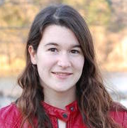

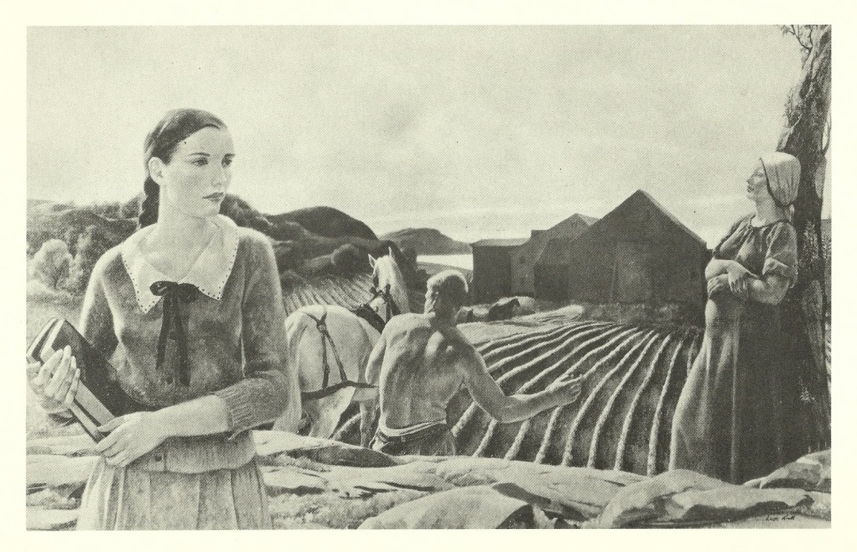
Use of LLMs to quantify positive thought disorder by examining the probability of each word, given prior context during natural language production in schizophrenia
74 first-episode psychosis patients
36 healthy controls
Symptoms assessed using the PANSS.
1-minute descriptions of 3 different pictures from the Thematic Apperception Test
Thought and Language Index (TLI; Liddle et al., 2002)
Discourse protocol: https://discourseinpsychosis.org/resources/

Slide 7



We used GPT-3 to estimate each word’s predictability/probability in natural speech production
Speech description
Speech transcripts
GPT-3 via openAI API
Text preprocessing
🚫 excluded function words, disfluencies
P(target word| context)
Lexical probability = -1 * log(P(target word | context)
(log transformed: more predictable → less surprising)

Slide 8
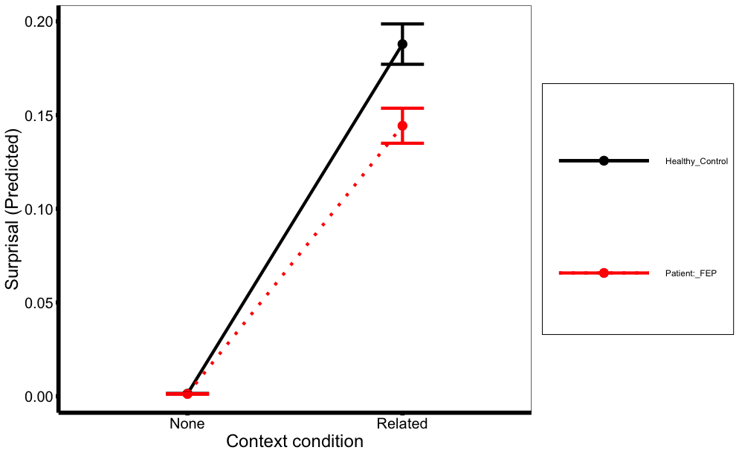
Reduced use of context to modulate probability
of each word produced in schizophrenia
0.20
0.15
Lexical Probability
0.10
HC
0.05
FEP
0.00
UnrelatedScrambled Context
AllAvailable Context

Slide 9

Positive thought disorder:
?? A selective impairment in using global vs. local context
“I always liked geography.
My last teacher in that subject was Professor August A.
He was a man with black eyes.
I also like black eyes.
There are also blue and grey eyes and other sorts, too...”
e.g. Andreasen et al, 1979; Liddle et al., 2002
Tangentiality & Derailment
1 – 2 – 3 – 4 – 5 – 6 – 7
Subjective & time-consuming
Notes:
[

Slide 10
Positive thought disorder:
Objectively quantifying a selective impairment in using global vs. local context
“I always liked geography. My last teacher in that subject was Professor August A. He was a man with black eyes. I also like black eyes. There are also blue and grey eyes and other sorts, too...”
Speech samples
Scz: n=70; controls: n=36
P(target | N=1)
P(target | N=2)
GPT estimates probability based on contexts of increasing window sizes
…
P(target | N=3)
…
P(target | N=50)
_

Slide 11
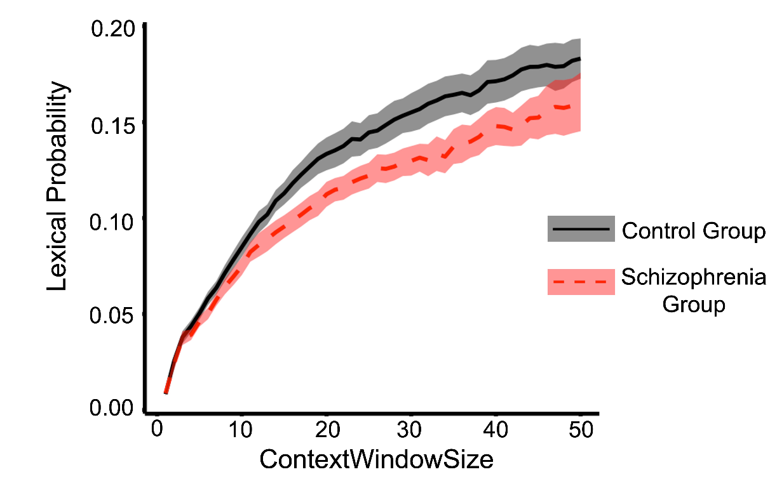
A selective impairment in using global context

Slide 12
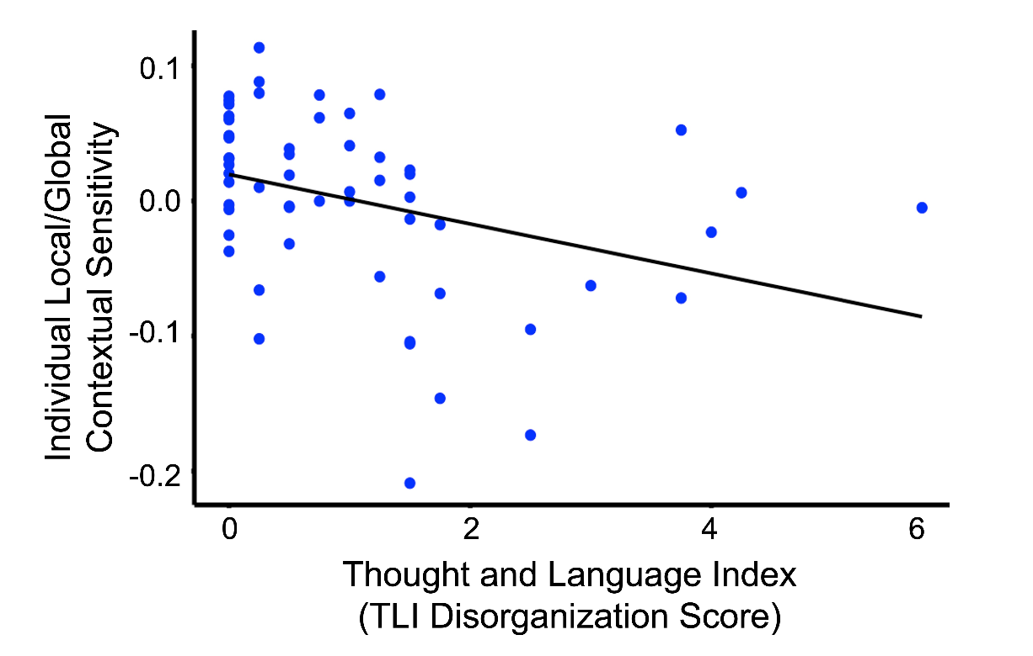
A selective impairment in using global context…
selectively predicts positive thought disorder

Slide 13

A selective impairment in using global context…
selectively predicts positive thought disorder
“Provides an automated, interpretable measure that can potentially be used to quantify speech disorganization in schizophrenia. Our findings directly link the clinical phenomenology of thought disorder to neurocognitive constructs that are grounded in psycholinguistic theory and neurobiology.”
STORED REAL-WORLD KNOWLEDGE
INTERPRETATION
❌
Impaired use of global context
DISCOURSE STRUCTURE
Context
EVENT STRUCTURE
✓
Preserved use of local context
SEM
SYNT
Lexical
Probability
Lexical
Sublexical
ORTH
PHON
Perceptual
visual
auditory

Slide 14

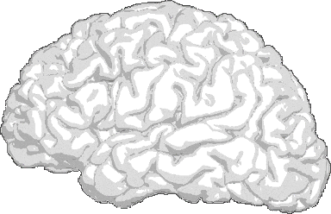
What Large Language Models
can and can’t tell us….
GPT
word1
70%
word2
30%
??
DECODER
Reviewer 1
. . .
. . .
Reviewer 2
Feedforward neural network
Masked self-attention
. . .
Reviewer 3
DECODER
INPUT
Reviewer 4
Reviewer 5
ENORMOUS Supplementary Materials
Table of Contents
1. Data Collection: Additional Methodological Details
2. Background: Context and Lexical Probability
3. Estimating Lexical Probability in Natural Language
4. The Present Study: Extraction of Lexical Probability Values Under Multiple Conditions
5. Preparation of Data for Statistical Analysis
6. Assumptions for Hypothesis Testing
7. Complete Results Tables for Analyses Reported in the Main Manuscript
8. Additional Statistical Analyses
50+ pages

Slide 15
Some Assumptions about Language Processing
STORED REAL-WORLD KNOWLEDGE
INTERPRETATION
Hierarchically structured
information represented at multiple temporal & spatial scales
DISCOURSE STRUCTURE
EVENT STRUCTURE
SEM
SYNT
Many constraints encoded
in the prior context “bottom out” to
inform the lexical properties
of each subsequent word
Lexical
Sublexical
ORTH
PHON
Perceptual
visual
auditory
“We were excited about the conference in Chicago. A group of us went out for dinner. At the restaurant Tilo got his tacos and asked for a …lime”

Slide 16
Some Assumptions about Language Processing
Dynamic & cooperative
Continually draw on shared linguistic & non-linguistic knowledge
At
the
restaurant,
Tilo
got
his
tacos
He
asked
for
a
…
lime
Comprehender
Producer
Words being produced one by one
Lexical bottleneck

Slide 17
Some Assumptions about Language Processing
Dynamic & cooperative
Continually draw on shared linguistic & non-linguistic knowledge
At
the
restaurant,
Tilo
got
his
tacos
He
asked
for
a
…
lime
Comprehender
Producer
Words being produced one by one
Use available context to
incrementally build hierarchical
representations
Continuously track
sequence of words
already produced
(the available context)
Lexical bottleneck
Use this information to
estimate the probability of
next word so that its processing
Is facilitated to the degree
that it has been pre-activated
Lexical probability is key
Adjust probability of each
subsequent word accordingly

Slide 18
Some Assumptions about Language Processing
STORED REAL-WORLD KNOWLEDGE
Hierarchically structured
information represented at multiple temporal & spatial scales
INTERPRETATION
DISCOURSE STRUCTURE
Incremental & interactive
EVENT STRUCTURE
SEM
SYNT
Lexical
Lexical probability:
Predictability of word in relation to
prior context as a function of
all linguistic/non-linguistic knowledge
encoded in the context
Sublexical
ORTH
PHON
Perceptual
visual
auditory

Slide 19
Some Facts about Language Processing
Lexical probability plays a central role
In healthy adults, the probability of each incoming word is an extremely robust predictor of both behavioral response times and neural activity
The more probable (predictable) a word is given the prior context
Faster to process (behavioral)
Cloze
Rayner & Well, Psych Bull Rev 1996; Brothers & Kuperberg, JML 2021
Evokes less neural activity
Cloze
Kutas & Hillyard, Nature 1984; DeLong, Urbach & Kutas, Nat Neurosci 2005; Brothers, Morgan, Yacovone, & Kuperberg, Cogn 2023
This is regardless of entropy/constraint of prior context

Slide 20
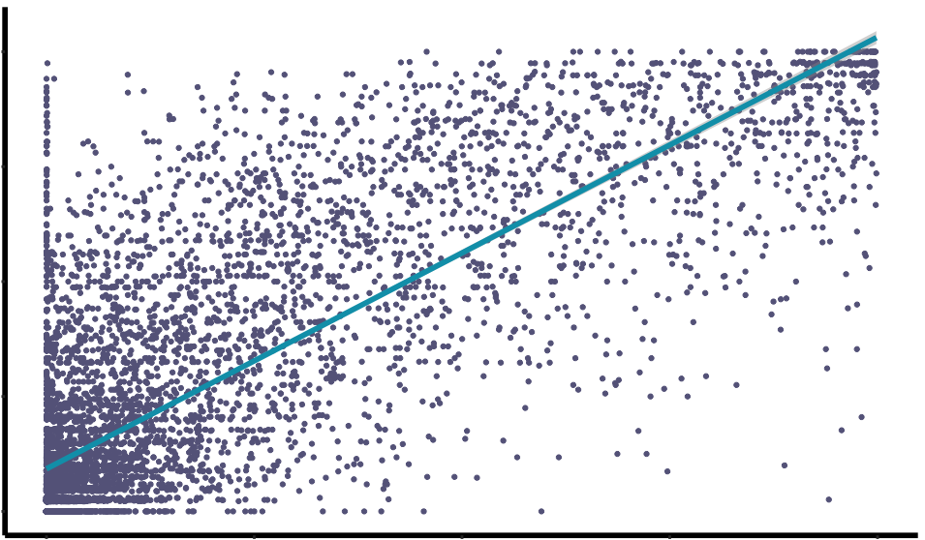

Large Language Models are v successful because they have been explicitly trained to do something that the brain does to optimize communication
LIME
70%
LEMON
30%
GPT
Once fully trained, model can take any context as an input & generate probabilities for any target token given that context.
DECODER
. . .
1.00
Feedforward neural network
. . .
0.75
Masked self-attention
DECODER
Cloze Probabilities
. . .
0.50
Predict missing token based on the context provided.
v. Large training set: (45 TB of text data)
Model adjusts parameters (including weights in “attention” mechanisms) to approximate the conditional probability distribution of tokens that could occur, given the context provided.
Unsupervised training
“Fine-tuning” to further optimize their parameters for particular tasks or purposes.
0.25
r = .81
0.00
0.00
0.25
0.50
0.75
1.00
GPT-2 Lexical Predictability

Slide 21
Some Facts about Language Processing
Lexical probability plays a central role
Effects are robust in natural language when lexical probability estimated using LLMs
The more probable (predictable) a word is given the prior context
Faster to process (behavioral)
Cloze
Rayner & Well, Psych Bull Rev 1996; Brothers & Kuperberg, JML 2021
LLMs
Boyce & Levy, Glossa Psycholing 2023; Shain, Meister, Pimentel, Cotterell, & Levy, PNAS 2024
Evokes less neural activity
Cloze
Kutas & Hillyard, Nature 1984; DeLong, Urbach & Kutas, Nat Neurosci 2005; Brothers, Morgan, Yacovone, & Kuperberg, Cogn 2023
LLMs
Michaelov et al., Neurobiol Lang 2024; Szewczyk & Federmeier, JML 2022

Slide 22
So back to our findings:
What Large Language Models can tell us
LIME
70%
LEMON
30%
GPT
DECODER
Encode statistical structure of human language!
i.e. captures contextual dependencies that are critical for producing coherent and normatively structured speech
. . .
. . .
Feedforward neural network
Masked self-attention
Such that they produce great estimates of lexical probability
DECODER
Which model???
They are all great!
Different models may generate more human-like estimates within different probability ranges
Most psycholinguistic studies:
Use models trained using prior (“left”) context
Because this is the only information comprehenders have access to during real-time speech. processing, and, to maintain coherence, producers must be sensitive to lexical probability based on the same context that is available to the comprehender.
e.g. GPT series; LLaMa

Slide 23
So back to our findings:
What Large Language Models can tell us
Context window size
(# prior words used to estimate lexical probability)
STORED REAL-WORLD KNOWLEDGE
INTERPRETATION
DISCOURSE STRUCTURE
Broad proxy for depth of
representational hierarchy
used to influence lexical probability.
EVENT STRUCTURE
SEM
SYNT
Lexical
Sublexical
ORTH
PHON
Perceptual
visual
auditory
Kuperberg & Jaeger, LCN, 2016

Slide 24
So back to our finding:
What Large Language Models can tell us
❌
Impaired use of global context
STORED REAL-WORLD KNOWLEDGE
INTERPRETATION
Estimates of lexical probabilities based
on the full global context will generally reflect
the use of information encoded
at both mid-levels and higher levels
DISCOURSE STRUCTURE
EVENT STRUCTURE
✓
Preserved use of local context
SEM
SYNT
Estimates of lexical probability based
only on a local context:
Reflect the use of information encoded
at mid-levels but but not higher levels
Lexical
Probability
Lexical
Sublexical
ORTH
PHON
Perceptual
visual
auditory

Slide 25
What Large Language Models cannot tell us
Why the brain predicts
Large Language Models (like GPT)
are trained to predict
The brain is not trained to predict!
LIME
70%
LEMON
30%
GPT
DECODER
. . .
. . .
Feedforward neural network
Masked self-attention
. . .
DECODER

Slide 26
What Large Language Models cannot tell us
The precise internal representations the brain uses to predict
LIME
70%
LEMON
30%
STORED REAL-WORLD KNOWLEDGE
GPT
INTERPRETATION
DECODER
. . .
DISCOURSE STRUCTURE
. . .
???
Feedforward neural network
Masked self-attention
EVENT STRUCTURE
. . .
DECODER
SEM
SYNT
Lexical
Sublexical
ORTH
PHON
Perceptual
visual
auditory
Kuperberg & Jaeger, LCN, 2016

Slide 27
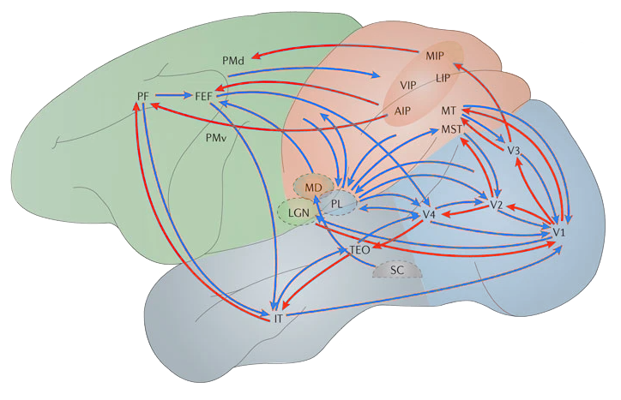
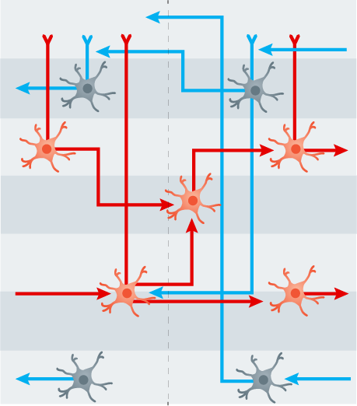
What Large Language Models cannot tell us
How the brain predicts: Connectivity
Feedforward connections
Feedforward + Feedback connections
LIME
70%
LEMON
30%
GPT
DECODER
. . .
. . .
Adapted from Gilbert & Li, Nat Rev Neurosci, 2013
Feedforward neural network
Feedforward
Masked self-attention
Lower level
Higher level
Feedback
. . .
L1
DECODER
*
L2/3A
L3B
L4
L5A
Axon
L5B
Dendrite
Adapted from Roelfsema & Holtmaat, Nat Rev Neurosci, 2018
L6
See also:
Mumford, Biol Cybern, 1992; Bastos et al., Neuron, 2012

Slide 28
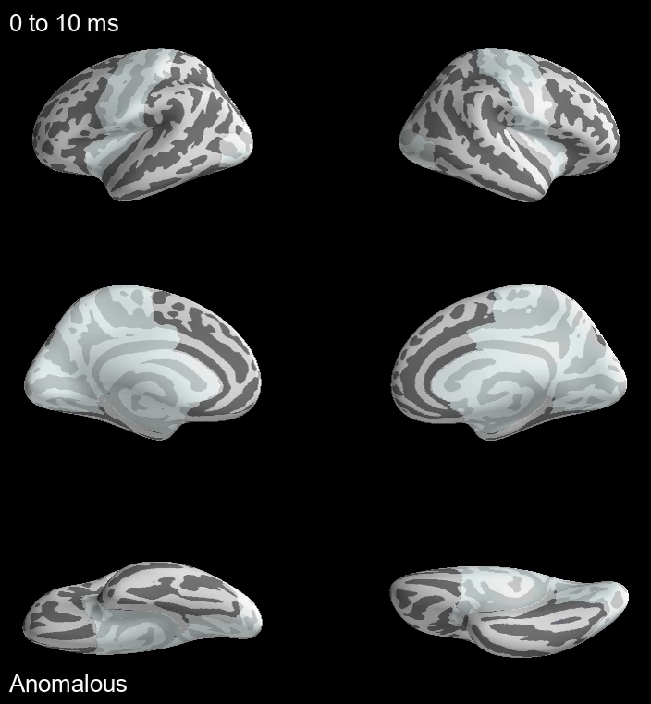

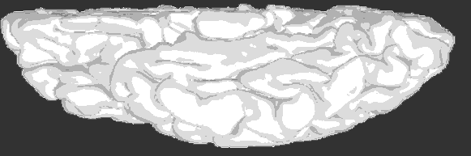
What Large Language Models cannot tell us
Where & when the lexical predictive effects are observed in the brain
Left temporal and inferior frontal cortex
N400 effect
Unpred. − Pred.
ms
-2µV
450
1sec
400
300 400 500
350
300
250
300-500ms

Slide 29
And LLMs definitely cannot tell us that the brain
does predictive coding!
What isn’t Predictive Coding?
Anything-to-do-with-prediction-in-the-brain
Any signature of “Prediction Error”
Linguistic Violation
Bayesian inference in the brain (one way of approximating this)
Linguistic Error (anomaly)

Slide 30
What is Predictive Coding?
Mumford, 1992; Rao & Ballard, 1999; Spratling, 2016
Top-down route
A particular network architecture…
Two types of units at each layer
Feedforward & feedback connections
Only residual
top-down
information
Error Units
Bottom-up & Top-down routes
State Units
…that implements a particular optimization algorithm
Error Units
Minimizes information redundancy
across cortical hierarchy
State Units
Only residual
bottom-up
information
Approximates Bayesian inference:
Infer ”cause” of bottom-up input
Error Units
State Units
Bottom-up route

Slide 31
What is Predictive Coding?
Mumford, 1992; Rao & Ballard, 1999; Spratling, 2016
Prior state: i-1
Current state: i
A particular network architecture…
Two types of units at each layer
Bottom-up & top-down routes
Error Units
PE
STnew
tdR
Feedforward & feedback connections
State Units
STold
PE
STnew
…that implements a particular optimization algorithm
Error Units
PE
STnew
tdR
Minimizes information redundancy
across cortical hierarchy
State Units
STold
PE
STnew
Inhibitory feedback Reconstruction (tdR)
Approximates Bayesian inference:
Infer ”cause” of bottom-up input
Error Units
PE
ST
tdR
State Units
ST
Bottom-up route

Slide 32
What is Predictive Coding?
Mumford, 1992; Rao & Ballard, 1999; Spratling, 2016
Prior state: i-1
Current state: i
A particular network architecture…
Two types of units at each layer
Bottom-up & top-down routes
Feedforward & feedback connections
STi-2 STi-1
STi-1
PE
STi
Reconstruction (tdR)
…that implements a particular optimization algorithm
PE
STi
tdR
Minimizes information redundancy
across cortical hierarchy
STi
Approximates Bayesian inference:
Infer ”cause” of bottom-up input
Bottom-up route

Slide 33
What is Predictive Coding?
Mumford, 1992; Rao & Ballard, 1999; Spratling, 2016
Prior state: i
Current state: i+1
A particular network architecture…
Two types of units at each layer
Bottom-up & top-down routes
Feedforward & feedback connections
STi-1 STi
STi
PE
STi+1
Reconstruction (tdR)
…that implements a particular optimization algorithm
PE
STi+1
tdR
Minimizes information redundancy
across cortical hierarchy
STi+1
Approximates Bayesian inference:
Infer ”cause” of bottom-up input
Bottom-up route

Slide 34
What is Predictive Coding?
Mumford, 1992; Rao & Ballard, 1999; Spratling, 2016
Prior state: i+1
Current state: i+2
A particular network architecture…
Two types of units at each layer
Bottom-up & top-down routes
Feedforward & feedback connections
STi STi+1
STi+1
PE
STi+2
Reconstruction (tdR)
…that implements a particular optimization algorithm
PE
STi+2
tdR
Minimizes information redundancy
across cortical hierarchy
STi+2
Approximates Bayesian inference:
Infer ”cause” of bottom-up input
Bottom-up route

Slide 35
What is Predictive Coding?
Mumford, 1992; Rao & Ballard, 1999; Spratling, 2016
Prior state: i+2
Current state: i+3
A particular network architecture…
Two types of units at each layer
Bottom-up & top-down routes
Feedforward & feedback connections
STi+1 STi+2
STi+2
PE
STi+3
Reconstruction (tdR)
…that implements a particular optimization algorithm
PE
STi+3
tdR
Minimizes information redundancy
across cortical hierarchy
STi+3
Approximates Bayesian inference:
Infer ”cause” of bottom-up input
Bottom-up route

Slide 36




An implemented predictive coding model of language processing…
Nour Eddine, Brothers, Wang, Spratling & Kuperberg, Cognition, 2024
Error Units
Semantic Feature: 3715
<small>
<green>
State Units
<crying>
<human>
<edible>
Error Units
Lexical Units: 1579
State Units
LIME
BABY
CAKE
…
Error Units
Orthographic Units: 104
1
…
…
2
…
…
State Units
3
…
…
4
A
B
C
…
Y
…

Slide 37








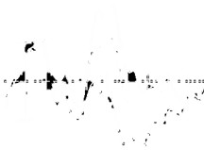

An implemented model of coding can explain….
Top-down contextual effects:
Consequence of predictive pre-activation
Priming effects:
Consequence of bottom-up activation
Bottom-up “lexical” effects:
Consequence of bottom-up activation
Interactions
Repetition priming
Frequency
Real data
Simulations
Real data
400
Simulations
Unrepeated
400
Low Freq
Repeated
High Freq
200
Real data
Simulations
Cz
-2μv
200
Lexico-semantic PE
Lexico-semantic PE
Cz
-2μv
800ms
800ms
Low cloze
400
0
0
-2μv
Med cloze
-5
0
5
10
15
20
-5
0
5
10
15
20
Pz
High cloze
Iterations after word onset
Iterations after word onset
200
Lexico-semantic PE
Misra & Holcomb, Psychophysiol, 2003
Van Petten & Kutas, Mem Cognit, 1990
800ms
0
-5
0
5
10
15
20
Iterations after word onset
Semantic priming
Orthographic Neighborhood Size
From Brothers, Morgan, Yacovone & Kuperberg, Cognition ,2023
Real data
Simulations
Real data
Simulations
Unrelated
400
400
Related
High ON
-2μv
Low ON
200
Cz
Lexico-semantic PE
-2μv
200
Lexico-semantic PE
Pz
800ms
800ms
0
-5
0
5
10
15
20
0
Iterations after word onset
-5
0
5
10
15
20
Iterations after word onset
Kreher, Holcomb & Kuperberg, Psychophysiol, 2006
Holcomb, Grainger, & O’Rourke, JCN, 2002
Nour Eddine, Brothers, Wang, Spratling & Kuperberg, Cognition, 2024

Slide 38
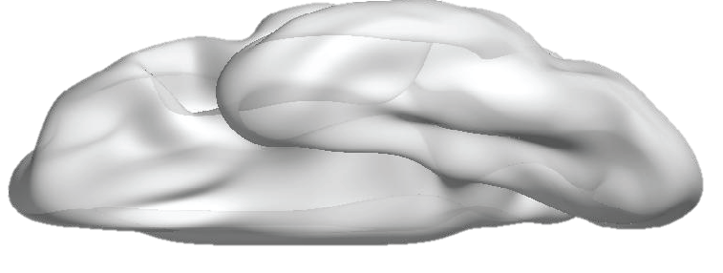
An implemented model of predictive coding can explain….
Expected (State)
Localization of both evoked & multivariate activity
Normalized
State &
Error
activity
Wang, Nour Eddine, Brothers & Kuperberg, NeuroImage 2025
Unexpected (State)
Unexpected (Error)
Expected (Error)
1
7
15
-5
0
5
10
15
Iteration #
Mix error & state outputs and project to 20-voxel space
MEG: Evoked effect
Expected
Unexpected > Expected
Unexpected
80
1000
Compute pairwise similarity amongst spatial patterns within this space
(nAm)
Within-expected
200
400
600
800
time (ms)
Critical word
Between expected/
unexpected
MEG: Neural similarity effect
Simulated effect: Within Expected > Between Expected/Unexpected
Within Expected > Between Expected/Unexpected
0.02
∆r
0.1
∆r
200
400
600
800
-5
0
5
10
15
20
Critical word
time (ms)

Slide 39
An implemented predictive coding model of language processing…
…naturally solves 5 fundamental puzzles
in language comprehension
1. The “Brain Behavior Dynamics” Puzzle
2. The “Neuroanatomical Localization” Puzzle
Error Units
Semantic Feature: 3715
<small>
<green>
State Units
<crying>
3. The “Prediction Error vs. Sharpening” Puzzle
<human>
<edible>
Error Units
4. The “No-cost of Top-down Predictions” Puzzle
Lexical Units: 1579
State Units
LIME
BABY
CAKE
…
5. The “Hallucinations” Puzzle
Error Units
Orthographic Units: 104
1
…
…
2
…
…
State Units
3
…
…
4
A
B
C
…
Y
…
Nour Eddine, Brothers, Wang, Spratling & Kuperberg, Cognition, 2024

Slide 40
Future Goals: Complementary Use of Large & Small Language Models
to understand thought disorder in schizophrenia
LIME
70%
LEMON
30%
Error Units
GPT
Semantic Feature: 3715
<small>
<green>
State Units
<crying>
DECODER
<human>
<edible>
. . .
. . .
???
Feedforward neural network
Error Units
Masked self-attention
Lexical Units: 1579
. . .
State Units
LIME
BABY
CAKE
…
DECODER
Error Units
Orthographic Units: 104
1
…
…
2
…
…
State Units
3
…
…
4
A
B
C
…
Y
…
Nour Eddine, Brothers, Wang, Spratling & Kuperberg, Cognition, 2024

Slide 41







Thank you!
Thank you to:
National Institute of Child Health and Human Development: R01HD082527
Sidney R. Baer Jr., Foundation
Jeff Stibel

