Slide 1
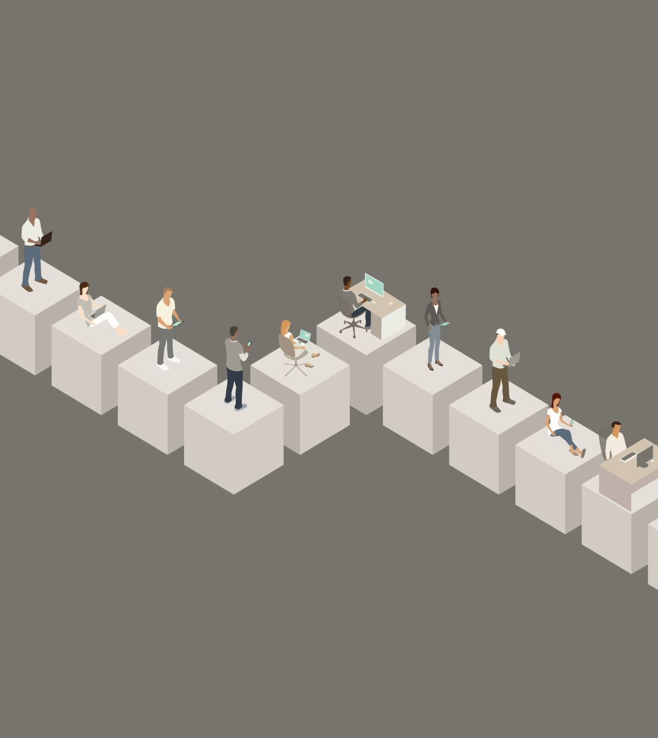
Working Groups
Overview of 5 groups
Group leaders to present progress
Interactions on
directions to take
new areas of work
ideas to pursue

Slide 2
Psychosis Talkbank v1.0 Release Today
Thanks to Brian MacWhinney & team’s tireless efforts
/ Rosa Ayesa Arriola

Slide 3
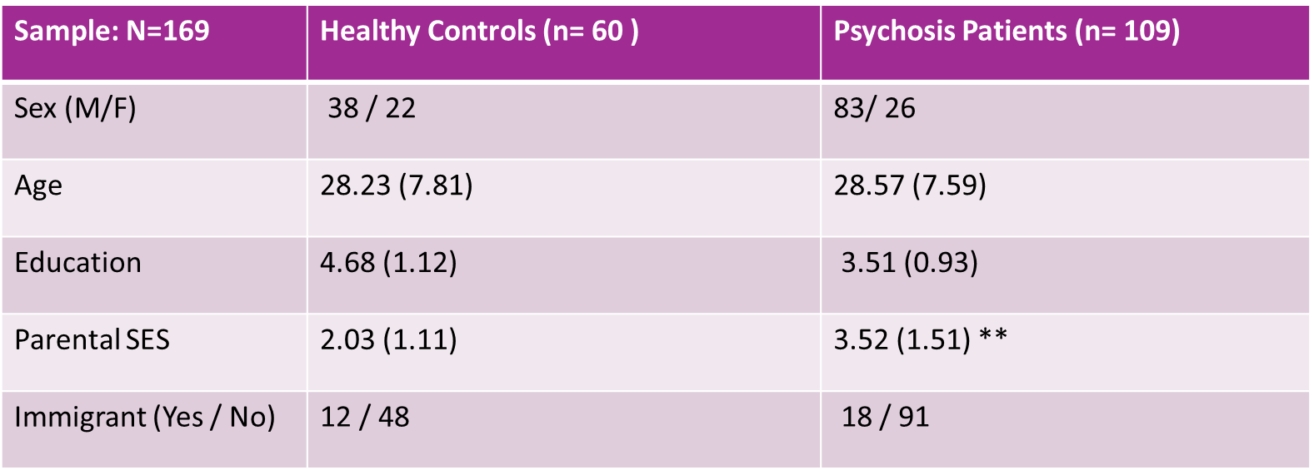
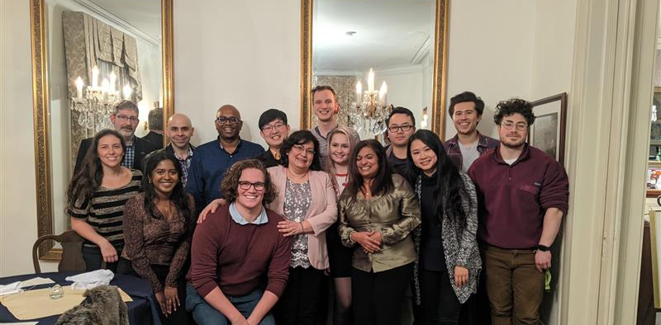
Western Ontario (UWO) dataset
Joseph Rea Foundation
R.M. Bucke Funds
7 items | features
Free conversational | Social discourse
Personal narrative | Self reflective content
Health narrative | Health content, insight
Picture description | Discursive discourse (referent)
Comic strip | Sequence, Mental State Talk
Dream Reports | Corpus free graph analysis
Read & Recall | Ground truth

Slide 4
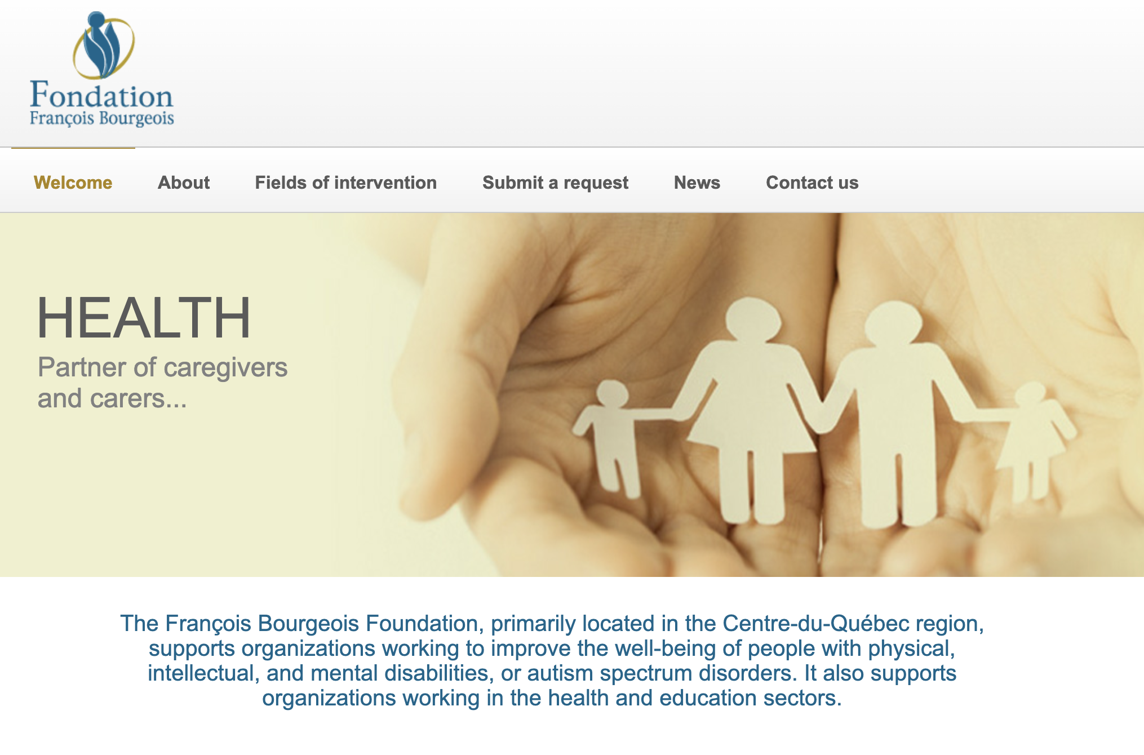
Annual Awards
13 Awardees
10 Annual Awards - Judged by a panel led by Natalia Mota
3 Poster Awards – judged by Rui He, Michael Spilka and Luz Maria Alliende Serra
https://www.fondationfrancoisbourgeois.org/

Slide 5
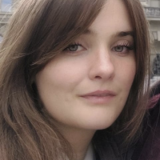
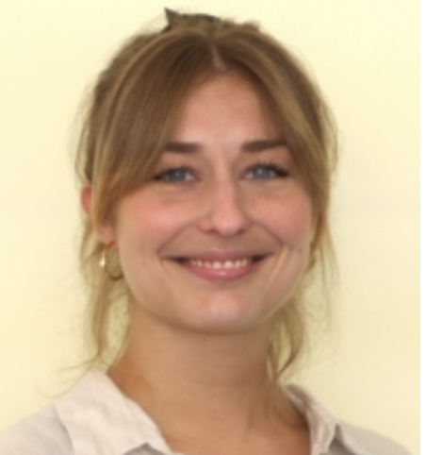
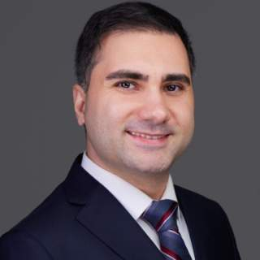
Fiona Meister - The Bourgeois Chair Prize. This is awarded in reference to the relevance of the recipient’s work to developmental disorders. Amir H. Nikzad - DISCOURSE Rising Star Award . This is awarded in reference to the relevance of the recipient’s continued contribution and its potential to the study of language in psychiatric disorders. Rieke Roxanne Mülfarth - DISCOURSE Open Science Award. This is awarded in reference to the potential of the recipient’s contribution to be applied to the open source datasets that are being made available through the consortium. A total of C$2500 shared among awardees

Slide 6
7 DISCOURSE Early Career Awardees
Hsi (Tiana) Wei, Canada Gowtham Premananth, USA Stefannye dos Santos, Brazil Burcu Verim, Turkey Yingqi Laetitia Wang, Canada Elisabeth Friederike Sterner, Germany Frederike Stein, Germany
A total of C$3500 shared among awardees

Slide 7
Poster Awardees

Slide 8
We will hear more from these stars
Awardees will be contributing to our Annual Webinar series
+ Please send your posters to Betsy to upload on the website.

Slide 9
Closing Remarks
Lena & Sunny

Slide 10
THANKS to the energetic minds behind this day
Vijay Mittal & ADAPT lab team at Northwestern Sophia Parmacek Madison Stevens Hailey Rich
Luz Maria Alliende Serra
2025 Program committee Natalia Mota Rui He Paulina Dzialoszynski Betsy Schaefer
Awards selection panel
Luz Maria Alliende Serra and Natalia Mota
Rui He, Michael Spilka and Luz Maria Alliende Serra

Slide 11
What have we done so far?
Workgroups
Psychosis TalkBank Release v1.0
Critical mass of data collected in the same way (DISCOURSE protocol). - Thanks to María Francisca Alonso & Claudio Palominos
Danish n=13
Croatian n=25
Serbian n=36 (Transdiag.)
Melbourne n=100
Braz. Portuguese n= 90 (3 sites)*
Quebec. French n= 35
Spanish (Santander) n= 200+ *
Turkish n>200 (Transdiag.)*

Slide 12
What can we do in the near future?
Position papers from the consortia
Reporting standards for speech-NLP studies
Overcoming participatory barriers for people with lived experience
Use of shared data
Workgroup publications
Next year’s meeting in Italy - *tbc

Slide 13
Social event
Tallboy taco
Cash needed

