Slide 1
Discourse in Psychosis Working Group: Clinical Data Harmonization
Frederike Stein

Slide 2
Data-driven approaches for clinical harmonization
Clinical Data Harmonization

Slide 3
Previous work on dimensions of formal thought disorder
STUDY I: explorative and confirmatory factor analyses of FTD symptoms (SANS+SAPS) in two samples with a total N=1071 patients with affective and psychotic disorders
Factor | Symptom | Cronbach‘s Alpha | Brain structural associations
Disorganization | Tangentiality | .857
 | Derailment
 | Circumstantiality
 | Pressure of speech
Emptiness | Poverty of speech | .757
 | Poverty of content
 | Increased latency of response
 | Blocking
Incoherence | Incoherence | .728
 | Illogicality
 | Distractibility
Clinical Data Harmonization
Stein et al., 2022, Schizophrenia Bulletin

Slide 4
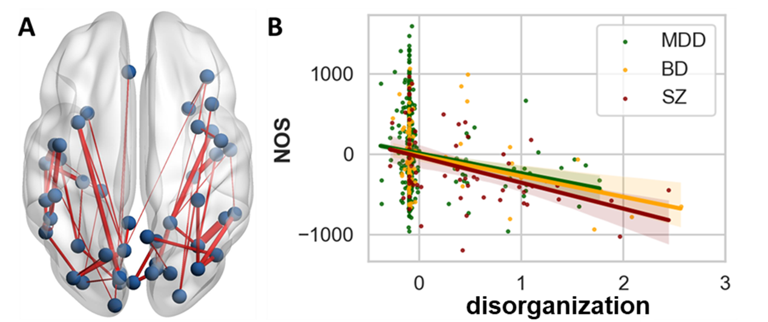
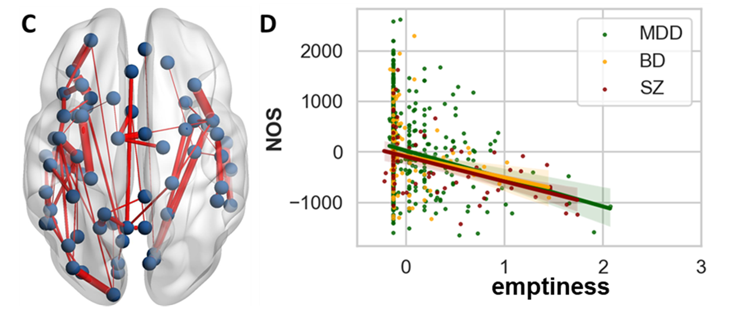
Previous work on dimensions of formal thought disorder
STUDY II: Association of FTD dimensions with the structural connectome in N=1071 patients with affective and psychotic disorders
Factor | Symptom | Cronbach‘s Alpha | Brain structural associations
Disorganization | Tangentiality | .857
 | Derailment
 | Circumstantiality
 | Pressure of speech
Emptiness | Poverty of speech | .757
 | Poverty of content
 | Increased latency of response
 | Blocking
Clinical Data Harmonization
Stein et al., 2023, Biological Psychiatry

Slide 5
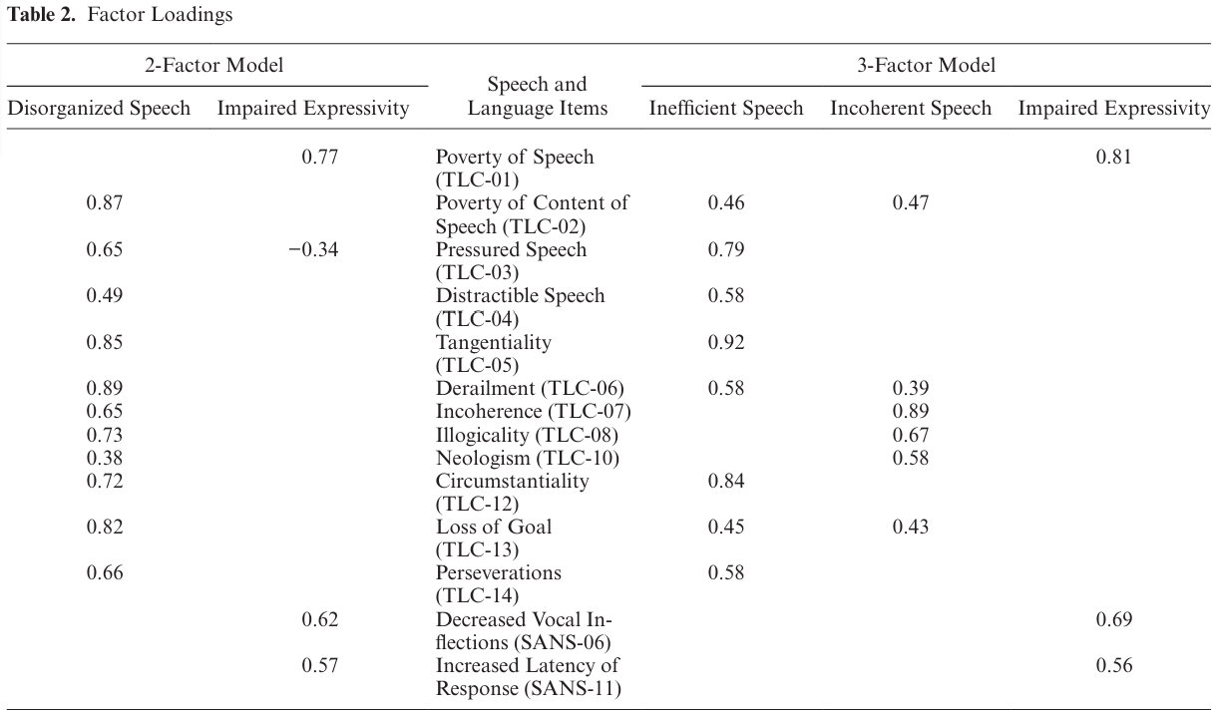
Previous work on dimensions of formal thought disorder
STUDY III: Latent Factors of Language Disturbance and Relationships to Quantitative Speech Features in a transdiagnostic sample N=343
Clinical Data Harmonization
Tang et al., 2023, Schizophrenia Bulletin

Slide 6
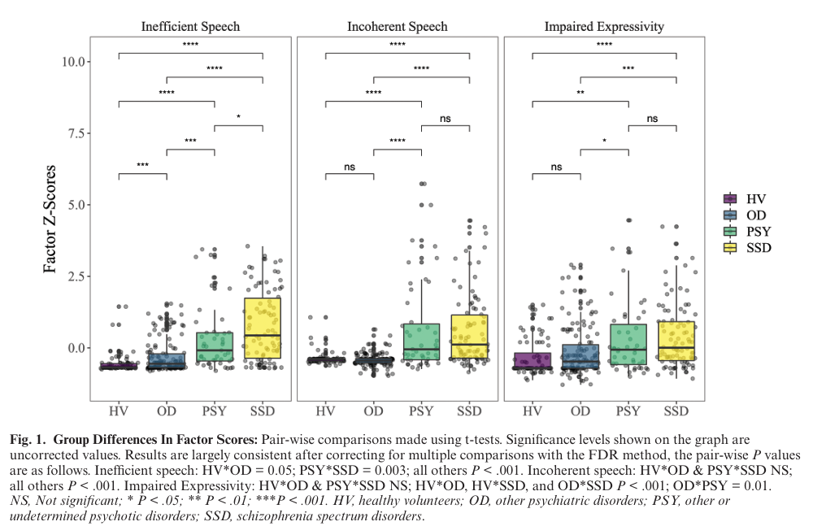
Previous work on dimensions of formal thought disorder
STUDY III: Latent Factors of Language Disturbance and Relationships to Quantitative Speech Features in a transdiagnostic sample N=343
Clinical Data Harmonization
Tang et al., 2023, Schizophrenia Bulletin

Slide 7
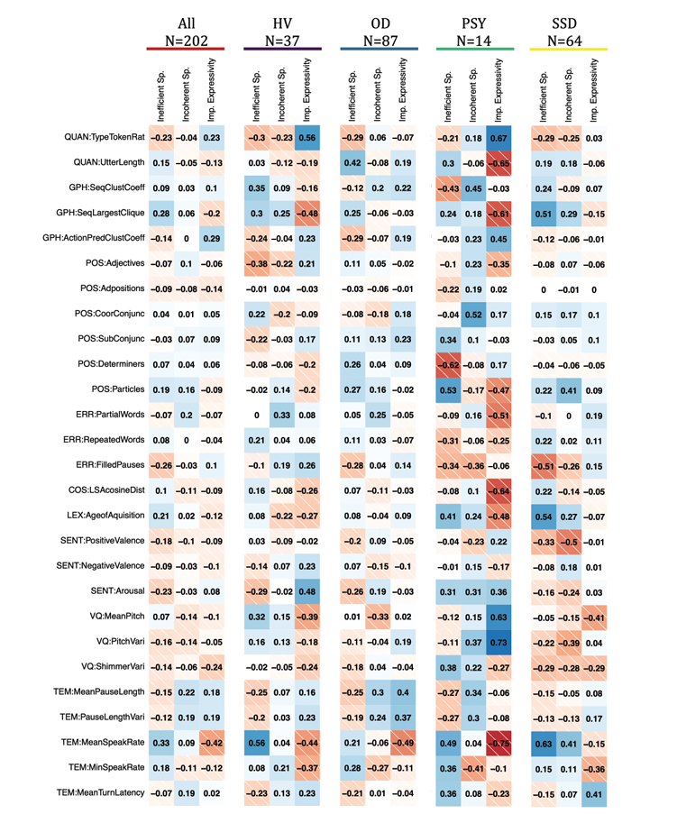
Previous work on dimensions of formal thought disorder
STUDY III: Latent Factors of Language Disturbance and Relationships to Quantitative Speech Features in a transdiagnostic sample N=343
Clinical Data Harmonization
Tang et al., 2023, Schizophrenia Bulletin

Slide 8
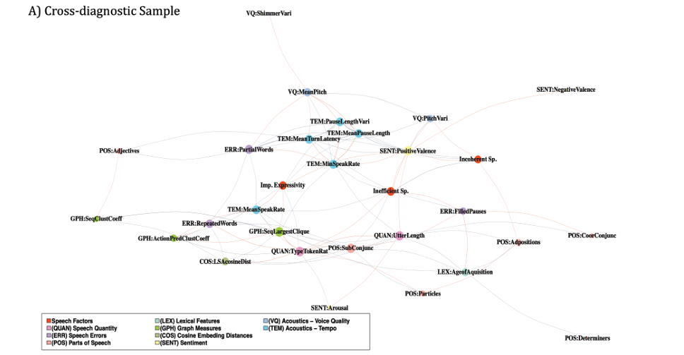
Previous work on dimensions of formal thought disorder
STUDY III: Latent Factors of Language Disturbance and Relationships to Quantitative Speech Features in a transdiagnostic sample N=343
Clinical Data Harmonization
Tang et al., 2023, Schizophrenia Bulletin

Slide 9
Dimensions of formal thought disorder across scales
Formal Thought Disorder is assessed using multiple rating scales
Lack of standardized scoring complicates cross-study comparisons and clinical assessments
However, evidence from Tang and Stein et al., for a 3-factor solution across disorders and across SANS, SAPS, TLC (all scales from the same author)
Our goal: Develop a harmonized “summary score” integrating key elements from existing scales
Clinical Data Harmonization

Slide 10
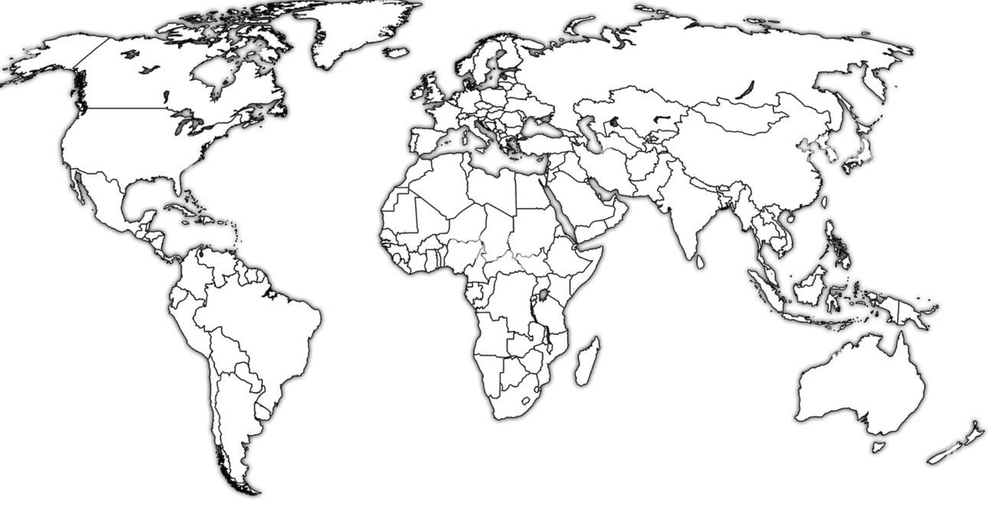
Dimensions of formal thought disorder across scales
FOR2107
TALD_Study
FOR2107_SPAPS project
Remora
LPOP
ACES
PsyCL
In-PsyCL
TLI_DEU_comb
TLI_DEU2
Early_schizobipolar_DEU
Discourse_lena
CAFLIP
TOPSY
IMPLEMENT
OCoPS-P
BrAGG-SoS
Gesture study
Discouse Santander
Discourse_BR-PR
Turkish adaptaion of TALD
RAPSODI
SCAANS
IPS
23 studies/samples
10 countries
8 languages:
PIs involved:
Tilo Kircher
Frederike Stein
Sunny Tang
Berna Yalincetin
Emre Bora
Lena Palaniyappan
Tim Crowe
Sebastian Walther
Rosa Ayesa Aricola
Raffael Massuda
Emre Mutlu
Iris Sommer
Sreeraj Venkatasubramanian
Katharina Stegmayer
Clinical Data Harmonization

Slide 11
Basic Information
Total sample size: 6,376 subjects (not counting multiple timepoints)
Groups included:
Healthy controls
Help seeking
First degree relation
Major Depression
Bipolar Disorder
Schizophrenia spectrum disorders
Dx methods:
DSM-IV / V and SCID I
ICD-10
Study exclusion criteria:
verbal IQ<80 or <70
history of head trauma or unconsciousness
severe medical illnesses (cancer, autoimmune diseases, and infections)
neurological illness
current substance dependence
substance induced disorders or disorders secondary to general medical condition
disorders affecting speech or language
movement disorders affecting speech
ECT
Type of FTD data acquisition:
semi-structured clinical interview or discourse interview
HC | MDD | BD | SSD | help seeking | other psychotic dx | first degree relation
2090 | 1398 | 380 | 2241 | 150 | 40 | 77
No. of sites with:
SANS | SAPS | TLI | TLC | TALD | PANSS | CDI
10 | 7 | 8 | 9 | 7 | 14 | 1
Clinical Data Harmonization

Slide 12
Top combinations
Combination | Sites | Total N | HC | MDD | BD | SSD
SANS + SAPS | FOR2107, TALD_Study FOR2107_SPAPS project PsyCL TLI_DEU2 SCAANS | 3770 | 1651 | 1374 | 285 | 460
SANS + SAPS + TALD | FOR2107 TALD_Study FOR2107_SPAPS project German | 918 | 403 | 392 | 69 | 54
SAPS + TLI | FOR2107_SPAPS project TLI_DEU2 Early_schizobipolar_DEU | 572 | 202 | 117 | 101 | 152
PANSS + TLI | TLI_DEU_comb Discourse_lena TOPSY IMPLEMENT | 557 | 158 | 0 | 0 | 399
SANS + TLC | TALD_Study Remora LPOP ACES PsyCL IPS | 540 | 156 | 63 | 20 | 301
Clinical Data Harmonization

Slide 13
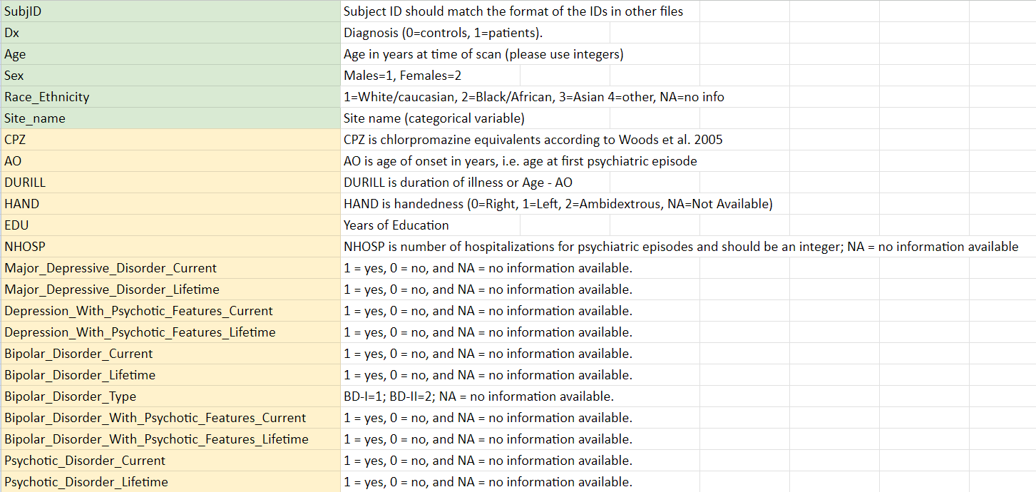
Variables for analysis
Diagnosis
Age
Sex
Medication (CPZ)
Age of Onset
Duration of illness
Years of education
Number of hospitalizations
At least one FTD rating scales:
SANS
SAPS
TALD
TLC
TLI
PANSS
BPRS
https://docs.google.com/spreadsheets/d/1rMlSYiAGoLqRmBzScq1hbZBAQOyiHLSvw9J2ikSxj4k/edit?usp=sharing
Clinical Data Harmonization

Slide 14
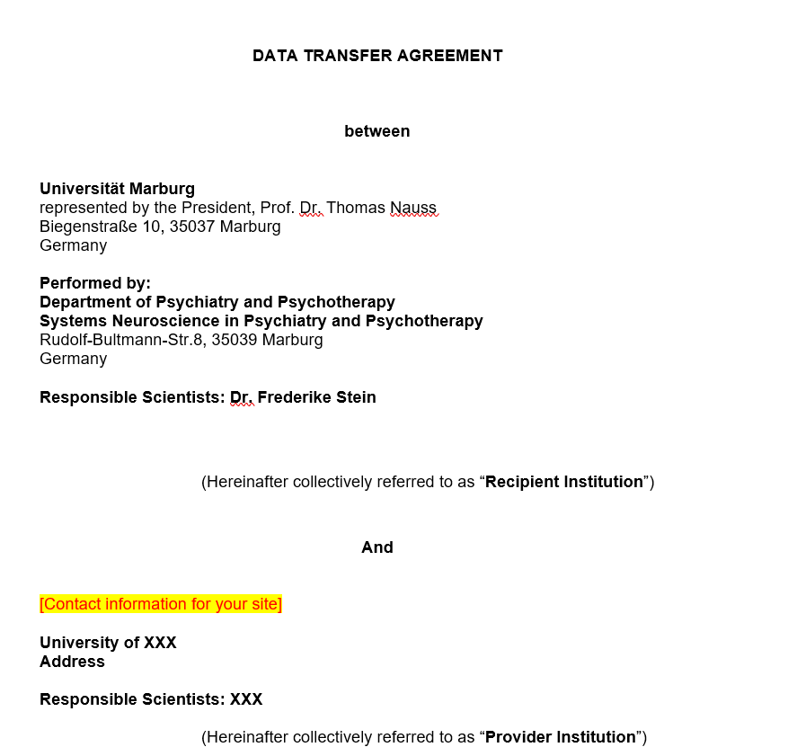
Data transfer agreement
DTA is prepared
In case you need a DTA please let us know
Adapt if necessary using tracked-mode
Clinical Data Harmonization

Slide 15
Analysis approach
Deidentified data will be processed by Dr. Frederike Stein and team, University of Marburg Germany, and aggregated for analysis:
Step 1: Poly-Correlations
Identify items/symptoms that can be collapsed, i.e., multi-colinearity
Step 2: Pairwise Correlation Matrix
Step 3: Random Forest Imputation
Impute missing data based on existing information (decide which variables should be used for that)
Step 4: Factor analysis
Exploratory
Confirmatory (could be of interest for sites that will not share single items)
Subsamples
Step 5: Method for computing factor scores
Clinical Data Harmonization

Slide 16
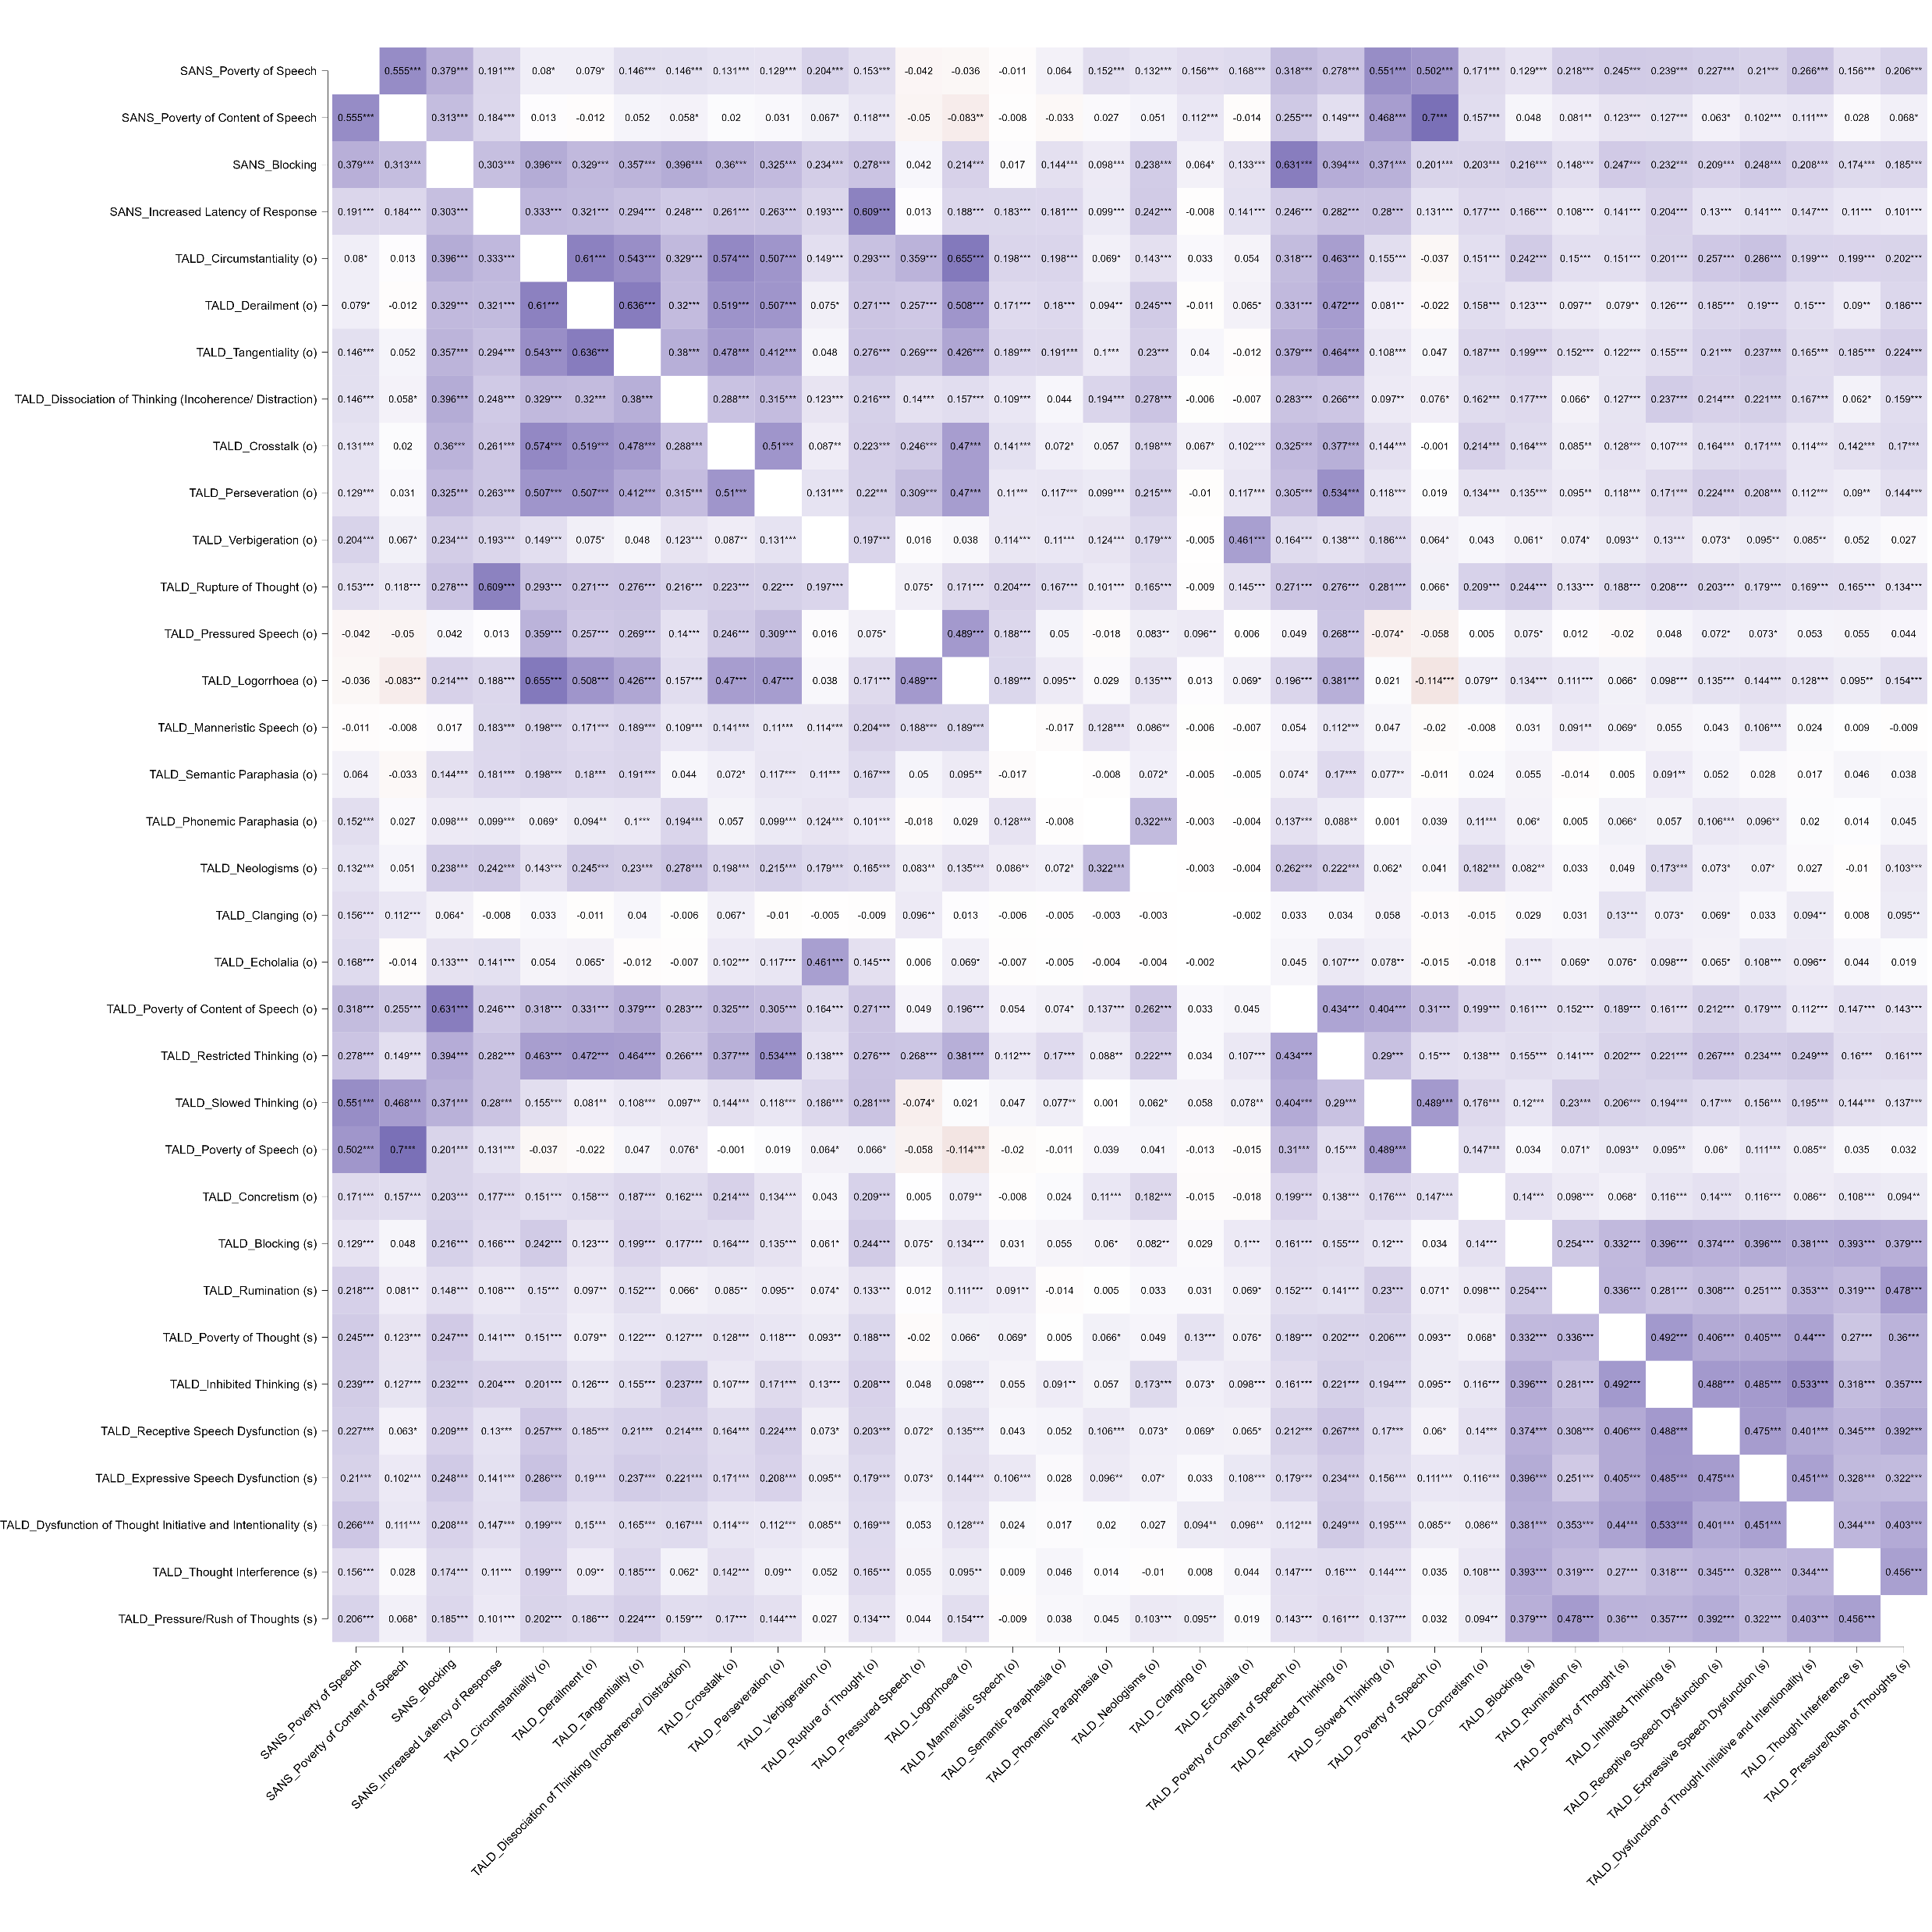
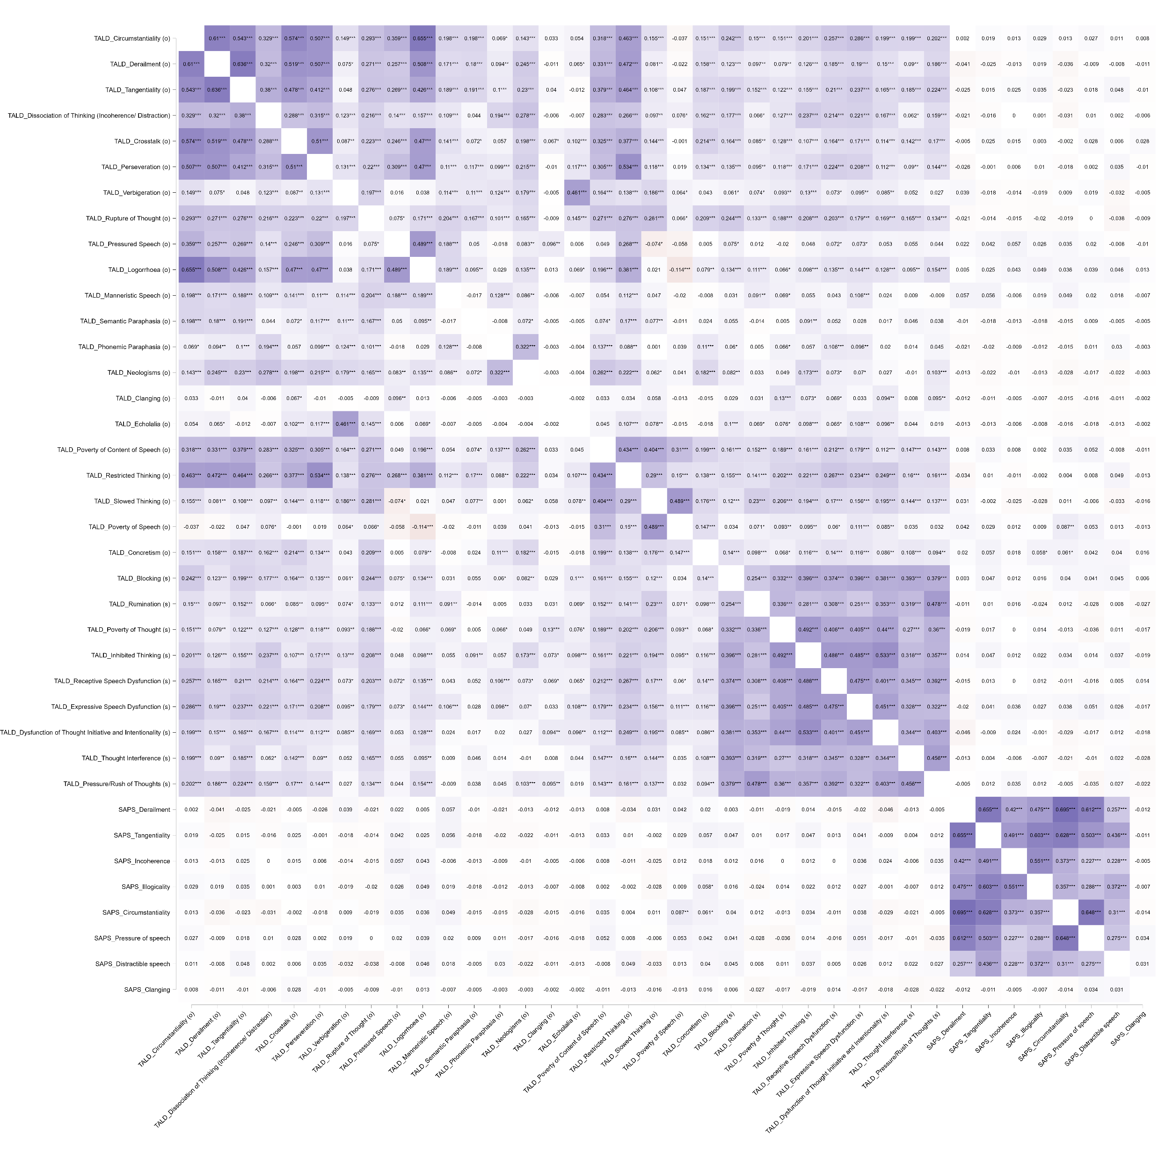
Analysis approach
Step 1: Poly-Correlations in the Marburg sample across SANS, SAPS, TALD N=1139
Clinical Data Harmonization

Slide 17
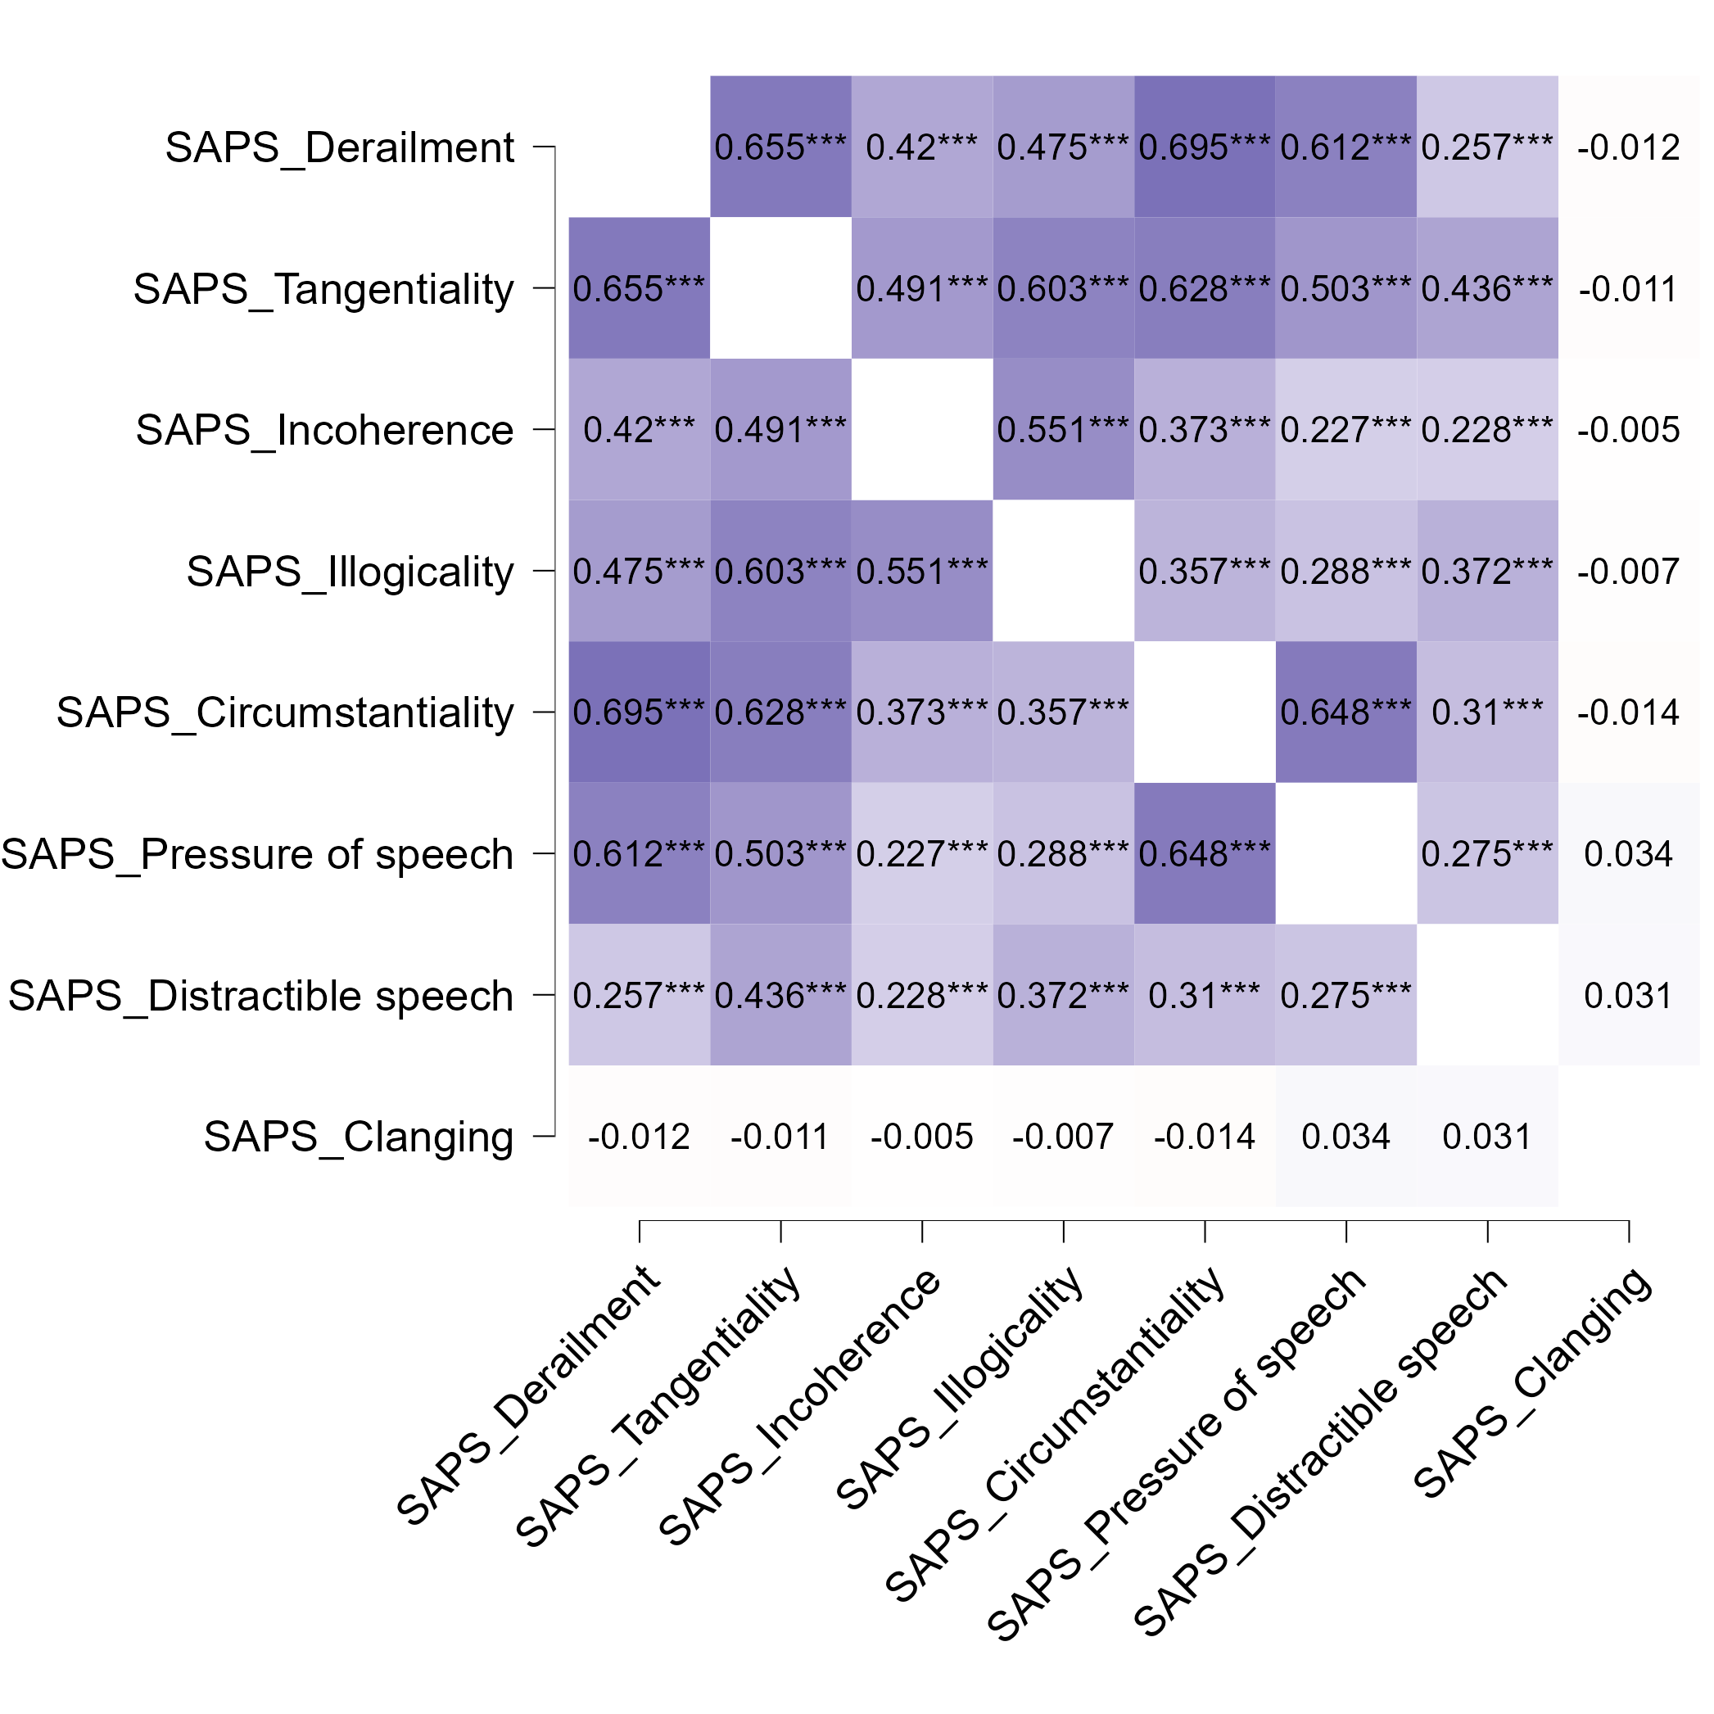
Analysis approach
Step 1: Poly-Correlations in the Marburg sample across SANS, SAPS, TALD N=1139
Correlations r > 0.6 within each of the scales but not across them even when looking at patients only
Clinical Data Harmonization

Slide 18
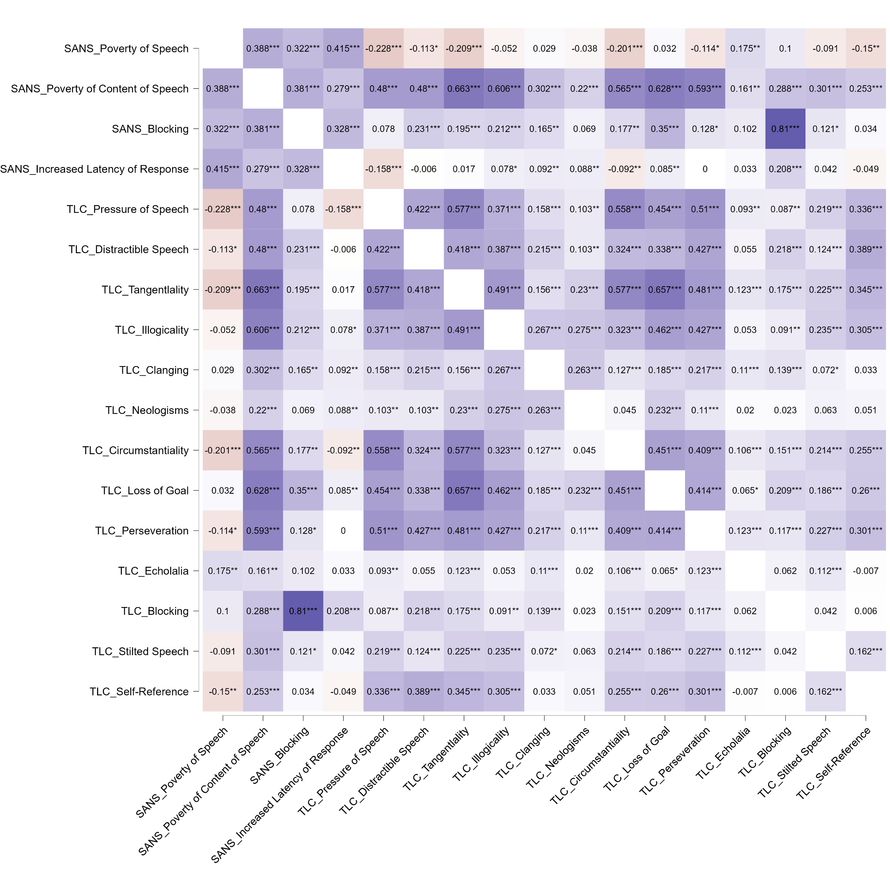
Analysis approach
Step 1: Poly-Correlations in the Tang samples across SANS, TLC N=600
Correlation r > 0.8 in TLC and SANS Blocking
Clinical Data Harmonization

Slide 19
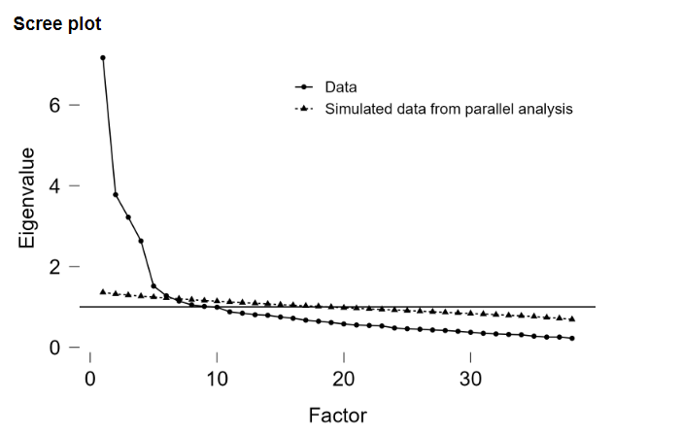
Analysis approach
Step 4: Exploratory Factor Analyses in the Marburg sample across SANS, SAPS, TALD N=1139
Factor extraction based on parallel analysis
Factoring method: Weighted least squares
Rotation oblique → promax
Clinical Data Harmonization

Slide 20
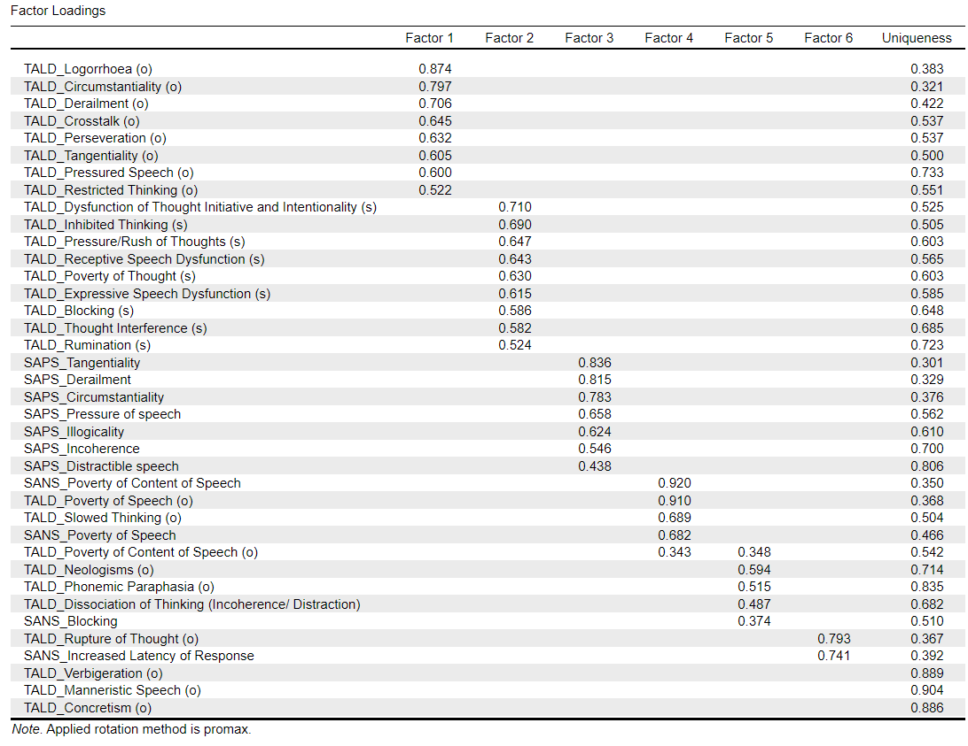
Analysis approach
Step 4: Exploratory Factor Analyses in the Marburg sample across SANS, SAPS, TALD N=1139
F1: TALD objective positive
F2: TALD subjective negative
F3: SAPS positive
F4: SAPS + TALD poverty
F5: TALD Neologisms
F6: Rupture of thought, increased latency of response
Clinical Data Harmonization

Slide 21
Analysis approach
Step 4: Exploratory Factor Analyses in the Marburg sample across SANS, SAPS, TALD N=1139
Clinical Data Harmonization

Slide 22
Next Steps
Data collection has started, currently 2 sites have provided data (Kircher + Tang) with TLC, SANS, SAPS, TALD as available scales
Set-up the code for analyses → partially done
Pre-liminary analyses in a smaller sample to investigate whether we are missing something → currently running
Clinical Data Harmonization

Slide 23
Thank you for your attention!
Clinical Data Harmonization

Slide 24
Basic Information
Combination | Sites | Total N | HC | MDD | BD | SSD
PANSS + SANS | PsyCL IPS | 169 | 0 | 0 | 0 | 169
PANSS + SAPS | PsyCL | 84 | 0 | 0 | 0 | 84
PANSS + TLI | TLI_DEU_comb Discourse_lena TOPSY IMPLEMENT | 557 | 158 | 0 | 0 | 399
PANSS + TLC | PsyCL CAFLIP Gesture study IPS | 311 | 0 | 0 | 0 | 311
PANSS + TALD | OCoPS-P BrAGG-SoS Turkish adaptaion of TALD RAPSODI | 334 | 35 | 24 | 20 | 255
PANSS + TLC + SANS | PsyCL IPS | 169 | 0 | 0 | 0 | 169
Clinical Data Harmonization

Slide 25
Basic information
Combination | Sites | Total N | HC | MDD | BD | SSD
SANS + SAPS | FOR2107 TALD_Study FOR2107_SPAPS project PsyCL TLI_DEU2 SCAANS | 3770 | 1651 | 1374 | 285 | 460
SANS + TLC | TALD_Study Remora LPOP ACES PsyCL IPS | 540 | 156 | 63 | 20 | 301
SAPS + TLI | FOR2107_SPAPS project TLI_DEU2 Early_schizobipolar_DEU | 572 | 202 | 117 | 101 | 152
SANS + SAPS + TALD | FOR2107 TALD_Study FOR2107_SPAPS project German | 918 | 403 | 392 | 69 | 54
Clinical Data Harmonization

Slide 26
Basic Information
Combination | Sites | Total N | HC | MDD | BD | SSD
SANS + SAPS + TLI + TALD | FOR2107_SPAPS project | 392 | 202 | 117 | 26 | 47
SAPS + SANS + TLC + TALD | TALD_Study | 210 | 64 | 63 | 20 | 63
Other scales assessed include:
HAM-D (6)
YMRS (8)
SPQ-B (1)
BPRS (4)
BNSS (2)
CLANG (1)
CASH (4)
CAINS (2)
BPS (1)
Clinical Data Harmonization

