Slide 1
Mechanisms and Models and Theory of Language Working Group
Maria Alonso Sanchez & Gina Kuperberg

Slide 2
Who are we?
?
?
?
?
There was a list
We had a zoom meeting and introduced ourselves
But then we got busy
🎉
And then Lena decided to write a huge grant…
…which meant that we all got very busy 🙂
(and we won it!)

Slide 3
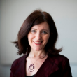
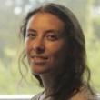
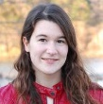
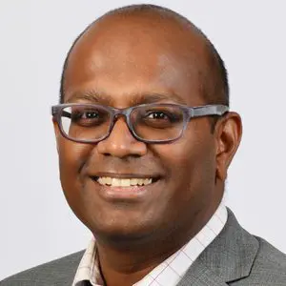
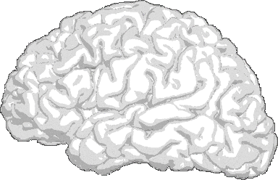
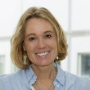
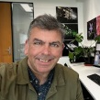
Activities: Lots of discussions of mechanisms and models
Gina Kuperberg
María Francisca Alonso Sanchez
GPT-3 reveals selective insensitivity to global vs. local linguistic context in speech produced by treatment-naïve patients with positive thought disorder. (Under review) bioRxiv. doi: 10.1101/2024.07.08.602512
Tori Sharpe
Reviewer 1
Reviewer 2
GPT
word1
70%
word2
30%
??
Lena Palaniyappan
DECODER
Reviewer 3
. . .
Valentina Bambini
. . .
Feedforward neural network
Reviewer 4
Masked self-attention
. . .
Susan Rossell
DECODER
Reviewer 5
INPUT
Tilo Kircher
Supplementary Materials
Iris Sommer
Table of Contents
1. Data Collection: Additional Methodological Details
2. Background: Context and Lexical Probability
3. Estimating Lexical Probability in Natural Language
4. The Present Study: Extraction of Lexical Probability Values Under Multiple Conditions
5. Preparation of Data for Statistical Analysis
6. Assumptions for Hypothesis Testing
7. Complete Results Tables for Analyses Reported in the Main Manuscript
8. Additional Statistical Analyses
Krish D Singh
Grant funded!
Neil Harrison
50+ pages

Slide 4
Mechanisms and Models of Language: Plans
Computational Methods Development
Open discussions on Zoom
Invited speakers from the psycholinguistics and computational linguistics communities
Clinical Harmonization
Clinical Translation
Collaborations through grants, e.g. Wellcome Trust Mental Health Award: DIALOG grant
Open to suggestions!
Lived Experience
Industry Collaborations and Stakeholders
Mechanisms and Models, Theory of Language

