Slide 1
Computational Methods
Working group update
Chicago, april 2025

Slide 2
Computational Methods
Goal – (work in progress):
The specific mission of this working group is to facilitate collaboration on projects that use computational methods as the key way for investigating these goals, particularly with regard to the linguistic and cultural context.
Understanding the nature of what the computational methods are measuring
Harmonize guidelines and develop standards for data collection and research methodology
Collate and disseminate tools for computational methods
Develop and test novel computational methods
Organize ~ bi-monthly meetings with resources, progress updates, project talks.

Slide 3
Members
María Francisca Alonso |  | mariafrancisca.alonso@uv.cl
Chiara Barattieri di San Pietro | IUSS, Pavia, Italy | chiara.barattieridisanpietro@iusspavia.it
Janna de Boer | UMCG, Groningen Netherlands | j.n.de.boer@umcg.nl
Tuğçe Çabuk |  | tugce1cabuk@gmail.com
Sylvia Ciampelli | UMCG, Groningen Netherlands | s.ciampelli@umcg.nl
Sunghye Cho | LDC, Philadelphia, USA | csunghye@ldc.upenn.edu
Yan Cong | Purdue University, Indiana, USA | yancong222@gmail.com
Anthony Deo | Rutgers University, New Jersey, USA | anthony.deo@rutgers.edu
Deanna Kelly | U Maryland, Baltimore, USA | dlkelly@som.umaryland.edu
Federico Frau | IUSS, Pavia, Italy | federico.frau@iusspavia.it
Claudio Palominos | UPF, Barcelona, Spain | claudio.palominos@upf.edu
Rui He | UPF, Barcelona, Spain | rui.he@upf.edu
Wolfram Hinzen | UPF, Barcelona, Spain | wolfram.hinzen@upf.edu
Alexandra Korda |  | Alexandra.Korda@uksh.de
Gina Kuperberg | MGH, Boston, USA | gkuperberg@mgh.harvard.edu
Esra Lenz |  | Esra.Lenz@zi-mannheim.de
Mark Liberman | LDS, Philadelphia, USA | markyliberman@gmail.com
Valeria Lucarini | Université Paris Cité, Paris, France | valeria.lucarini@inserm.fr
Nancy B. Lundin | Ohio State University, Ohio, USA | Nancy.Lundin@osumc.edu
Brian MacWhinney | Carnegie Mellon Univeristy, Pittsburgh, USA | macw@andrew.cmu.edu
Fiona Meister | Mcgill & Douglas, Montreal, Canada | fiona.meister.comtl@ssss.gouv.qc.ca
Natália Mota |  | natalia.mota@ipub.ufrj.br
Chaimaa El Mouslih | McGill | chaimaa.elmouslih@mail.mcgill.ca
Caroline Nettekoven |  | cnetteko@uwo.ca
Amir Nikzad | Northwell Health, New York, USA | ANikzad@northwell.edu
Matthew Nour | Kings College, London, UK | matthew.nour.18@ucl.ac.uk
Lena Palaniyappan | McGill University, Montreal, Canada | lena.palaniyappan@mcgill.ca
Alberto Parola |  | alberto.parol@gmail.com
Ryan Partlan | Northwell Health, New York, USA | rpartlan@northwell.edu
Sameer Pradhan |  | pradhan@cemantix.org
Philip Resnik | U Maryland, Baltimore, USA | resnik@umd.edu
Roberta Rocca |  | roberta.rocca@cas.au.dk
Kaustubh Supekar | Stanford | ksupekar@stanford.edu
Sunny Tang | Northwell Health, New York, USA | stang3@northwell.edu
Alban Voppel | McGill University, Montreal, Canada | alban.voppel@mail.mcgill.ca
Yuqian Zhuang | University of British Columbua, Canada | yuqian.zhuang@ubc.ca
Emre Bora |  | boremre@gmail.com
Berat Arslan |  | arslan.ufuk.berat@gmail.com
Elif Kizilay |  | elif.irem.kizilay@gmail.com
Co-chairs – Sunny Tang & Alban Voppel
Want to join?
Mail us at
stang3@northwell.edu
or
Alban.voppel@mail.mcgill.ca

Slide 4
Ongoing projects 1/2
 | Subgroup Focus | Contact Person | Members/Collaborators | Status | Principal Findings | Deliverables
1 | Measure Stability across time and task | Wolfram Hinzen | Sunny Tang, Derya Cokal, Martin Villalba, et al. | Crowd-sourced study being written up as manuscript. | Limited stability of individual semantic measures across measures and timepoints, but respectable ICCs for EFA-derived semantic factors. | Paper to be archived within 1 month
2 | Stability of the measurements across languages | Wolfram Hinzen | Yan Cong, Rui He, et al. | Data analysis phase with prelim results. | Extracted 126 semantic space features for 8 languages -only 4 are stable. | Paper to be archived within 2 months.
3 | Course of Illness / Age Effects | Alban Voppel | Sunny Tang, Silvia Ciampelli, Federico Frau | 3 sources of data; initial draft of features to be extracted made. Taking illness stage and age as variables. Preliminary 16-64 years old. At least n=600 available in MTL | Pending | article
4 | Developmental effects | Anthony Deo | Silvia Ciampelli | Data collection and preliminary analyses | Pending
5 | Cross-linguistic generalizability of speech graph findings | Amir Nikzad & Sylvia Ciampelli | Natália Mota, Sunny Tang | integrated different methods/codes to extract sequential, semantic, and syntactic graphs in a harmonized manner using the same preprocessing and network analysis approach. Next step is to apply the harmonized speech graph pipeline to process a benchmark dataset and evaluate performance. | Pending | Abstract (pending)

Slide 5
Ongoing projects 2/2
project number | Subgroup Focus | Contact Person | Members/Collaborators | Status | Principal Findings | Deliverables
6 | Topic Modeling | Chiara Barattieri di San Pietro | Bambini, Scalingi, Martinelli (IUSS), Nichini, Politi, Rocchetti (ASST Pavia) | To track variations in delusions at acute phase (day of hospitalization) and after treatment (15-30 days) using a combination of distributional semantic and topic modeling. 60 participants, recruitment ongoing (now 35 with 2 time points completed), completed some literature review (to be expanded), transcriptions and annotation ongoing | Pending | Article
7 | Harmonized Longitudinal Stimuli | Sunny Tang | Wolfram Hinzen | Refining approach, will begin stimuli generation next, followed by normative testing. Happy to share at any time. | Pending | Stimuli set (pending)
8 | Cross-linguistic acoustics & multimodal models | Alberto Parola, Sunghye Cho | Chiara BdSP, Silvia Ciampelli, Alberto Parola, Wolfram Hinzen, Sunghye Cho, Federico Frau, Valeria Lucarini | Alberto Parola, Sunghye Cho

Slide 6
Next steps
Updating & consolidating Notion
Ongoing meetings
Progress for each of the projects
Publications
Author groups
BIDS-like structure publication?

Slide 7
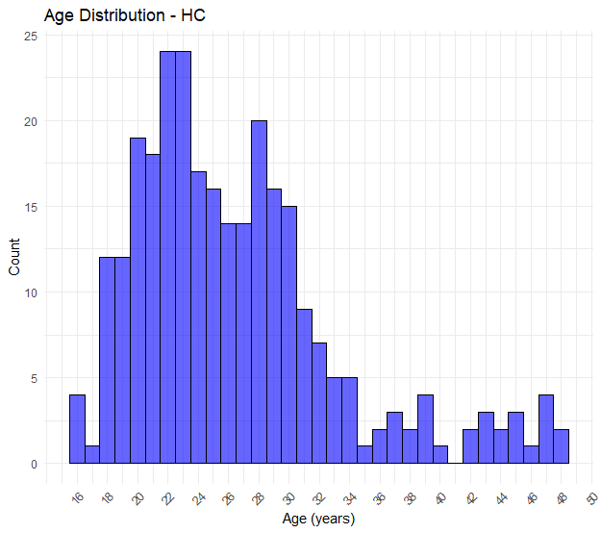
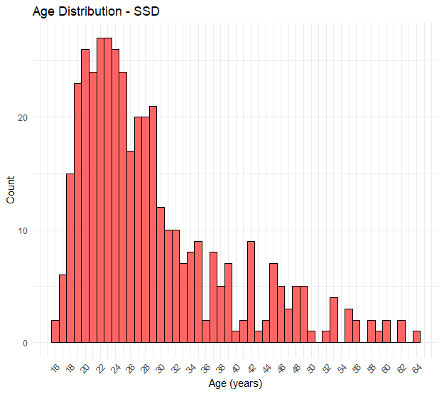
Symptoms over lifespan - Alban
Group n Mean_Age SD_Age Min_Age Max_Age
1 HC 282 26.5 6.84 16 48
2 SSD 415 28.8 9.86 16 64

Slide 8
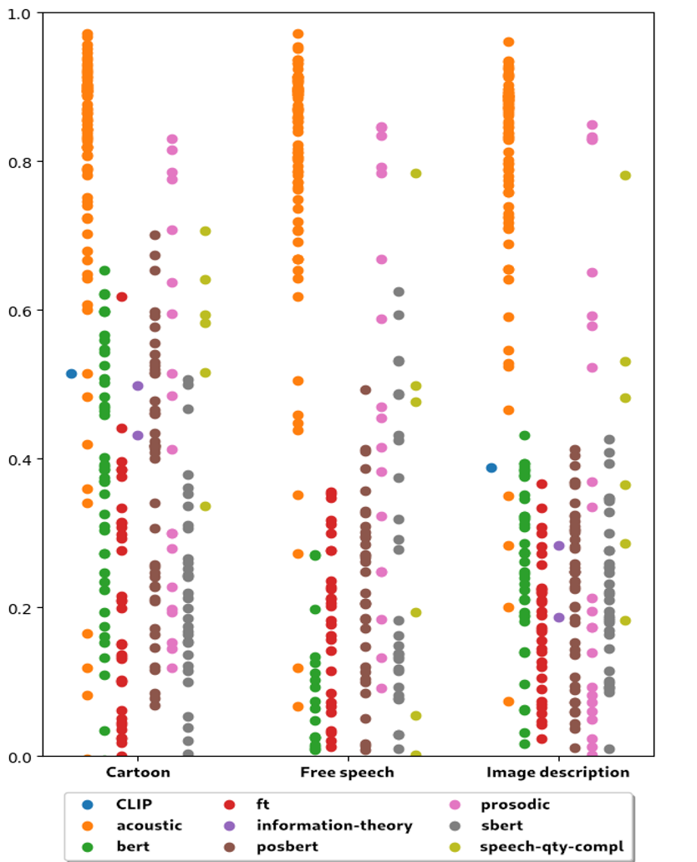
test-retest reliability Wolfram Hinzen
every dot is a variable;
y axis is the ICC scores

